Slide 1



Activities 2013
Consortium:
In colaboration with:

Slide 2
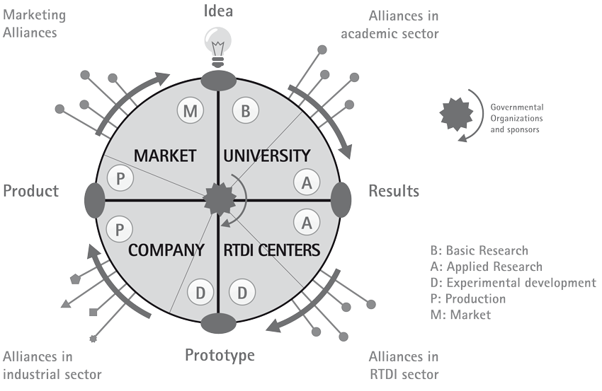
Introduction

Slide 3
Press releases

