Slide 1
Interface for CFD ground models
Albert Gancedo Vila

Slide 2
INDEX
IMPORTING A TERRAIN
MESHES
BODY FITTED MESH
BODY FITTED CASES
EMBEDDED MESH
FURTHER STEPS

Slide 3
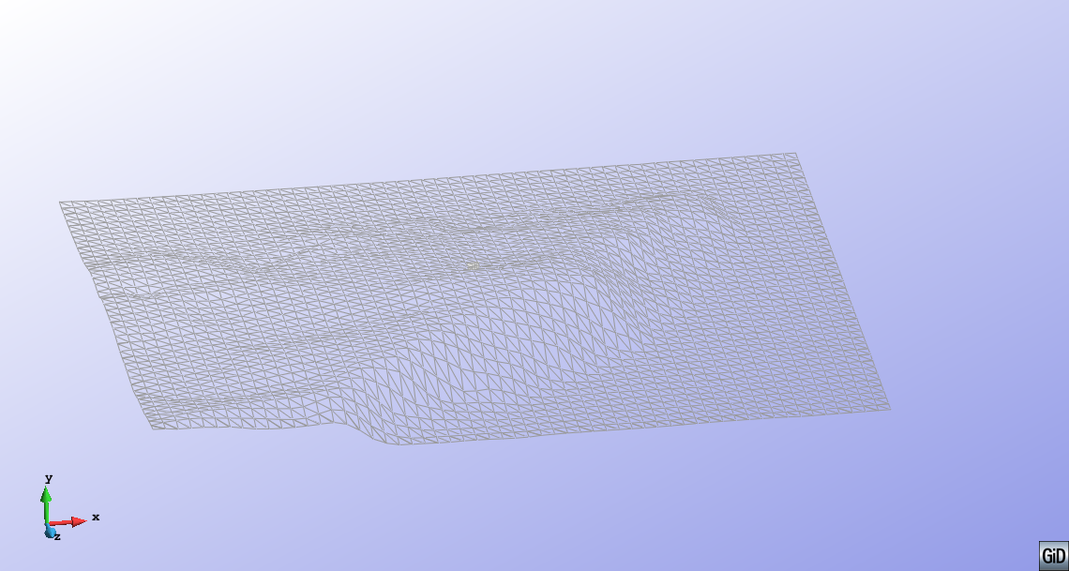
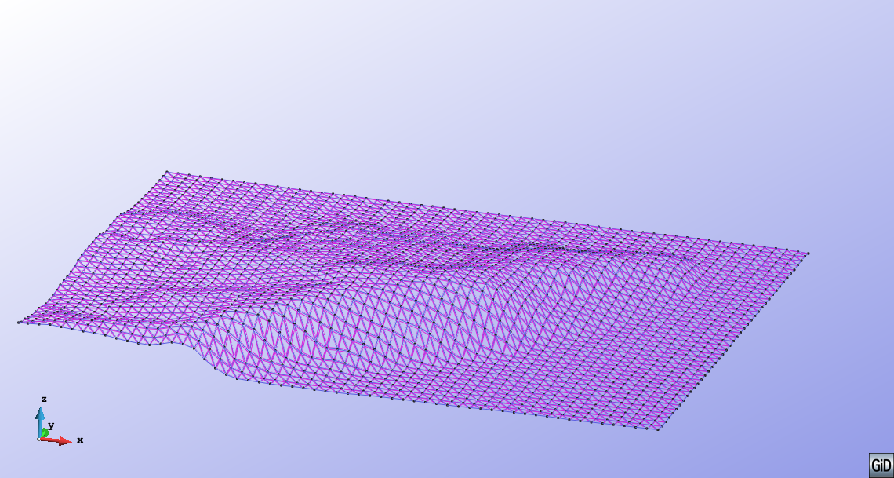
IMPORTING A TERRAIN
Several sources: Google Earth, Institut cartográfic
MESH (Vrml, NASTRAN, OBJ Wavefront…)
Needs to be converted to a Geometry
Check for gaps and quality
GEOMETRY (dxf, stp,igs…)
Check gaps and quality

Slide 4
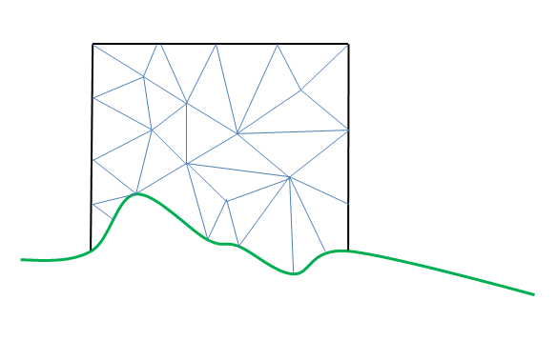
BODY FITTED MESH
BODY FITTED
Terrain is well defined
Control volume by the base and 5 sides of a parallelepiped
All points belong to fluid (or boundary at least)
Control volume
terrain

Slide 5
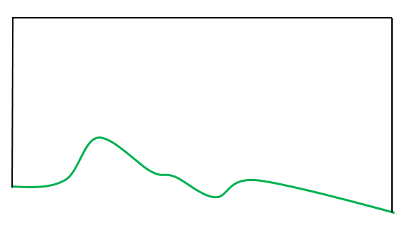
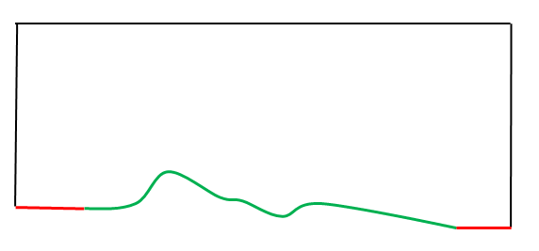
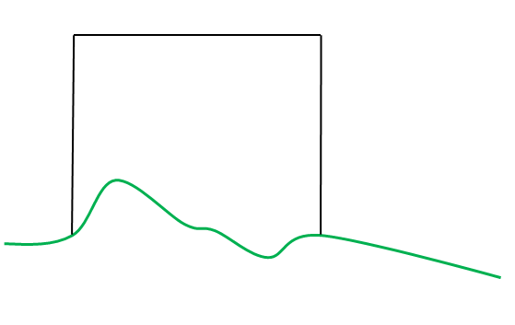
BODY FIttED CASES
EXACT BASE
Geometry fits with Control Volume
Extrusion of the corners
Control volume
terrain
AUXILIAR TERRAIN
Auxiliar surfaces for intersecting
the Control Volume
aux
aux
CUT TERRAIN
Control Volume smaller than terrain
Control Volume intersects terrain
Control volume
terrain

Slide 6
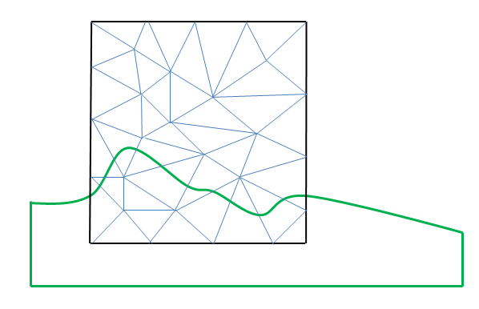
EMBEDDED MESH
Does not respect the shape of the terrain
Detection of the domain of the points
Easy to implement
Control volume
terrain

Slide 7
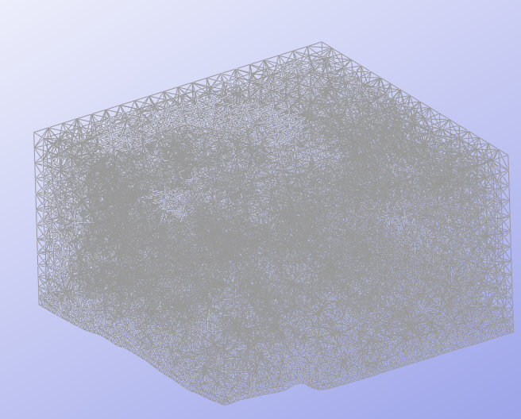
FURTHER STEPS
Location and properties of the Control Volume
Properties of the mesh
Full automation of the calculation
User interface
Flow properties

Slide 8
Thanks for your attention

