Slide 1

INTEROPERABILITY IN
FINITE ELEMENT TOOLS
USING HDF5
Carlos Agelet
Anshuman Singh
UPC BarcelonaTech

Slide 2
Objective
Enable API(Application Program Interface) based interaction of Abaqus- Python and HDF.
Define a procedure to import/export data from Abaqus ODB using HDF5 standard.
Create an elaborate list of keywords, which will be used as metadata for data description in HDF5 files.

Slide 3
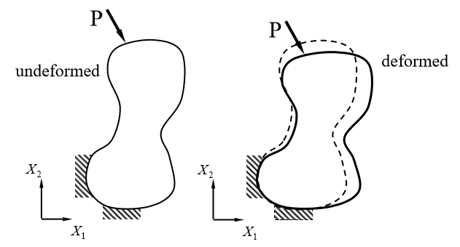
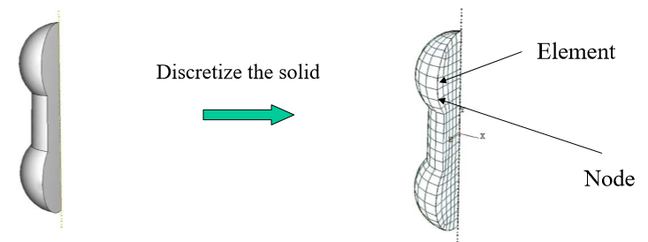
Finite Element Method: A Brief Introduction.
FEM is a procedure for the numerical simulation of equations (PDEs) which govern problems
found in nature.
QUESTION:
If we apply force on a solid, what are the values of the displacement, stresses and strains at EACH MATERIAL POINT?
ANSWER:
“Divide and Conquer”
Fig. A solid with known mechanical properties
(a shaft, human tissue, etc).
Fig. A quarter of the solid.
Fig. Discretization of the solid
into finite number of elements.
Ref: Introduction to Finite Element Method – Eugenio Onate, CIMNE, Finite Element Analysis – Dr. H. “Jerry” Qi, University of Colorado.

Slide 4
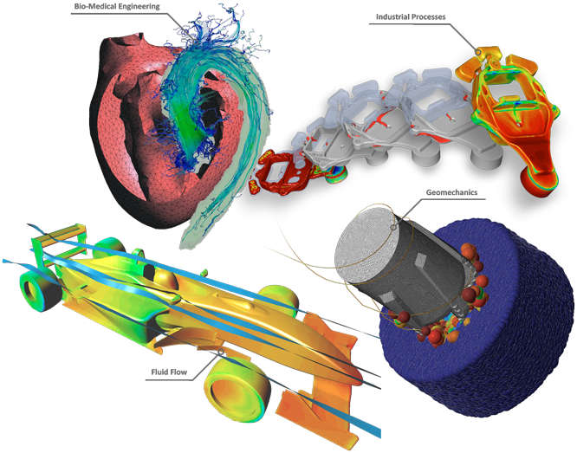

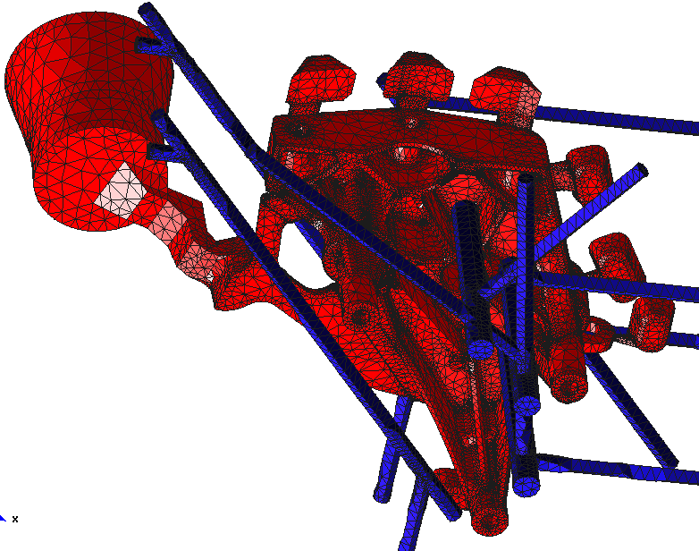

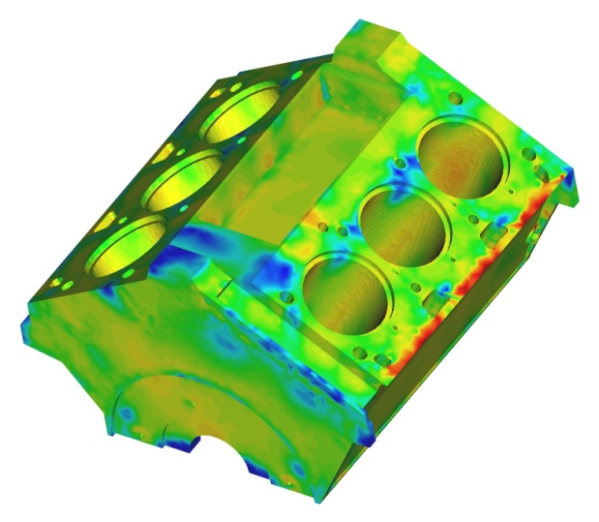
Applications
Biomedical Engineering
Industrial Processes
Fig. Cast, cooling system and mould: 380,000
linear tetrahedral elements.
Geomechanics
Fluid Flow
Fig. Temperature distribution over a cylinder
block.

Slide 5
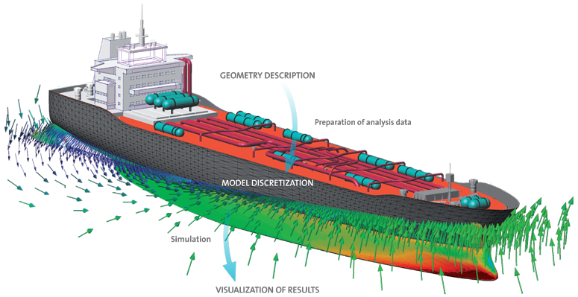
Data Associated With Finite Element Problems
GEOMETRY INFORMATION
BOUNDARY CONDITIONS
MESH
MATERIAL PROPERTIES
….

Slide 6









What Is Interoperability?
“Interoperability: The ability of a system to work with or use the parts or equipment of another system. “
Multiple Tools For Finite Element Analysis
Multiple Formats For Data Import/Export
VTK
PLY
XDMF
STL
FEMAP
…
AND MANY MORE…
Each format specializes in exporting some form of data, geometry, meshes, datasets etc. and are not enough for complete interoperability among different tools.

Slide 7
How can we tackle the InterOp problem?
Customize HDF5 using
ICMEg standards to enable
interoperability!!!
“Goal: To develop a common language by standardizing and generalizing data formats
for the exchange of simulation results. “

Slide 8



How will it work?
Tool
Built upon/
Scripting Interface
HDF5 API enables writing, reading, of HDF5 files from languages like C/C++, Python, Java, Fortran, Matlab.
API

Slide 9
Next Steps
Abaqus Workflow
GUI
1
API
CLI
Python
Interpreter
Abaqus
Kernel
Input File
Abaqus/
Standard
SCRIPT
ODB
API
2
1
WILL BE IMPLEMENTED
(INPUT TO THE ABAQUS MDB
FROM HDF5 FILES)
2
ALREADY IMPLEMENTED
(OUTPUT FROM THE ABAQUS ODB
TO HDF5 FILES)

Slide 10
HDF5: File Structure
HDF5
HIERARCHICAL
DATA FORMAT
HDF5 Objects
Groups
Datasets
Attributes
Attributes
Analogous to labels or annotations
Some of the key features of HDF5:
Unlimited size, extensibility, and portability
Practically no size limit, APIs for Java, Python, C++/C, Fortran,MATLAB.
General data model
Simple but versatile data model to match individual needs.
Unlimited variety of datatypes
Efficient mechanism for describing data.
Flexible, efficient I/O
Supports parallel data access, more customized schemes possible.
Flexible data storage
Supports compression, chunking for efficient storage and retrieval.

Slide 11

Example Of HDF5 Performance
At University of California, San Diego
“The question the scientists wanted to answer is why some particles from the sun are accelerated to very high energy and form auroras or wreak havoc on electronics. “
“Trillion-particle datasets, each ranging between
30 and 42 terabytes in size, were written as HDF5 files at rates of 27 gigabytes per second. “
“HDF5 is on the trajectory toward exascale computing i.e. a billion billion computations per second..”

Slide 12
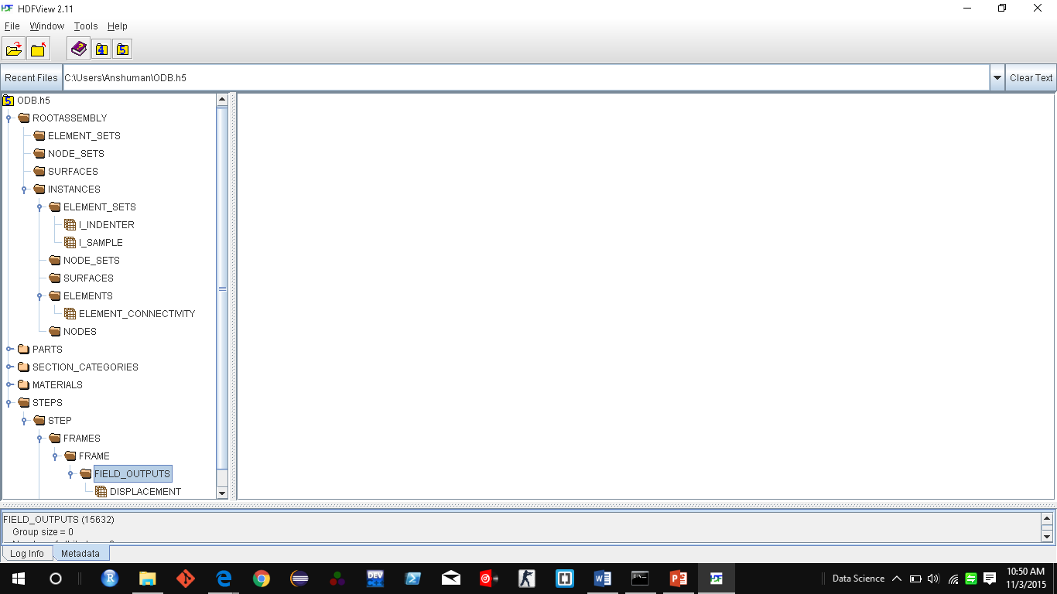
Metadata
“Data can be made self-descriptive with the right metadata.”
ELABORATE LIST OF KEYWORDS USED AS METADATA
METADATA

Slide 13
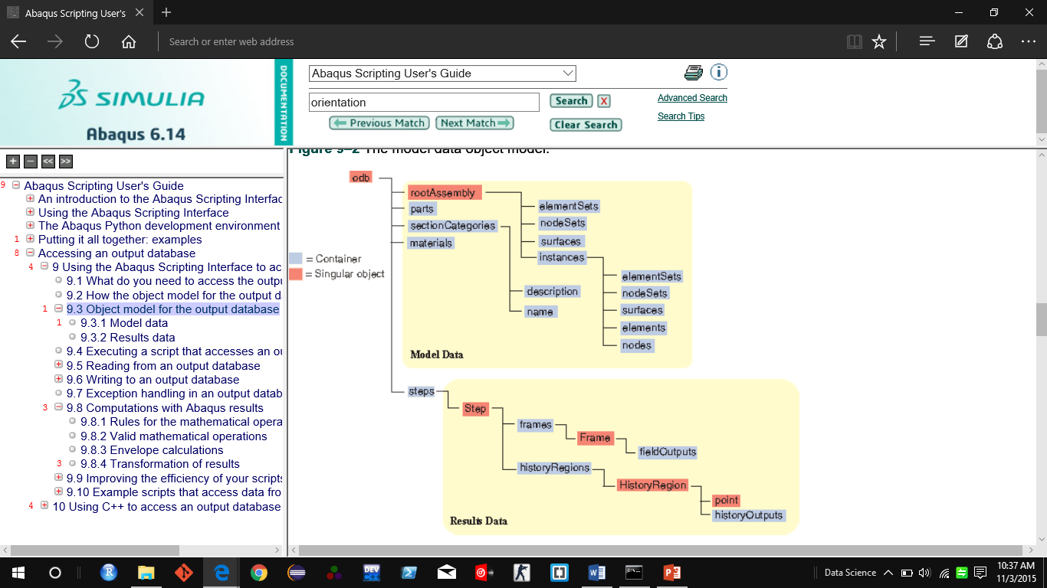
Hierarchical Structural Comparison
Abaqus Output Database Structure
HDF5 Container Structure
Groups
Datasets
We will extract these data from ODB as an
example and put it in the HDF5 container.
What is the role of Keywords/Metadata
in all this??
Subgroups

Slide 14
Structure of the Abaqus ODB (Ouput Database)
As an example, we access the rootAssembly and extract data of element connectivity and node coordinates.
Structure of the problem.
({'analysisTitle': ‘Indentation',
'closed': False,
'customData': None,
'description': 'DDB object',
'diagnosticData': ({'analysisErrors': 'OdbSequenceAnalysisError object',
'analysisWarnings': 'OdbSequenceAnalysisWarning object',
'isXplDoublePrecision': False,
'jobStatus': JOB_STATUS_COMPLETED_SUCCESSFULLY,
'jobTime': 'OdbJobTime object',
'numDomains': 1,
'numberOfAnalysisErrors': 0,
'numberOfAnalysisWarnings': 3,
'numberOfSteps': 3,
'numericalProblemSummary': 'OdbNumericalProblemSummary object',
'steps': 'OdbSequenceDiagnosticStep object'}),
'isReadOnly': True,
'jobData': ({'analysisCode': ABAQUS_STANDARD,
'creationTime': 'Sun Oct 25 00:04:21 Romance Daylight Time 2015',
'machineName': '',
'modificationTime': 'Sun Oct 25 00:04:45 Romance Daylight Time 2015',
'name': 'C:/Users/Anshuman/indentation_axi1.odb',
'precision': SINGLE_PRECISION,
'productAddOns': 'tuple object',
'version': 'Abaqus/Standard Student Edition 6.14-2'}),
'materials': {'INDENTER_MAT': 'Material object',
'SAMPLE_MAT': 'Material object'},
'name': 'C:/Users/Anshuman/indentation_axi1.odb',
'parts': {'P_INDENTER': 'Part object',
'P_SAMPLE': 'Part object'},
'path': 'C:/Users/Anshuman/indentation_axi1.odb',
'profiles': {},'readInternalSets': False,
'rootAssembly': ({'connectorOrientations': 'ConnectorOrientationArray object',
'datumCsyses': 'Repository object',
'elementSets': 'Repository object',
'elements': 'OdbMeshElementArray object',
'instances': 'Repository object',
'name': 'ASSEMBLY',
'nodeSets': 'Repository object',
'nodes': 'OdbMeshNodeArray object',
'pretensionSections': 'OdbPretensionSectionArray object',
'rigidBodies': 'OdbRigidBodyArray object',
'sectionAssignments': 'SectionAssignmentArray object',
'surfaces': 'Repository object'}),
'sectionCategories': {'solid < INDENTER_MAT >': 'SectionCategory object',
'solid < SAMPLE_MAT >': 'SectionCategory object'},
'sections': {'Section-ASSEMBLY_I_INDENTER_ALL_ELEMENTS':
'sectorDefinition': None,
'steps': {'LOADING': 'OdbStep object',
'PRELOADING': 'OdbStep object',
'UNLOADING': 'OdbStep object'},
'userData': ({'annotations': 'Repository object',
'xyDataObjects': 'Repository object'})})
Indepth view of the rootAssembly
({'connectorOrientations': [],
'datumCsyses': {},
'elementSets': {' ALL ELEMENTS': 'OdbSet object',
'ErrElemAnisotropicMaterial': 'OdbSet object',
'WarnElemDistorted': 'OdbSet object'},
'elements': [],
'instances': {'I_INDENTER': 'OdbInstance object',
'I_SAMPLE': 'OdbInstance object'},
'name': 'ASSEMBLY',
'nodeSets': {' ALL NODES': 'OdbSet object',
'REFERENCE_POINT_I_INDENTER 296': 'OdbSet object'},
'nodes': [],
'pretensionSections': [],
'rigidBodies': [],
'sectionAssignments': [],
'surfaces': {}})
The OdbSet objects are like arrays which can be accessed like we access normal arrays.
Text in orange represents Level 1
Text in green represents data we access as example.

Slide 15
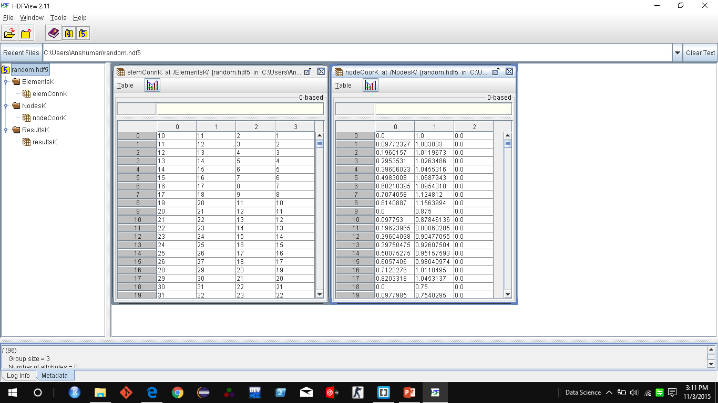
Result: Successful Export of Data to HDF5
An HDF5 file generated HDF5 API in Abaqus-Python, showing Element Connectivity , Node Coordinates, and some results
from one of the analytical steps..
Element Connectivity
Node Coordinates
Finally, other post processing tools which
have superior plotting and data manipulating
capabilities like R and Python, can be used
for further post-processing.

Slide 16
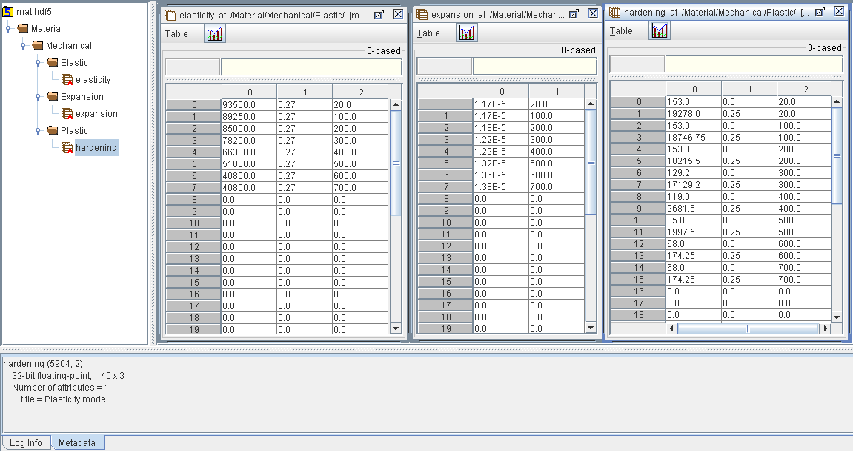
Material (*.mat) File Export
Abaqus Output Database Structure
Equivalent HDF5 File Structure
We will extract these
data from ODB as an
example.

Slide 17
STRUCTURE(Internal View): Abaqus ODB
As an example, we access the rootAssembly and extract data of element connectivity and node coordinates.
Structure of the problem.
In-depth view of the Materials
({'analysisTitle': 'Cross-section of a disc',
'closed': False,
'customData': None,
'description': 'DDB object',
'diagnosticData': ({'analysisErrors': 'OdbSequenceAnalysisError object',
'analysisWarnings': 'OdbSequenceAnalysisWarning object',
'isXplDoublePrecision': False,
'jobStatus': JOB_STATUS_COMPLETED_SUCCESSFULLY,
'jobTime': 'OdbJobTime object',
'numDomains': 1,
'numberOfAnalysisErrors': 0,
'numberOfAnalysisWarnings': 0,
'numberOfSteps': 1,
'numericalProblemSummary': 'OdbNumericalProblemSummary object',
'steps': 'OdbSequenceDiagnosticStep object'}),
'isReadOnly': True,
'jobData': ({'analysisCode': ABAQUS_STANDARD,
'creationTime': 'Sun Nov 01 12:27:41 Romance Standard Time 2015',
'machineName': '',
'modificationTime': 'Sun Nov 01 12:27:42 Romance Standard Time 2015',
'name': 'C:/Users/Anshuman/discbrake_sst_axi.odb',
'precision': SINGLE_PRECISION,
'productAddOns': 'tuple object',
'version': 'Abaqus/Standard Student Edition 6.14-2'}),
'materials': {'FONTE': 'Material object'},
'name': 'C:/Users/Anshuman/discbrake_sst_axi.odb',
'parts': {'PART-1': 'Part object'},
'path': 'C:/Users/Anshuman/discbrake_sst_axi.odb',
'profiles': {},
'readInternalSets': False,
'rootAssembly': ({'connectorOrientations': 'ConnectorOrientationArray object',
'datumCsyses': 'Repository object',
'elementSets': 'Repository object',
'elements': 'OdbMeshElementArray object',
'instances': 'Repository object',
'name': 'Assembly-1',
'nodeSets': 'Repository object',
'nodes': 'OdbMeshNodeArray object',
'pretensionSections': 'OdbPretensionSectionArray object',
'rigidBodies': 'OdbRigidBodyArray object',
'sectionAssignments': 'SectionAssignmentArray object',
'surfaces': 'Repository object'}),
'sectionCategories': {'solid < FONTE >': 'SectionCategory object'},
'sections': {'Section-DISC': 'HomogeneousSolidSection object'},
'sectorDefinition': None,
'steps': {'Step-1': 'OdbStep object'},
'userData': ({'annotations': 'Repository object',
'xyDataObjects': 'Repository object'})})
{'FONTE': ({'description': '',
'elastic': ({'dependencies': 0,
'moduli': LONG_TERM,
'noCompression': OFF,
'noTension': OFF,
'table': 'tuple object',
'temperatureDependency': ON,
'type': ISOTROPIC}),
'expansion': ({'dependencies': 0,
'table': 'tuple object',
'temperatureDependency': ON,
'type': ISOTROPIC,
'userSubroutine': OFF,
'zero': 0.0}),
'materialIdentifier': '',
'name': 'FONTE',
'plastic': ({'dataType': HALF_CYCLE,
'dependencies': 0,
'hardening': KINEMATIC,
'numBackstresses': 0,
'rate': OFF,
'strainRangeDependency': OFF,
'table': 'tuple object',
'temperatureDependency': ON}),
The tuple objects are accessed exactly like we would access a nested dictionary object in normal Python.

Slide 18
RESULT: Successful Export of Data to HDF5
An HDF5 file generated from Abaqus-Python, showing Material Elasticity, Plasticity and Expansion, tables.
Elasticity table
Expansion table
Plasticity table

Slide 19
Advantages of HDF5 integration with FE tools
Since HDF has APIs for all major languages like Python, C++,
Java, MATLAB it can be used as a neutral format for information
exchange between several tools and can enable a perfect interop.
Metadata collection, although a tedious, but can be very efficiently
used to develop a self-describing data approach.
HDF5 practically has no limits on size of datasets and supports
operations like chunking, compression, parallel I/O, and a data read/
write speed of upto 35 Gb/Sec.

Slide 20
Future work
To develop the codes for complete transfer of the problem data
    (including Boundary, Material, Loads etc., along with metadata.
Enable communication with other tools for eg. KRATOS, GiD.
Extend this procedure to enable export of images produced by
    Abaqus through HDF5.

Slide 21
Conclusion
Developed an interface between HDF5 and Abaqus.
Customized output from Abaqus to HDF5 file using Metadata for
Thermo-Mechanical problems.
Compiled a list of Keywords for Thermo-Mechanical problems using
Abaqus 6.14 as a reference.

Slide 22
  THANK YOU !!!

