Slide 1
Analysis of the investment project regarding construction process management (gas industry)
by Olga Makeeva
15.11.2019
Communication skills II

Slide 2
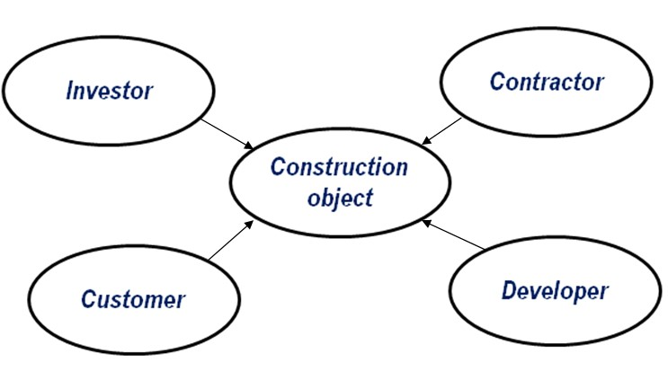
Investment and construction project
Participants in the investment and construction project
Subject | Goals of construction | Construction tasks
Investor | Finish the object in time | Secure financing, control over invested funds, reduce the cost, early entry into operation
Customer, Contractor, Developer | Receive the profits | Reduce the cost, early entry into operation

Slide 3
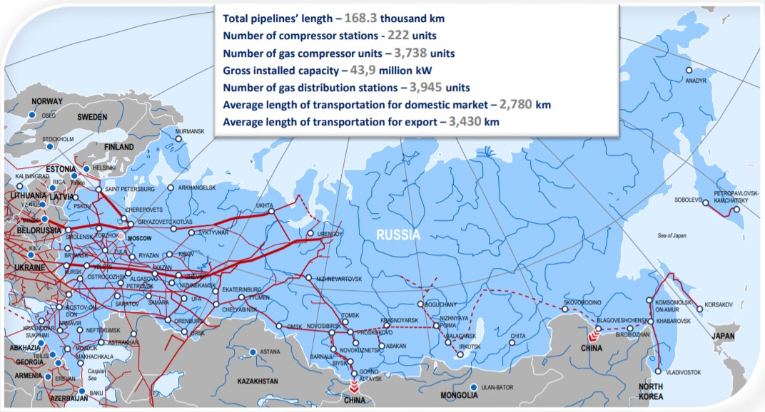
Gazprom in the Russian domestic market

Slide 4
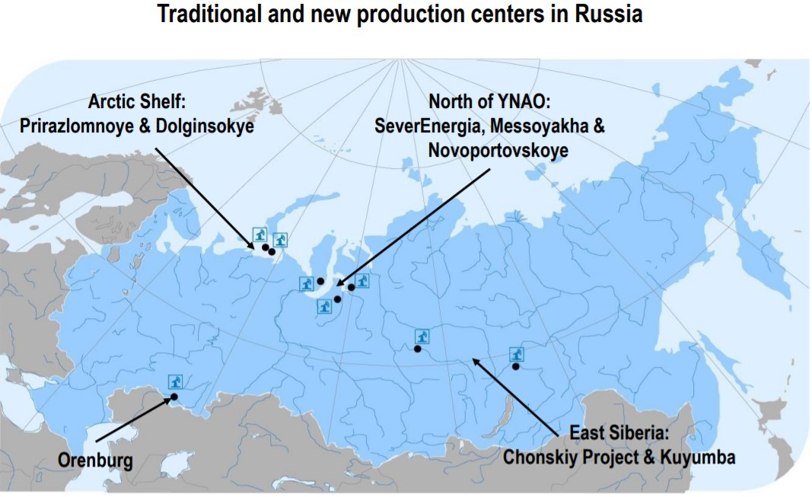
Gazprom in the Russian domestic market

Slide 5
Contract system
Contract systems | Type of contract
Investor and customer | Investment contract, contract of sale
Customer and the developer | Agency agreement
Customer and the general contractor | General contract
Investor and others | Lease agreement, contract for technical supervision, contract for insurance of hazardous objects
Investment contract
Competitive procurement process
Investor Tender Documentation
Preparation of tender documentation
Signing an investment contract for construction works
Investment contract
-Production Department
-Contract Work Department
-Estimated Division, others
Investor
General contractor

Slide 6
Signing of contracts for the implementation of investment projects
January | February | March | April | May | June | July | August | September | October | November | December
 | Contracts signing with counterparties (additional agreements)
 | Investment contracts, sale and purchase agreements (additional agreements)

Slide 7
Construction of objects
according to the program of gasification of the regions, Russian Federation
 | Indicators | Number of objects | Length, km
1 | TOTAL objects | 993 | 13 395
1.1 | Construction completed on 01/01/2019 | 617 | 7 770
1.2 | Excluded | 63 | -
1.3 | In work, including | 313 | 5 625
1.3.1 | Plan for 2019 (completion) | 155 | 2 457
1.3.1.1 | completed at the reporting date | 23 | 288
1.3.1.2 | in work | 132 | 2 169
1.3.2 | To be completed in future periods | 158 | 3 168
 | Indicators | Cost, billion Euros
1 | TOTAL | 35,953
1.1 | Capitalized on 01.01.2019 | 26,421
1.2 | Balance for capitalization, including | 9,532
1.2.1 | Plan for 2019 | 2,653
1.2.1.1 | Capitalized at the reporting date | 1,114
1.2.1.2 | in work | 1,322
1.2.2 | To be developed in future periods | 6,879

Slide 8
Object Design according to the program of gasification of the regions of the Russian Federation
 | Indicators | Number of objects | Length, km
1 | TOTAL objects | 1 309 | 17 383
1.1 | Construction completed on 01/01/2019 | 654 | 9 586
1.2 | Excluded | 223 | -
1.3 | In work, including | 432 | 7 797
1.3.1 | Plan for 2019 (completion) | 227 | 3 566
1.3.1.1 | completed at the reporting date | 110 | 1 579
1.3.1.2 | in work | 117 | 1 987
1.3.2 | To be completed in future periods | 205 | 4 231
 | Indicators | Cost, billion Euros
1 | TOTAL | 5,630
1.1 | Capitalized on 01.01.2019 | 3,646
1.2 | Balance for capitalization, including | 1,984
1.2.1 | Plan for 2019 | 0,524
1.2.1.1 | Capitalized at the reporting date | 0,348
1.2.1.2 | in work | 0,120
1.2.2 | To be developed in future periods | 1,460

Slide 9
The process of transferring completed construction projects to the Investor
Closing an investment agreement
Lease contract
Transfer object to the operating organization
Registration of ownership rights to the Customer
Registration of property rights to the Investor
Transfer of the object to the Investor
Closing the contract of sale
Plan 2019 год | Quantity | Cost, billion Euros
Gasification program | 553 | 4,8371
Transfer of construction and installation works | 146 | 2,0389
Transfer of objects design work | 172 | 0,5876
In work | 235 | 2,2106
Control and monitoring of the state of the object

Slide 10
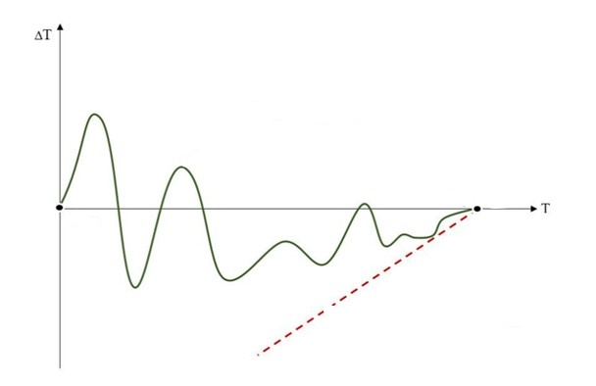
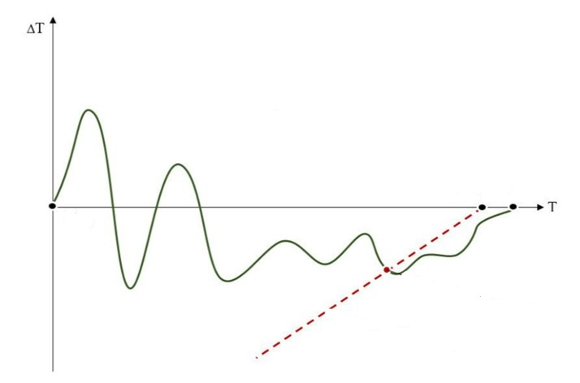
Dynamic model of the dependence of deviations of the project completion forecast from the reporting date
Timely completion of the project
Failure of the project.

Slide 11
Conclusion
Scientific tasks:
Identify the stage of the design, construction or transfer of the object in which the delay occurs;
Analyse the features of the formation cost of the construction object;
Summarize the results of the analysis and form the optimal scheme of work;
Develop a unified regulation for the relationship between subjects of construction.

Slide 12
Thank for your attention

