Slide 1


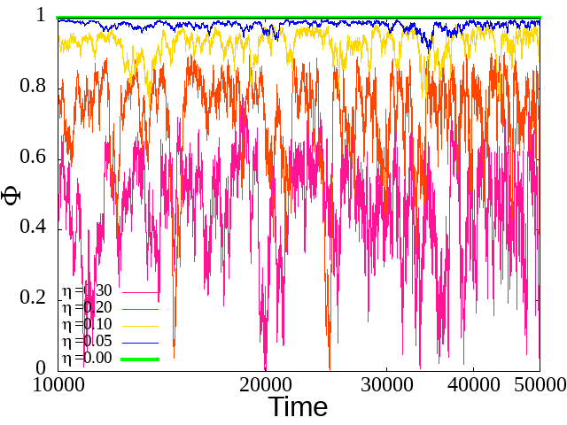
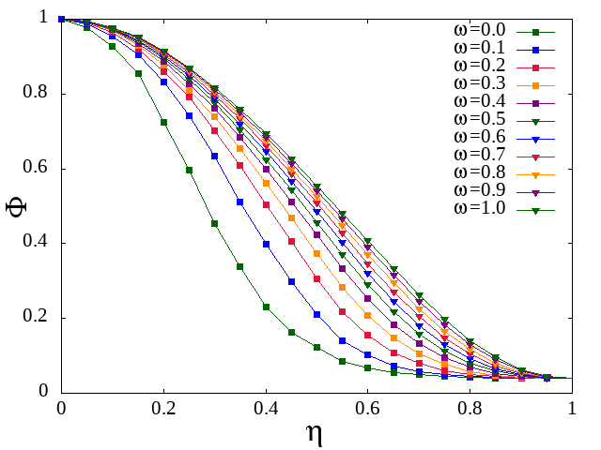
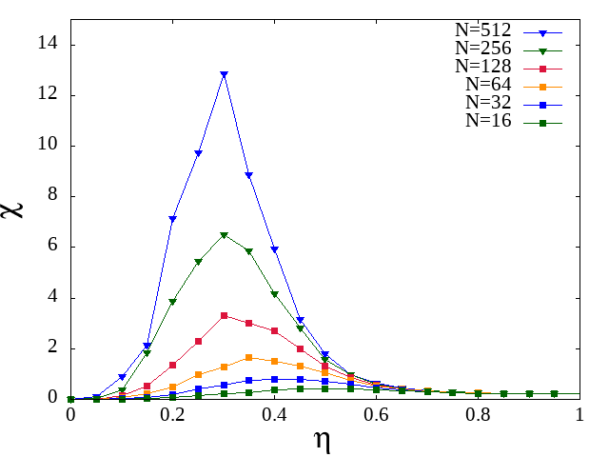
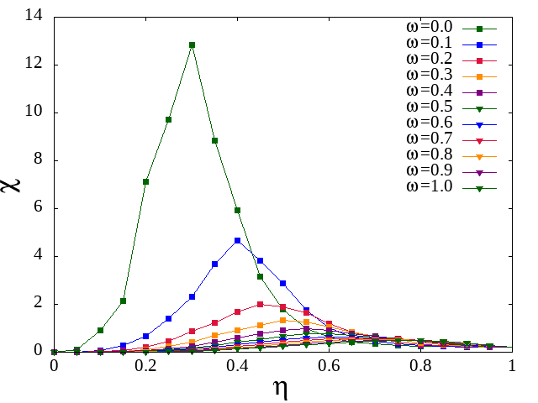
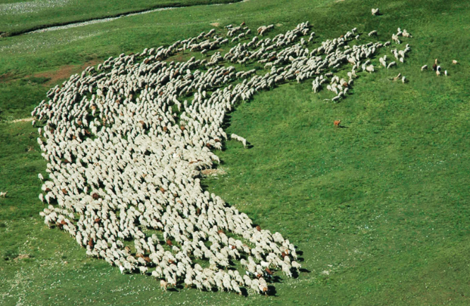
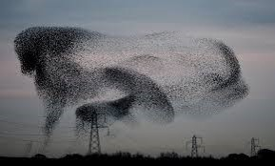


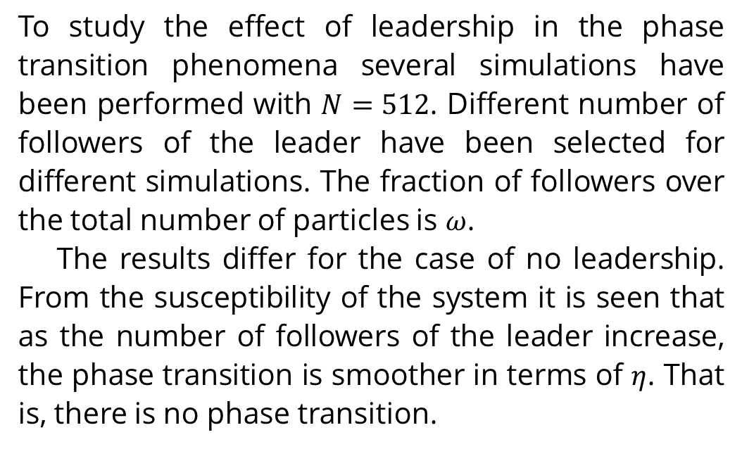
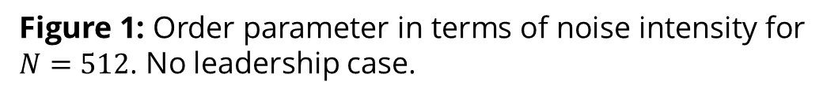
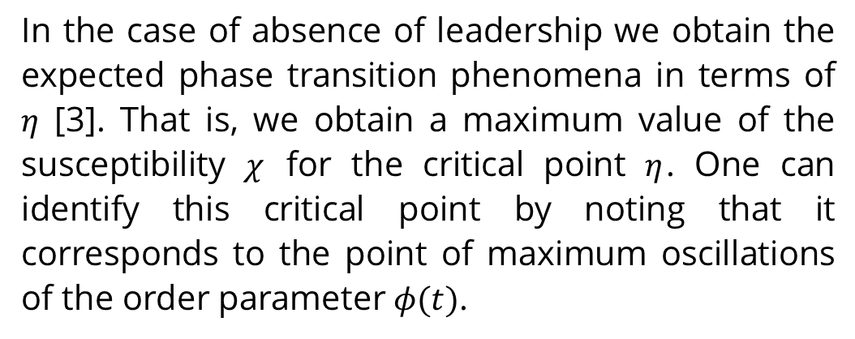


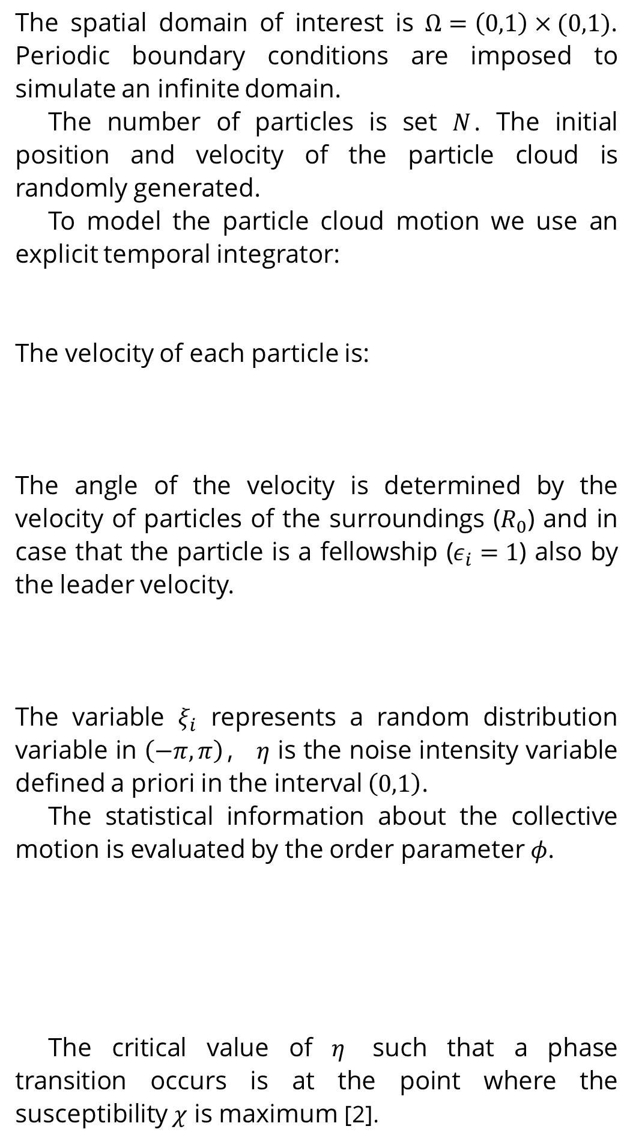
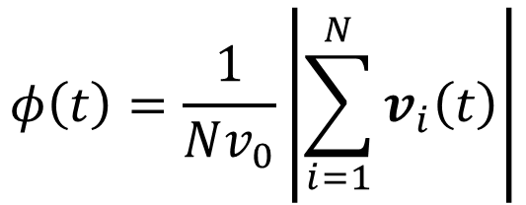

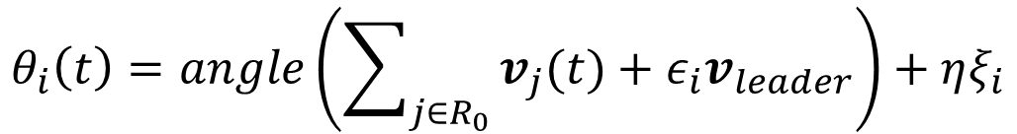
Phase transition of Vicsek Model
Zichen Ding, Oriol Falip i Garcia, Rafel Perelló i Ribas
Universitat Politècnica de Catalunya-CIMNE
Introduction
Methodology
Results
In nature, collective motion plays an important role in life being behaviour. Examples of that fact are seen worldwide and are well-known since it can be seen in our everyday life. Representative examples, which highlight that fact, are schools of fish providing protection or outmanoeuvring, in a matter of seconds, a predator, a flock of birds moving around or migrating in formation or a sheep herd.
Vicsek model is simple mathematically and computationally. It models velocity of every particle as having constant speed magnitude and the evolution of the direction is such it tends to evolve towards the average of their closest neighbors.
In Vicsek model appears the fundamental behavior of most collective motion phenomena, i.e. a phase transition between ordered and disordered phases [1].
We also present an extended Vicsek model with a leadership role. That is, particles that are considered followers of the leader will consider the velocity of the leader for the evolution of the velocity direction independently of the position of every particles
The spatial domain of interest is $Ω=\left(0,1\right)×(0,1)$. Periodic boundary conditions are imposed to simulate an infinite domain.
The number of particles is set $N$. The initial position and velocity of the particle cloud is randomly generated.
To model the particle cloud motion we use an explicit temporal integrator:
The velocity of each particle is:
The angle of the velocity is determined by the velocity of particles of the surroundings ($R_{0}$) and in case that the particle is a fellowship ($ε_{i}=1$) also by the leader velocity.
The variable $ξ_{i}$ represents a random distribution variable in $\left(−π,π\right)$， $η$ is the noise intensity variable defined a priori in the interval $\left(0,1\right)$.
The statistical information about the collective motion is evaluated by the order parameter $φ$.
The critical value of $η$ such that a phase transition occurs is at the point where the susceptibility $χ$ is maximum [2].
In the case of absence of leadership we obtain the expected phase transition phenomena in terms of $η$ [3]. That is, we obtain a maximum value of the susceptibility $χ$ for the critical point $η$. One can identify this critical point by noting that it corresponds to the point of maximum oscillations of the order parameter $φ(t)$.
To study the effect of leadership in the phase transition phenomena several simulations have been performed with $N=512$. Different number of followers of the leader have been selected for different simulations. The fraction of followers over the total number of particles is $ω$.
The results differ for the case of no leadership. From the susceptibility of the system it is seen that as the number of followers of the leader increase, the phase transition is smoother in terms of $η$. That is, there is no phase transition.
$$r_{i}\left(t+Δt\right)=r_{i}\left(t\right)+v_{i}\left(t\right)Δt$$
$$v_{i}\left(t\right)=v_{0}\left(\cos\left(θ_{i}\left(t\right)\right),\sin\left(θ_{i}\left(t\right)\right)\right)$$
$$θ_{i}\left(t\right)=angle\left(\sum_{j∈R_{0}}{v_{j}(t)}+ε_{i}v_{leader}\right)+ηξ_{i}$$
Figure 1: Order parameter in terms of noise intensity for $N=512$. No leadership case.
Figure 3: Average of the order parameter in terms of noise intensity and number of particles. Leadership case.
$$φ\left(t\right)=\frac{1}{Nv_{0}}\left|\sum_{i=1}^{N}{v_{i}\left(t\right)}\right|$$
Objectives
Figure 2: Susceptibility in term of noise intensity and number of particles. No leadership case
Figure 4: Average of the order parameter in terms of noise intensity and number of particles. Leadership case.
Here we present the study of phase transition of phenomena modeled using a 2D standard Vicsek model. In particular we study the consequences to the phase structure of the solutions by adding leadership role.
$$χ=N\left(\left\langle φ^{2}\right\rangle −{\left\langle φ\right\rangle }^{2}\right)$$
Conclusion
References
The behavior seen in the case of leadership suggests that after reaching some value of the fraction of followers $ω,$ only one phase is present in the system. The reason of this phenomena is because when the fraction $ω$ is high enough, the system remains in an ordered configuration even for the higher nose intensity. That is, the order parameter $φ$ does not reach 0 but a small value. As there is only one possible phase configuration, there is no phase transition point.
[1] T. Vicsek et al. Novel Type of Phase Transition in a System of Self-Driven Particles, Physical Review Letters, N. 75, p. 1226 (1995)
[2] T. Vicsek, A. Zaferis. Collective Motion, Physics Reports, N. 517, p. 71-140 (2012)
[3] F. Ginelli. The Physics of the Vicsek Model, The European Physical Journal Specal Topics, N.11, p. 2099 (2016)

