Slide 1
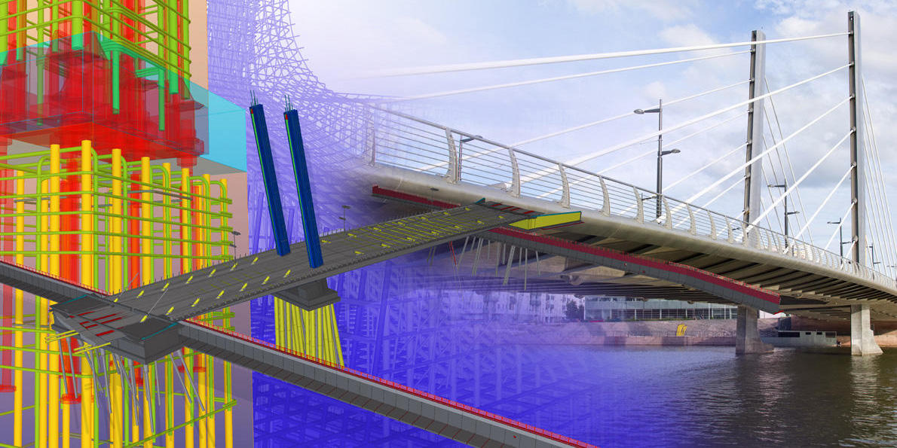
BIM bridge model
Bruno Stemberger

Slide 2
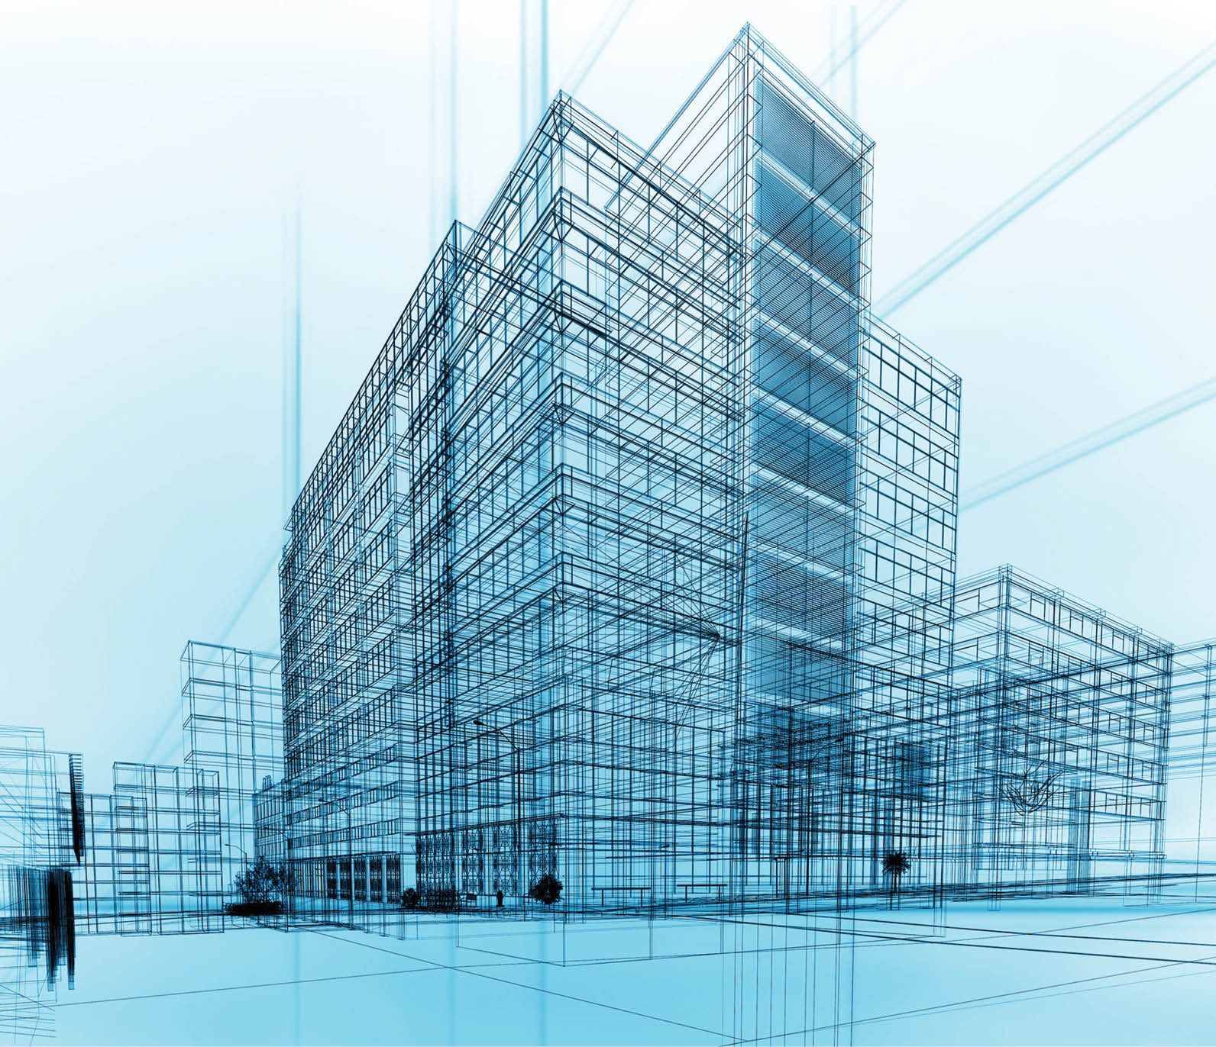
What is BIM?
Building Information Modeling
Connecting AEC
3D model with data
Cost analysis, construction schedule, visualisation
Design, construction and maintenance
Notes:
. You all probably know what BIM is, but just in case someone doesn’t I’ll shortly explain. BIM is an abbreviation for Building Information Modeling and it is a digital tool which unites building project stakeholders throughout its whole process. With stakeholders I mean Architects, Engineers (Structural, Mechanical, Electrical) and contractors.
. Building Information Model. The 3D model is the main point of BIM approach. It is a digital 3D model that includes data like physical and functional characteristics of elements. This data defines the design elements and establishes their behavior and relationships. It allows designing, building and maintenance processes to be more efficient and effective.
. BIM software also include cost analysis and construction schedule. That with a realistic visualization which we get with our 3D model allows us to see what errors and collisions might happen in construction. So it saves us a lot of work and money in future.
. Third thing which BIM stands for is Building Information Management. It emphasizes that BIM is a tool that should be used throughout the whole lifecycle of a structure including design, construction and maintenance.

Slide 3
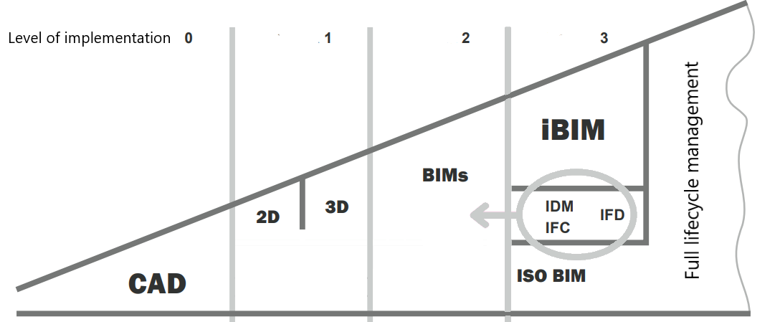
BIM applicability
Notes:
0 2D CAD drawing, communication with printed copies or via email
1 includes 2D and 3D with communication via CDE (common data environment) within one stakeholder
2 unites communication between stakeholders, universal data format, IFC (neutral, universal norm in future)
3 future, common 3D model for all stakeholders, live online updates
FM (Facility Management) is a relatively young field which apart from cleaning, maintenance and repairing includes different activities to fulfill building’s strategic goals
60-70% of full lifecycle costs
Benefits from BIM: transparency, and amount of available information

Slide 4
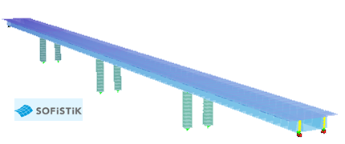
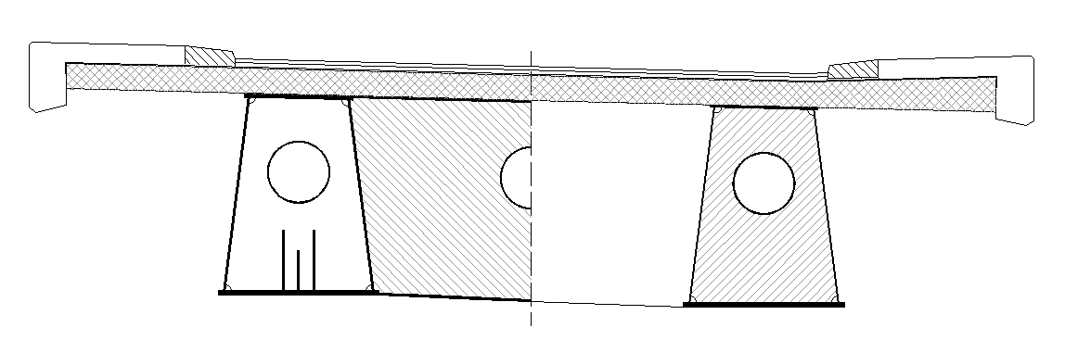
Composite bridge model

Slide 5
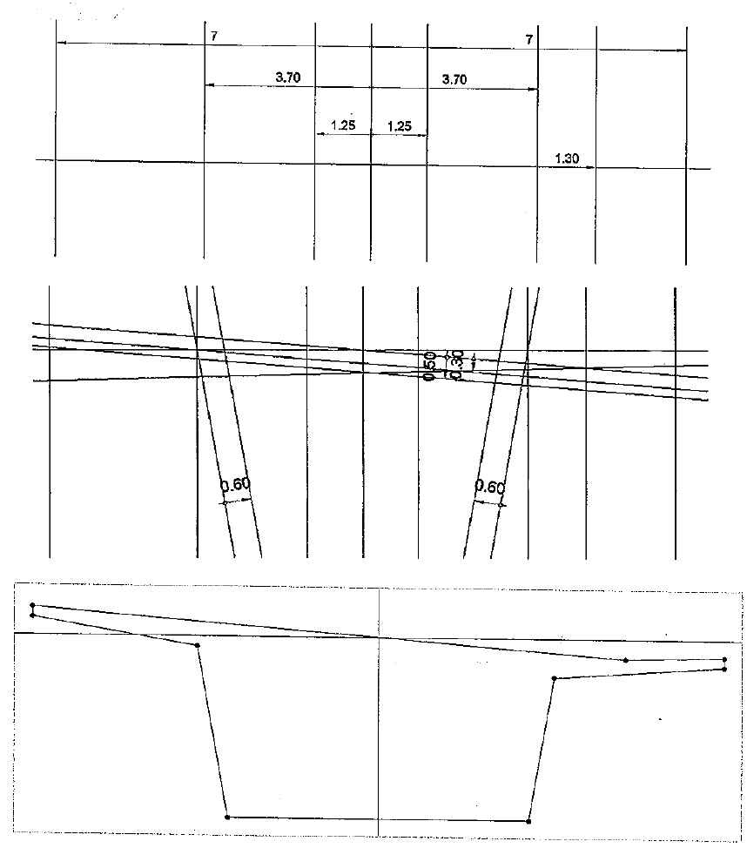
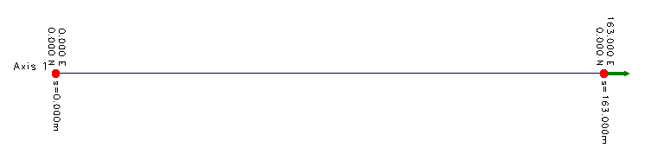
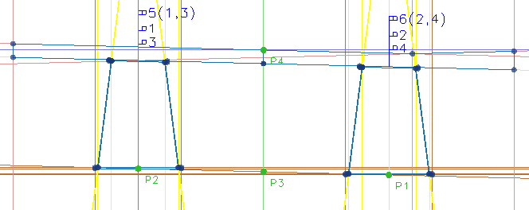
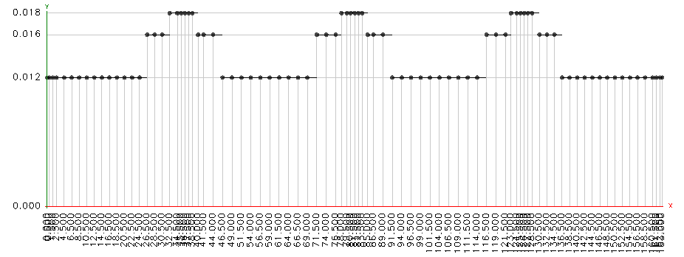
Axis + Cross section
Longitudinal variations

Slide 6
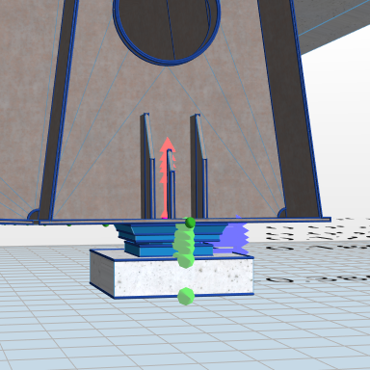
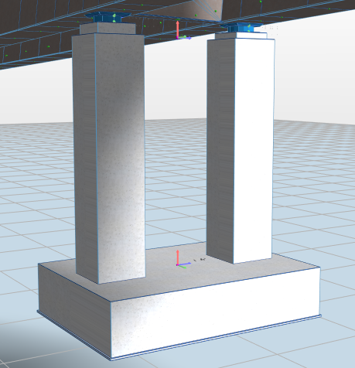
Vertical elements

Slide 7
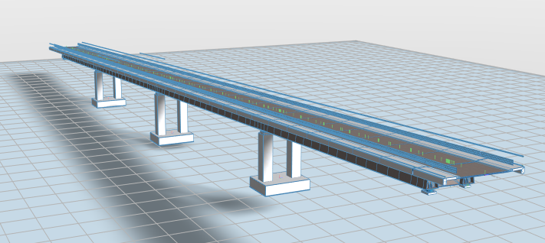
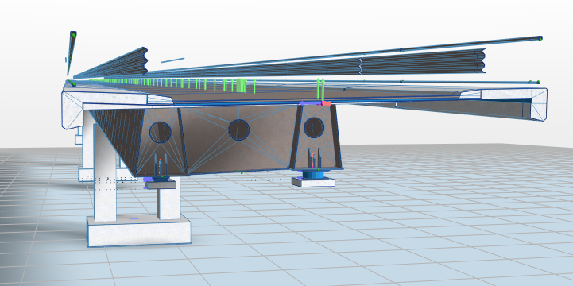
Current model

Slide 8
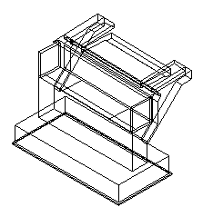
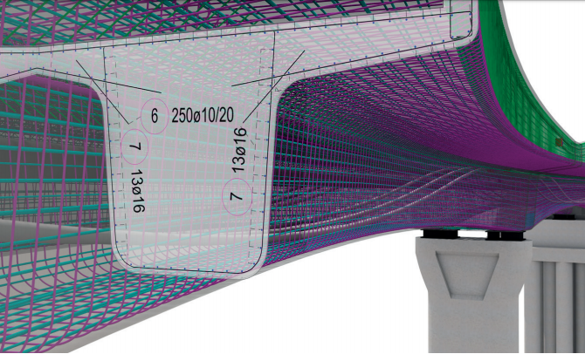
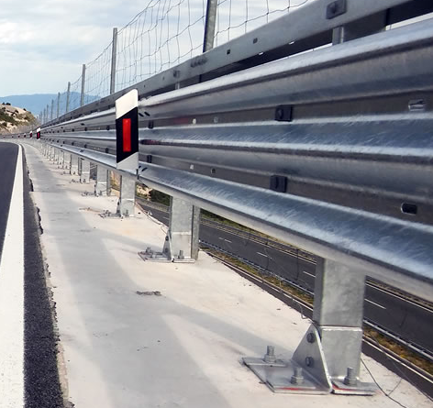
Needs to be done...
...in Allplan

Slide 9
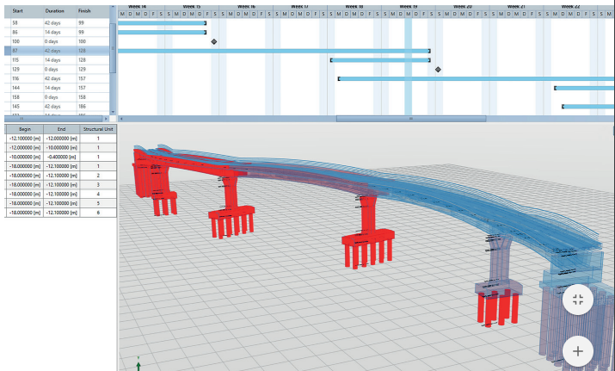
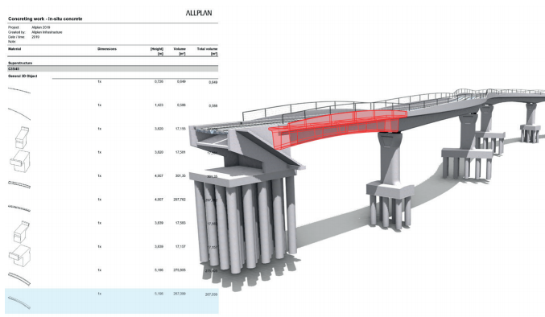
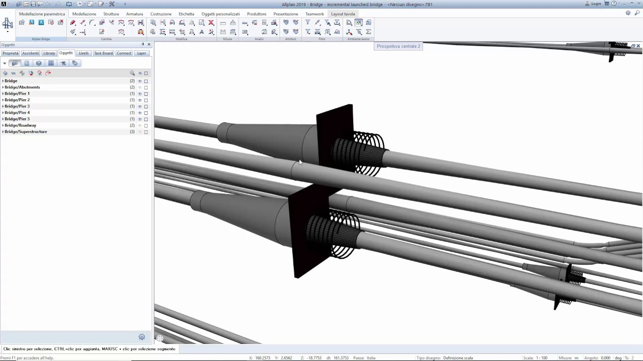
Other Allplan Bridge options

Slide 10
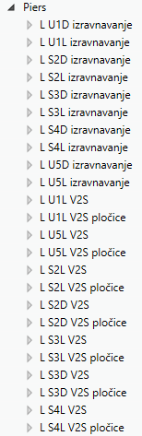
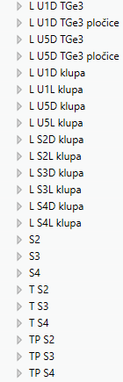
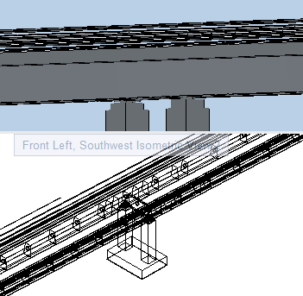
Conclusions so far
Software too early in development
Details hard to model
Allplan not adapted
Very efficient
Notes:
Structural analysis in future
Very adaptable

Slide 11
Thank you!

