Slide 1
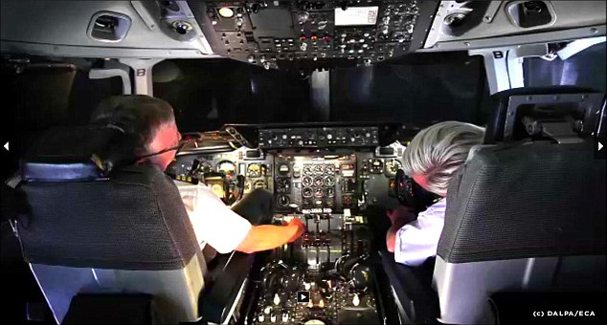
Airplane Automation
Would you fly in an airplane without a pilot?
Source: https://www.dailymail.co.uk/news/article-3992306
By David Teixidó

Slide 2
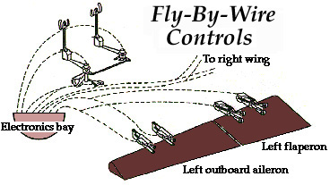

Fly-By-Wire concept
Source: https://www.mura.org/websites/me39c.me.berkeley.edu/Spring97/Projects/b777/flightdeck2.html

Slide 3
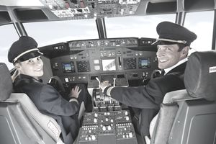
Who would you trust more?
Source: https://www.thebalancecareers.com/important-skills-pilots-acquire-282950

