Slide 1

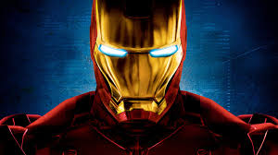

Slide 2
3.8 KM
SWIMMING
180 KM
CYCLING
42 KM
RUNNING

Slide 3
HOW CAN THEY DO IT?
PERSEVERANCE & DISCIPLINE
MENTAL TRAINING
ADAPTIVE CAPACITY
RECOVERY

Slide 4
