Slide 1
ITAIPU BINACIONAL
Leon Frei
Ewelina Ulanicka
Mads Albæk Sørensen
Source: www.iagua.es-Itaipu Binacional: la mayor central
generadora de energía limpia y renovable del planeta

Slide 2
Facts
Worlds largest clean energy generator
The border of Brazil and Paraguay; the Panama River
Area: 1350 km2
Length: 170 km
Total capacity: 14000 MW
Average: 95 million MWh per year

Slide 3
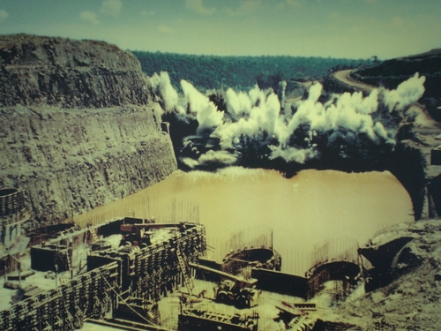
Source http://ea.com.py/wp-content/uploads/2013/02/itaipu-desvio.jpg

Slide 4
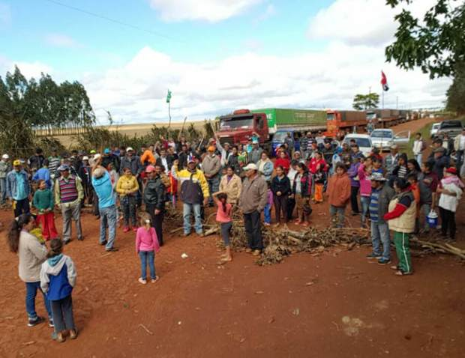
2. Consequences for the population
officially 4000 people relocated for the project
Another source - 40.000 Brazilians, 25.000 Paraguayans
Compensation issues
Resistance
“Environmental sin”
Source: http://www.capitanbado.com/files/2016/10/DI05F1VIER.jpg

Slide 5
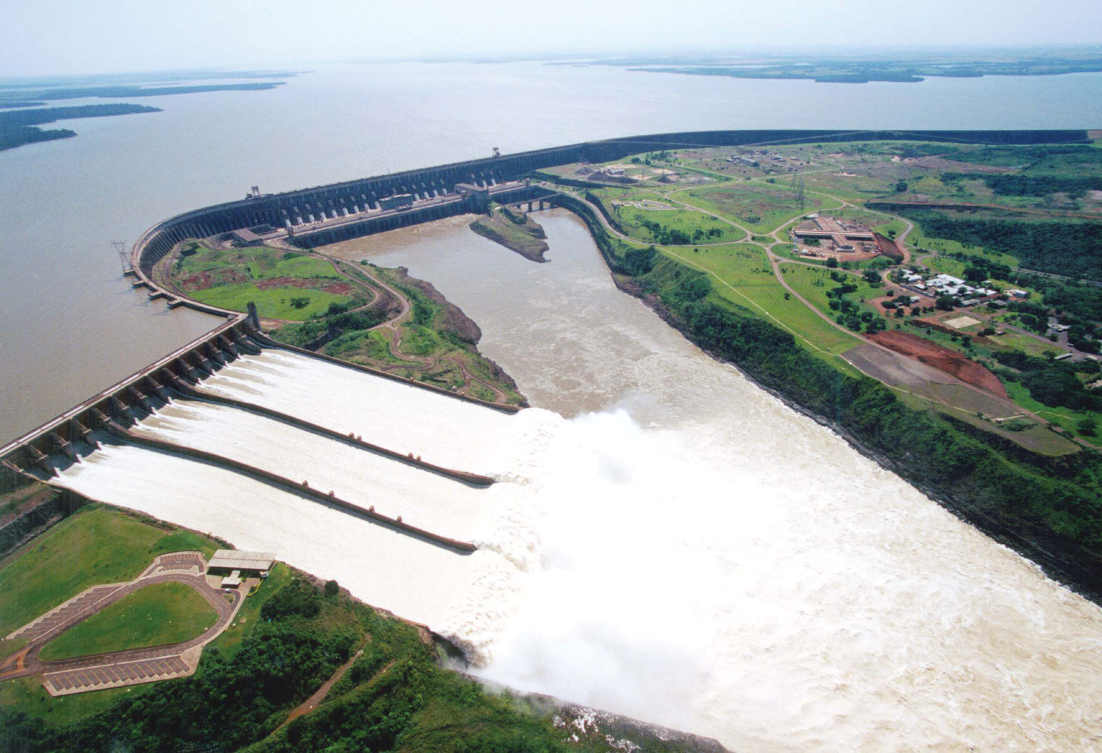
3. Consequences for the environment
Regulated flows of the dam
Groundwater sink
Sedimentation
Erosion
http://megaconstrucciones.net/images/presas/foto/itaipu-represa.jpg

Slide 6
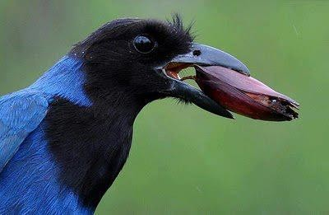
4. Ecological measures
Project “Gralha Azul”
  Afforestation project
  700 km² destroyed during construction
  630 km² afforested since
http://www.clmais.com.br/informacao/54339/o-que-a-gralha-azul-tem-haver-com-o-pinh%C3%A3o

Slide 7
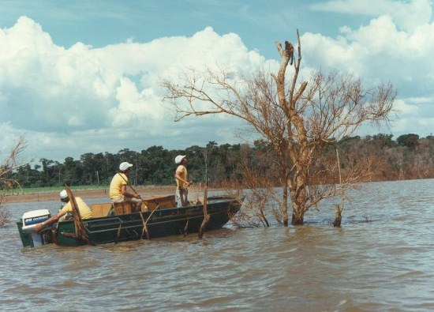
4. Ecological measures
Project “Mymba Kuera”
  Minimizing effects of reservoir flooding
  Catch and release of animals
  27150 animals captured in total (7547 mammals, 1848 birds and 5674 arachnids), and released
  Highly respected organisation for preservation and protection of animals.
http://jie.itaipu.gov.br/node/48598

Slide 8
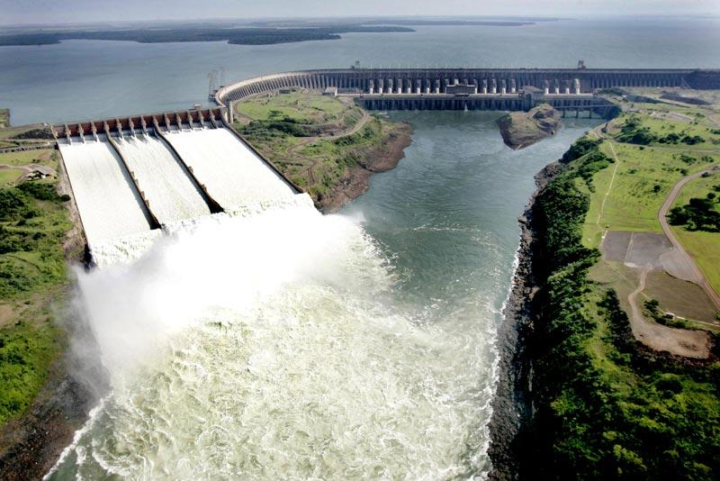
5. Ecological disaster as a result of ecological greed?
?
http://mundomelhor.net/wp-content/uploads/2014/01/hidreletrica-itaipu-binacional.jpg

