Slide 1
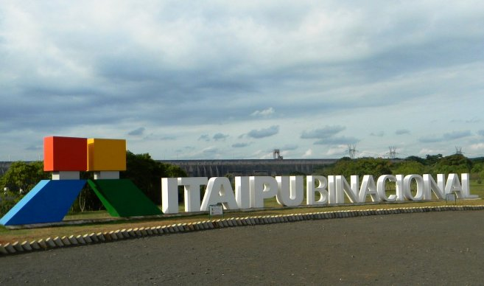
Itaipu Binacional
Communication Skills
Elevator Pitch
Leon Frei, 18.11.2016

Slide 2
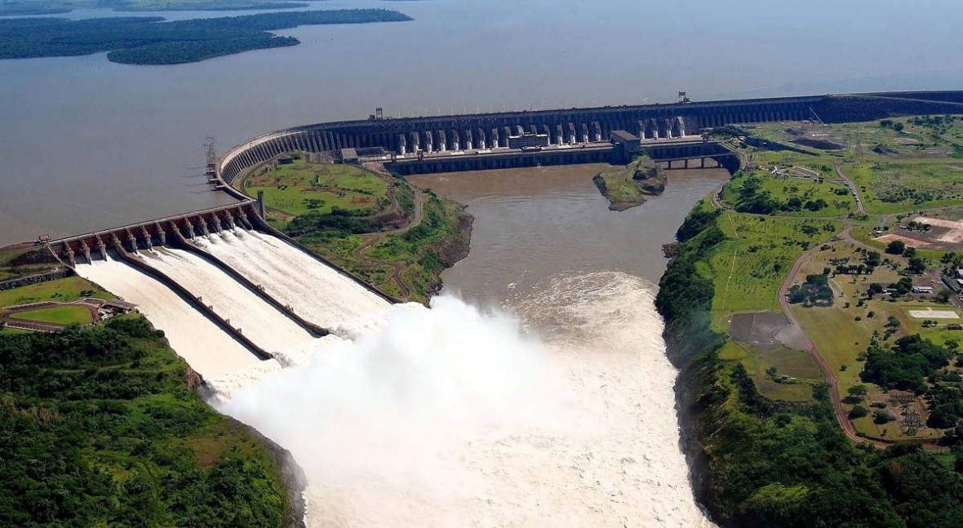
Itaipu Binacional?
Biggest clean energy
generator
of the world
Source: www.iagua.es-Itaipu Binacional: la mayor central
generadora de energía limpia y renovable del planeta

Slide 3
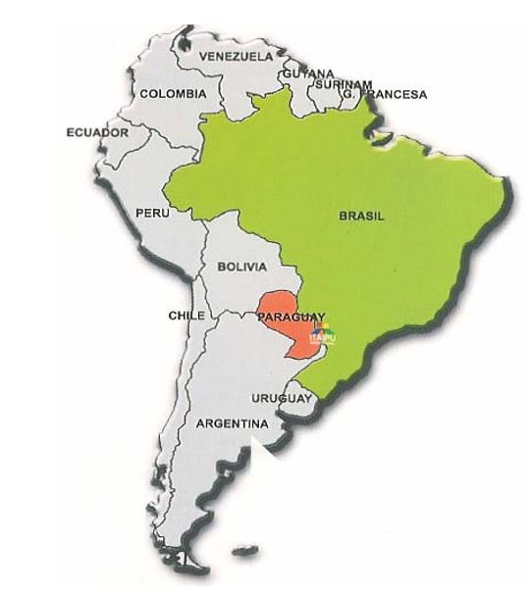
Where is it located?
Frontier Brazil – Paraguay
River Paraná
Source: „Itaipú Binacional – La Mayor Hidroeléctrica Del Mundo”

Slide 4
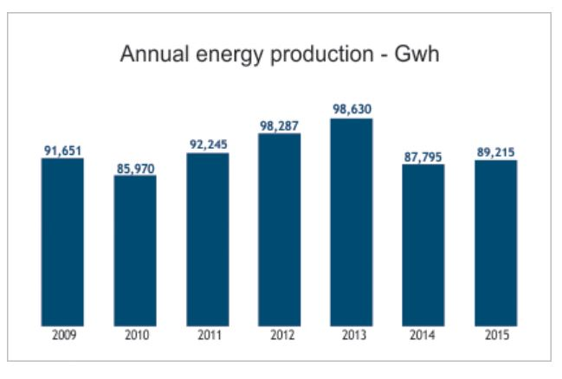
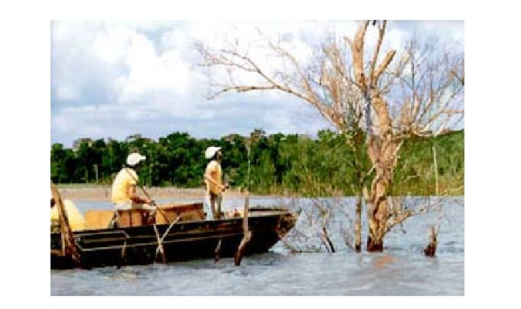
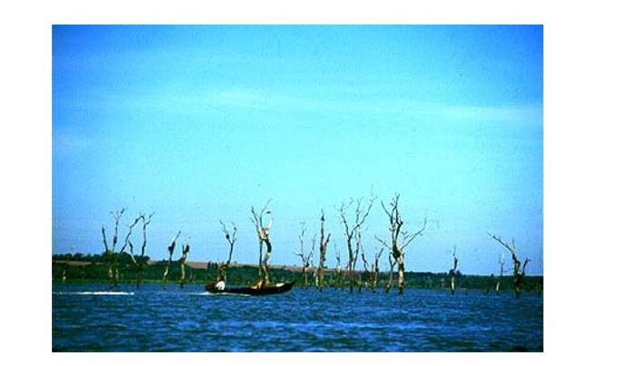
Economy - Ecology
Source: http://www.itaipu.gov.py/en/energy/energy
Source: www.itaipu.gov.py/www.ciudaddeleste.galeon.com

