Slide 1
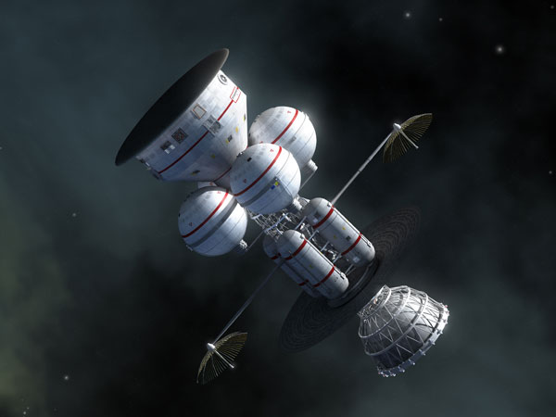
1
SPACE PROPULSION
By- Mr. Kimey K Wazare

Slide 2
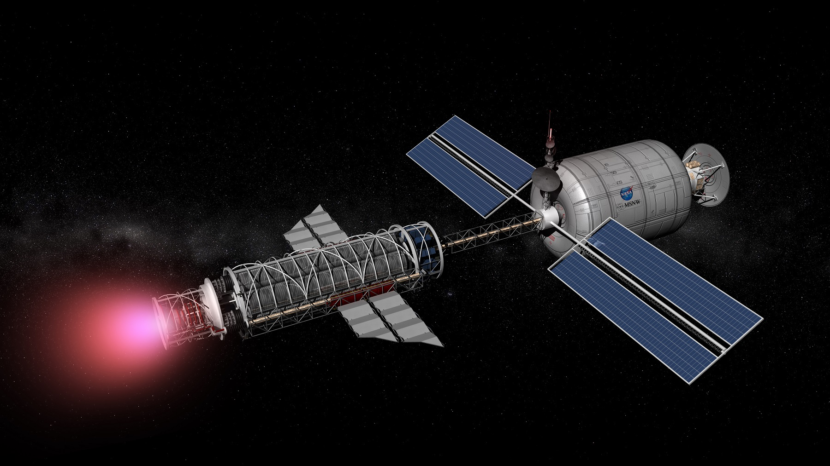
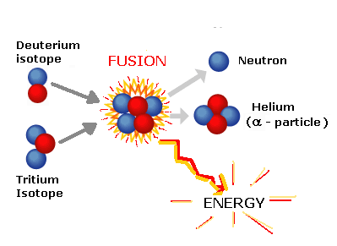
What is Nuclear Fusion?
2
What is Space Propulsion?

Slide 3
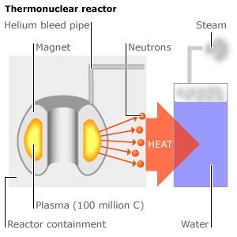
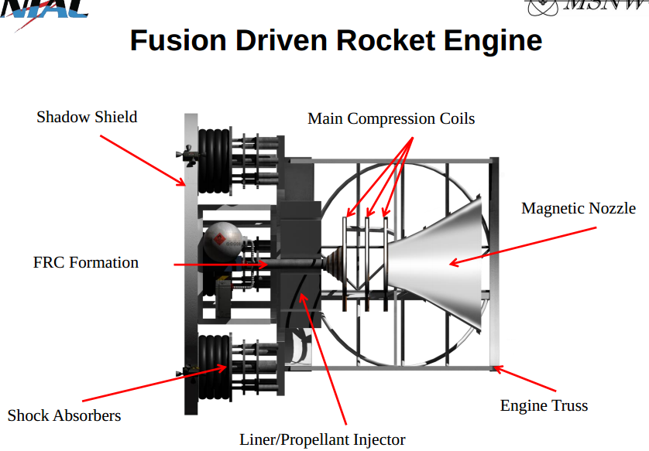
Process of Nuclear Fusion
3
Fig: Thermo-Nuclear Fusion
Fig: Nuclear Fusion Engine

Slide 4
Advantages
Disadvantages
Applications
Future
High Inert Mass
Large size Reactor
High Power Allows High Thrust
Low Specific Mass
Use of any Propellant
Near Earth Application
Political & Social Issues
Base Settlement Mission
Interplanetary Mission
Interstellar Mission
Human on Mars
Satellite on Jupiter
4
Nuclear Fusion

Slide 5
5
“ Really exotic methods of Propulsion.. Will have to be devised to get there…. How will it be done, I don’t know.. Whether it will be done, I am not quite certain. But I would bet it can be done.. “
-Edward Teller

