Slide 1
Waste Heat Recovery Systems
COMMUNICATION SKILLS I
ASSIGNMENT # 2
Inocencio Castañar
Samuel Parada
Saskia Loosveldt

Slide 2
CONTENTS
Introduction and Motivation
Waste Heat Recovery Systems
Applications
Conclusions and Future Work

Slide 3



1/14
INTRODUCTION AND MOTIVATION
Current situation: very restrictive environmental regulations, especially in industry emissions
INTRODUCTION AND MOTIVATION
WHRS
It is becoming really difficult to fulfill the emissions requirements by optimizing the traditional engine functioning
APPLICATIONS
CONCLUSION AND FINAL WORK
There is a need of new technologies

Slide 4
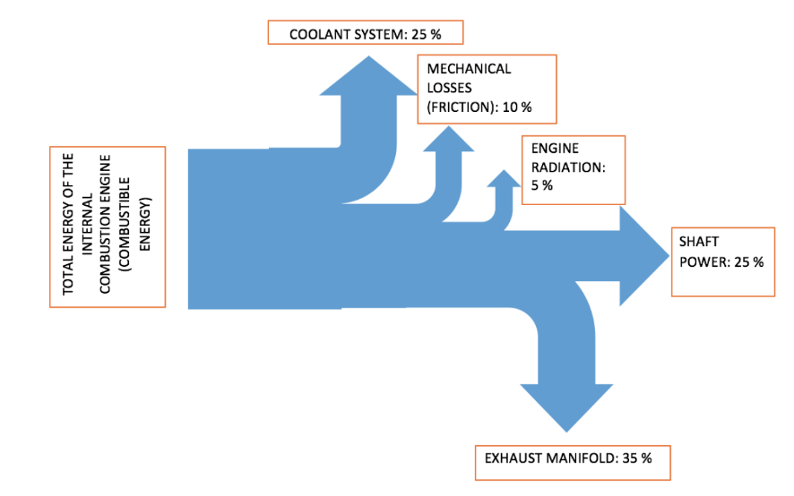
2/14
INTRODUCTION AND MOTIVATION
INTRODUCTION AND MOTIVATION
WHRS
APPLICATIONS
60% of the combustible
energy is wasted
CONCLUSION AND FINAL WORK
Waste Heat Recovery Systems appear

Slide 5
3/14
WASTE HEAT RECOVERY SYSTEMS
Thermo-electric Generators
INTRODUCTION AND MOTIVATION
WHRS
Turbochargers
APPLICATIONS
CONCLUSION AND FINAL WORK
Organic Rankine cycle

Slide 6
4/14
TURBOCHARGERS
Method to increase air density by increasing its pressure
INTRODUCTION AND MOTIVATION
WHRS
Two main components: compressor + turbine
APPLICATIONS
CONCLUSION AND FINAL WORK
Functioning: Energy of exhaust gases drive the turbine
which drives compressor

Slide 7
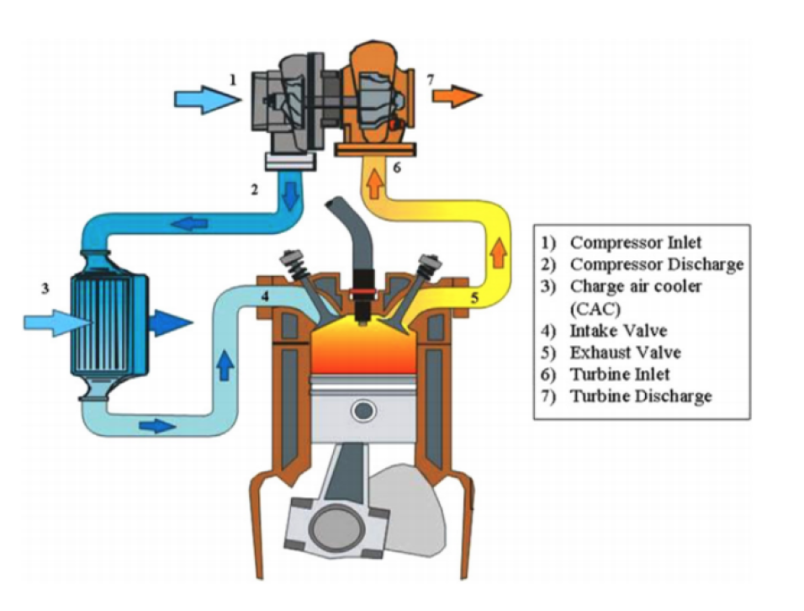
5/14
TURBOCHARGERS
INTRODUCTION AND MOTIVATION
WHRS
APPLICATIONS
CONCLUSION AND FINAL WORK

Slide 8
6/14
TURBOCHARGERS
Main turbocharger
drawback
TURBOLAG
INTRODUCTION AND MOTIVATION
WHRS
ELECTRICAL
TURBOCHARGERS
Solution
APPLICATIONS
CONCLUSION AND FINAL WORK
Compressor & Turbine
Components:
+
Generator & Storage device

Slide 9
7/14
ORGANIC RANKINE CYCLE
Based on the same working principle as water/steam Rankine cycle used in power plants
INTRODUCTION AND MOTIVATION
WHRS
Four elemental components:
· Pump
· Evaporator
· Turbine
· Condenser
APPLICATIONS
CONCLUSION AND FINAL WORK

Slide 10
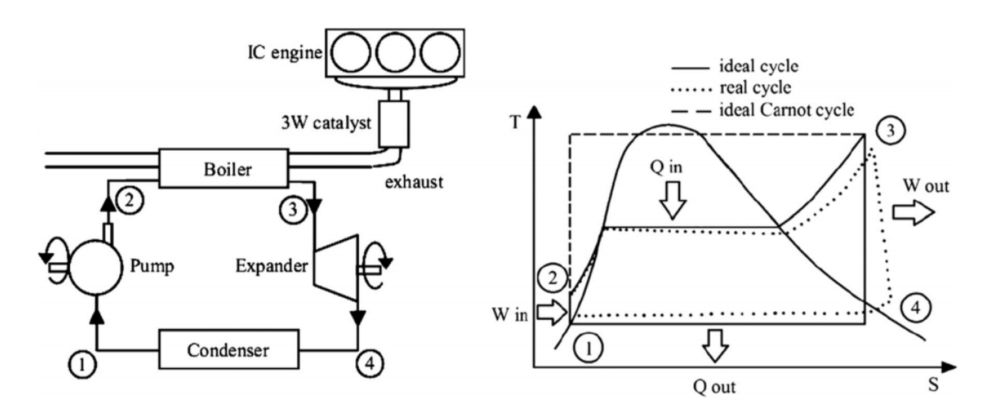
8/14
ORGANIC RANKINE CYCLE
INTRODUCTION AND MOTIVATION
WHRS
APPLICATIONS
CONCLUSION AND FINAL WORK

Slide 11
9/14
ORGANIC RANKINE CYCLE vs STEAM CYCLE
Difference: ORGANIC working fluid
INTRODUCTION AND MOTIVATION
WHRS
Main features (compared to water):
· Low boiling point at same pressure
· Low specific volume
APPLICATIONS
CONCLUSION AND FINAL WORK

Slide 12
10/14
ORGANIC WORKING FLUIDS
Classified based on their slope in the T-s diagram
INTRODUCTION AND MOTIVATION
WHRS
APPLICATIONS
Dry fluids (benzene, toluene): dT/ds >0
Wet fluids (ethanol, amonia): dT/ds <0
Isentropic fluids (R11, R134): dT/ds = ∞
CONCLUSION AND FINAL WORK

Slide 13
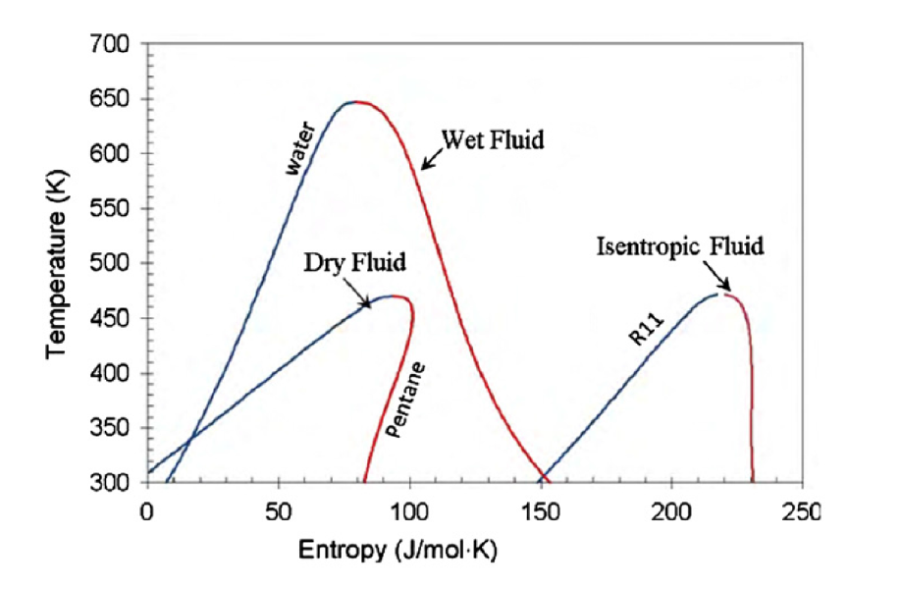
11/14
ORGANIC WORKING FLUIDS
INTRODUCTION AND MOTIVATION
WHRS
APPLICATIONS
CONCLUSION AND FINAL WORK

Slide 14
12/14
CONTAINER SHIPS
EMISSION | TONS SAVED PER YEAR
CO₂ | 11.000
NO_{x} | 300
SO_{x} | 200
Particulates | 30
INTRODUCTION AND MOTIVATION
WHRS
APPLICATIONS
CONCLUSION AND FINAL WORK
EDDI REDUCTION OF A 9.2%

Slide 15
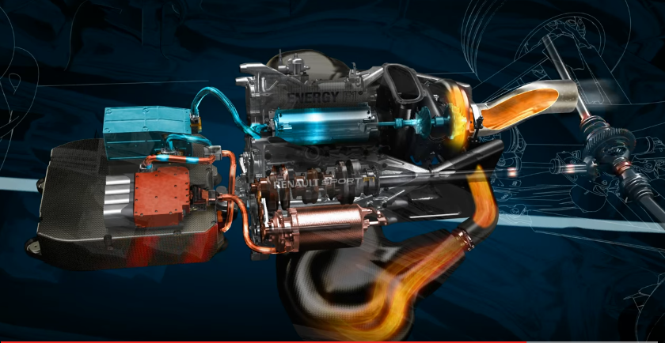
13/14
FORMULA ONE CARS
INTRODUCTION AND MOTIVATION
WHRS
APPLICATIONS
CONCLUSION AND FINAL WORK
MGU-K + MGU-H + ES → TOTAL RECOVERY OF 95% OF WASTED ENERGY

Slide 16
14/14
CONCLUSION AND FUTURE WORK
Introduction of WHRS in technologies increments efficiency
INTRODUCTION AND MOTIVATION
WHRS
Less contamination to the environment
APPLICATIONS
CONCLUSION AND FUTURE WORK
Enormous improvement in a short period, up to what point will we be able to arrive?

Slide 17
Waste Heat Recovery Systems
COMMUNICATION SKILLS I
ASSIGNMENT # 2
Inocencio Castañar
Samuel Parada
Saskia Loosveldt

