Slide 1

Socio-Economic Benefits of Satellite Technologies
Notes:
Courtesy : https://www.eurisy.org/on-satellite-applications.php

Slide 2
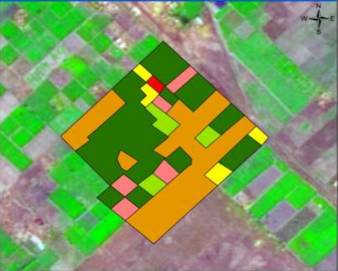
Agriculture
Crops Estimation and
Forecasting
Identify deforestation
Irrigation System

Slide 3
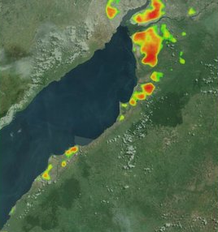
Geology
Petroleum Exploration
Mining Minerals
Archeological Sites
Notes:
Courtesy : https://www.researchgate.net/figure/Lake-Alberts-microseepage-anomaly-map-generated-using-multi-sensor-satellite-imagery_fig6_281269057

Slide 4
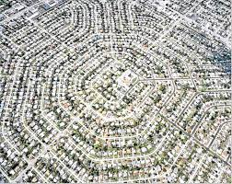
Urban Planning
Population Density
Land Information &
Management
Notes:
Courtesy : https://business.inquirer.net/241168/urban-planning-matters

Slide 5
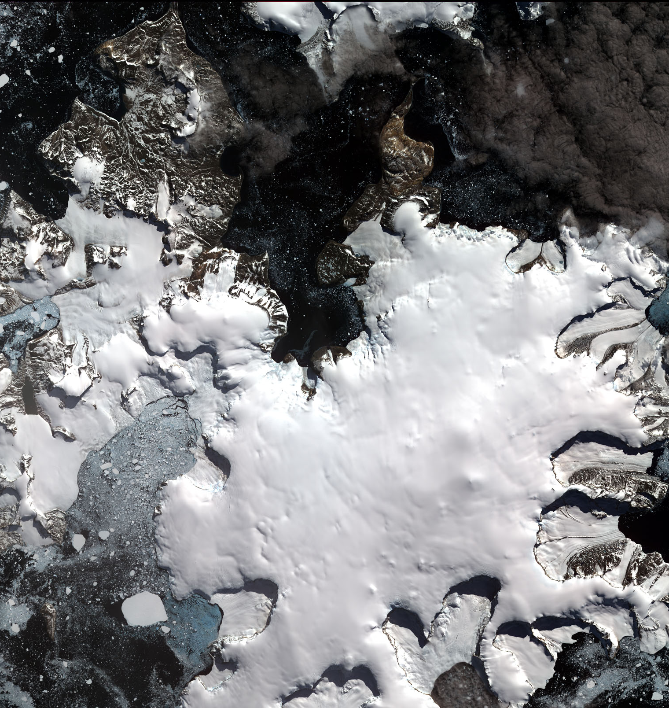
Environment
Water Pollution
Air Pollution
Wildlife Protection
Glacier Study
Notes:
Courtesy : http://www.antarcticglaciers.org/glaciers-and-climate/glacier-recession/observing-glacier-change-space/

Slide 6
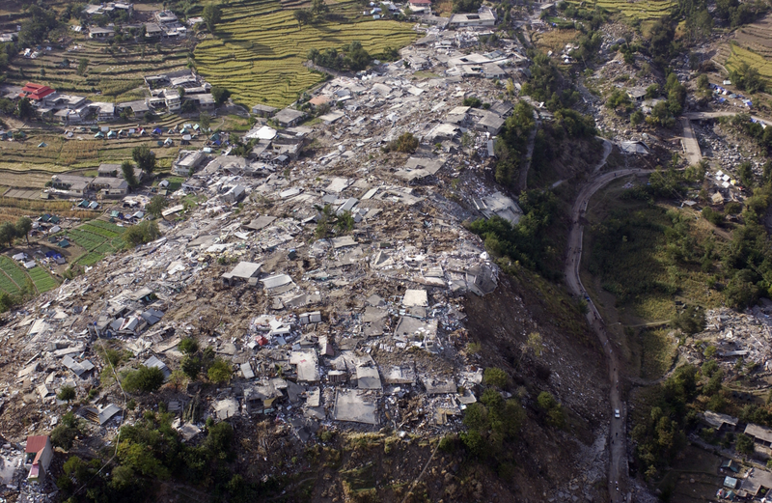
Disaster & Relief Management
Tsunami
Flood
Earthquake
Notes:
Courtesy : https://earthobservatory.sg/blog/looking-back-2005-kashmir-earthquake

Slide 7
Adnan Ali Imran
MS-Computational Mechanics
End

