Slide 1
Dating Jungle Survival Texts
Communication Skills 1 - Mao Ye, Hong Nhung Ngo

Slide 2
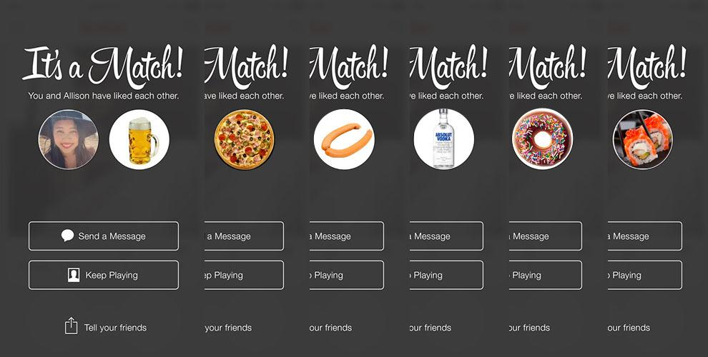

Slide 3
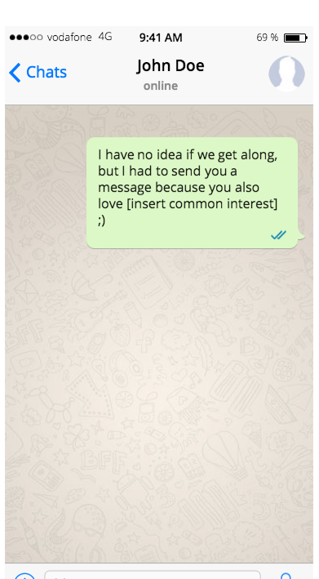

Slide 4
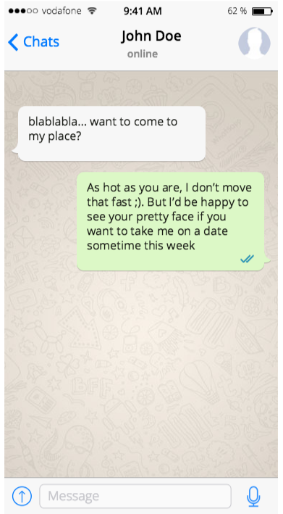

Slide 5
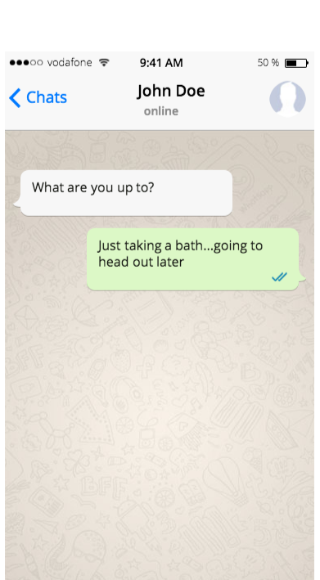

Slide 6
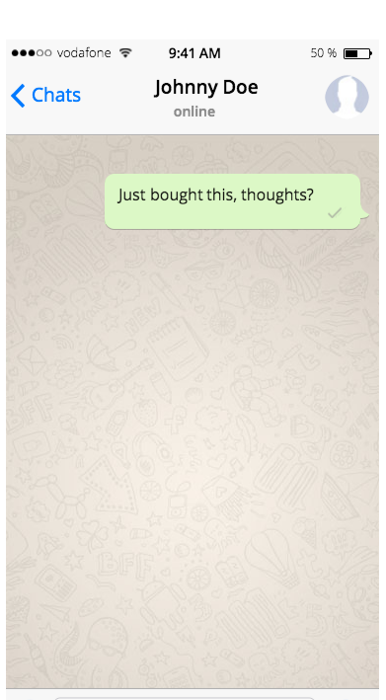
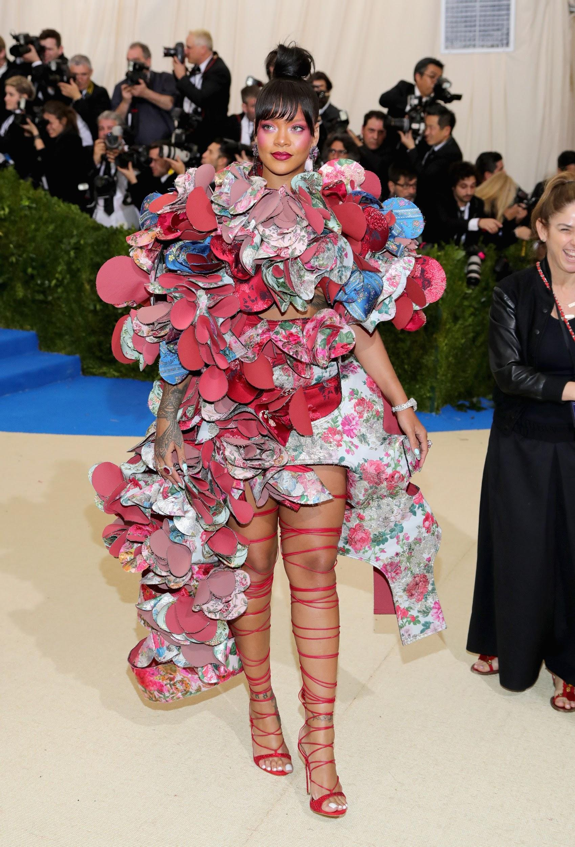

Slide 7
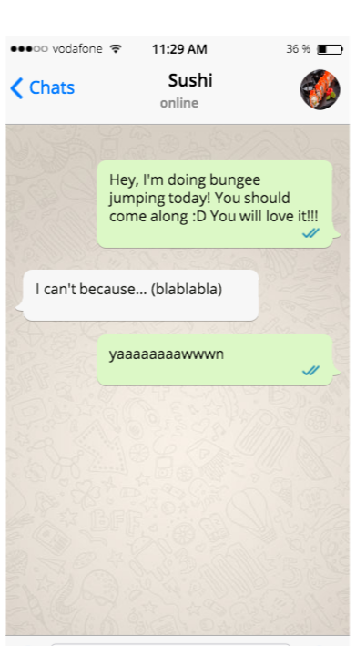

Slide 8
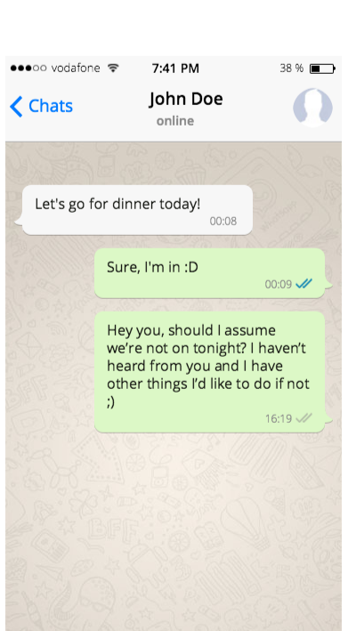

Slide 9
Reference
https://www.rollingstone.com/wp-content/uploads/2018/06/gettyimages-675607998-fa15edf3-fa66-4148-9a2f-09d5508e2b34.jpg
https://www.fakewhats.com/generator
https://s14422.pcdn.co/wp-content/uploads/2016/03/tinder-matches-redone-700px.jpg
https://www.youtube.com/user/gettheguyteam

