Slide 1

Human Mobility

Slide 2
Agenda
History and past – Arnfinn
Development until nowadays – Renan
Ongoing in the future – Sebastian

Slide 3
Mobility Milestones
3500 B.C.
Invention
of the wheel
Horses
800 B.C.
Streets
19th century
Cars, Bicycles and locomotives
2000 B.C.
20th century
3000 -1500 B.C.
Aerospace
Ships
E – mobility
21st century
Animals as transport
~ 8000
B.C.
Pesse canoe

Slide 4

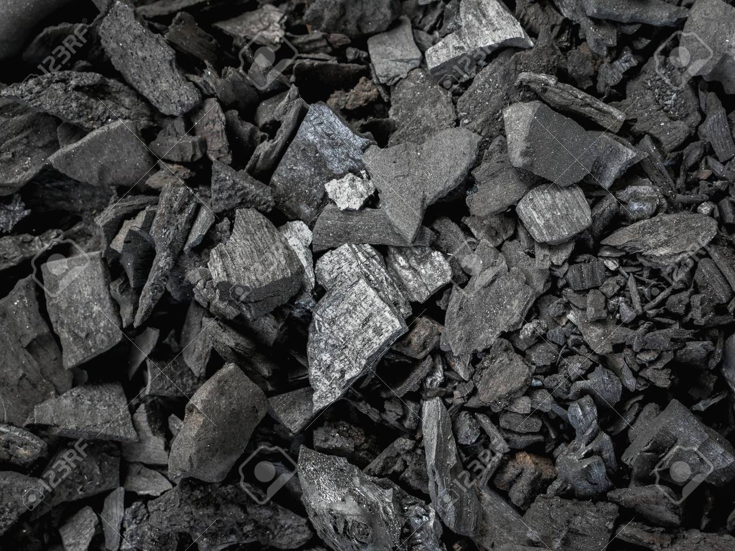
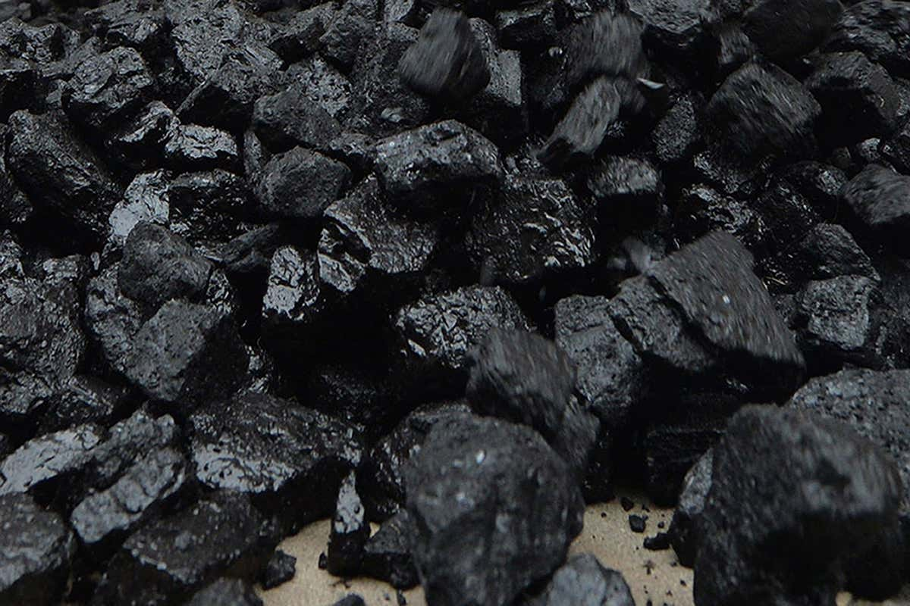
THE ESTABLISHMENT
THE NEEDED PUSH, UNFORTUNATELY
THE TOLL UPON THE ENVIRONMENT
Reference [1]
CHARCOAL AND FOSSIL FUELS
Reference [2]
Reference [3]

Slide 5
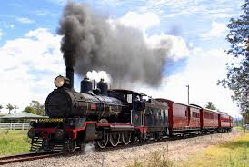
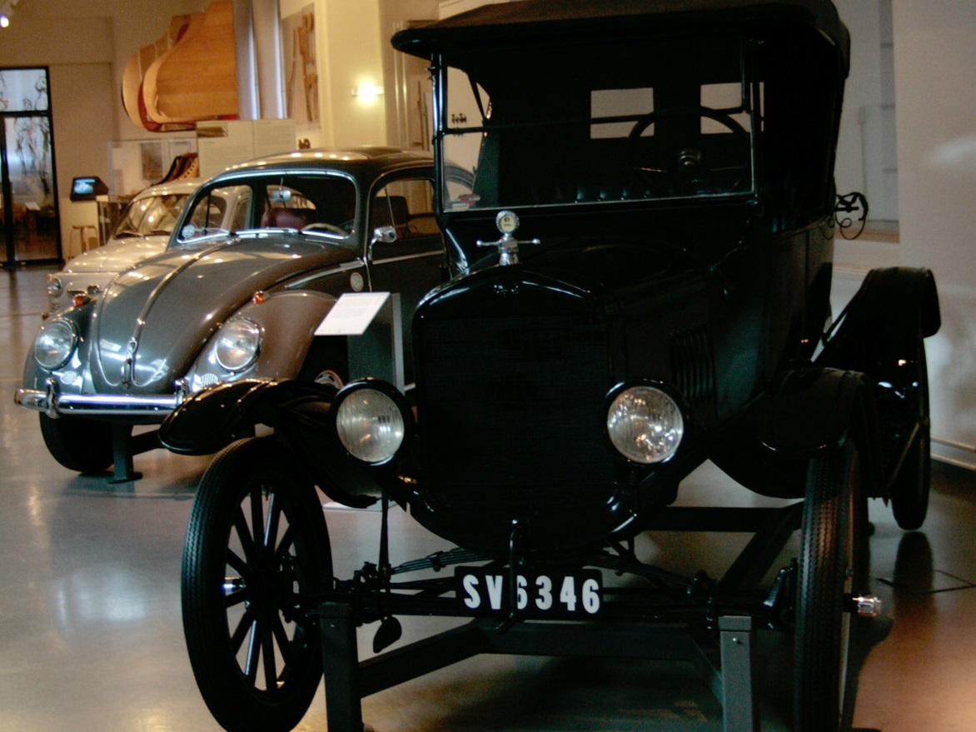
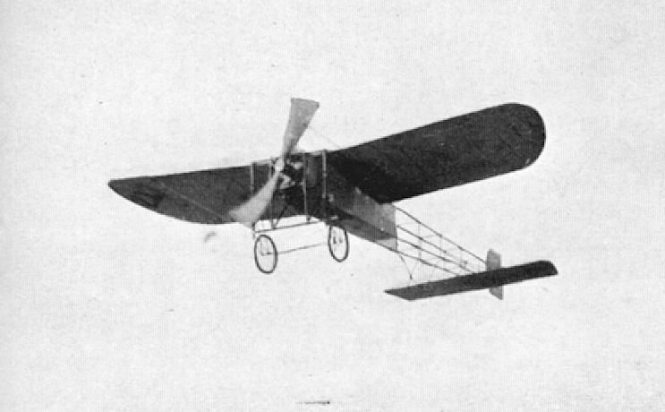
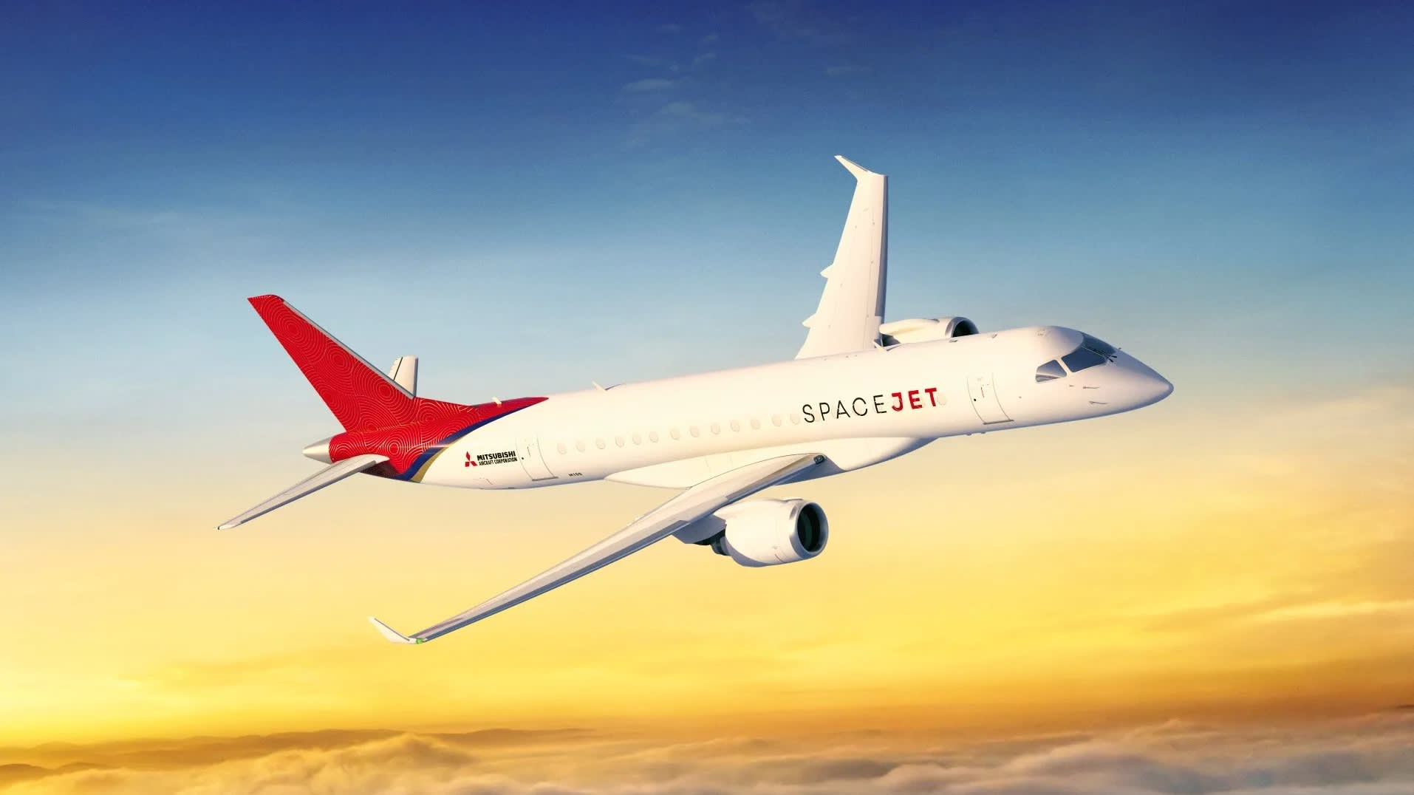
THE ESTABLISHMENT
FIRST CARS AND TRAINS
Reference [4]
Reference [5]
THE SKY IS THE LIMIT
Reference [6]
Reference [7]

Slide 6
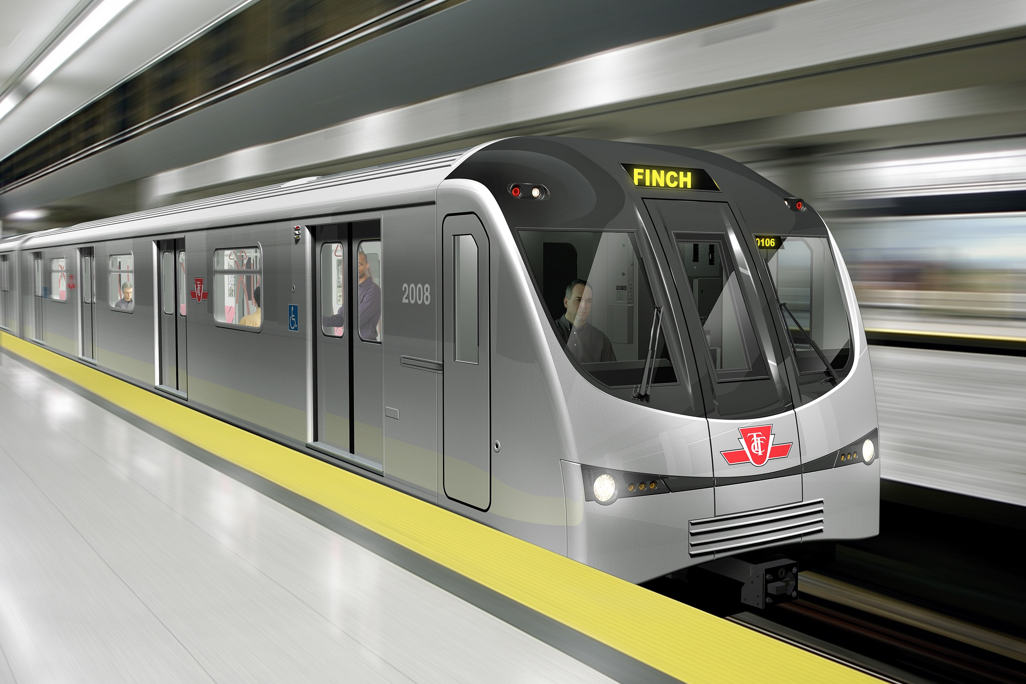
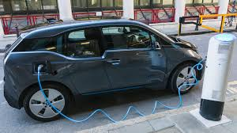
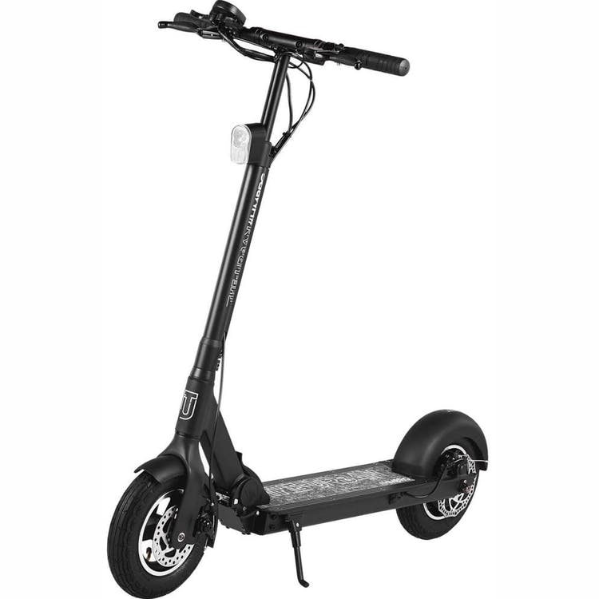

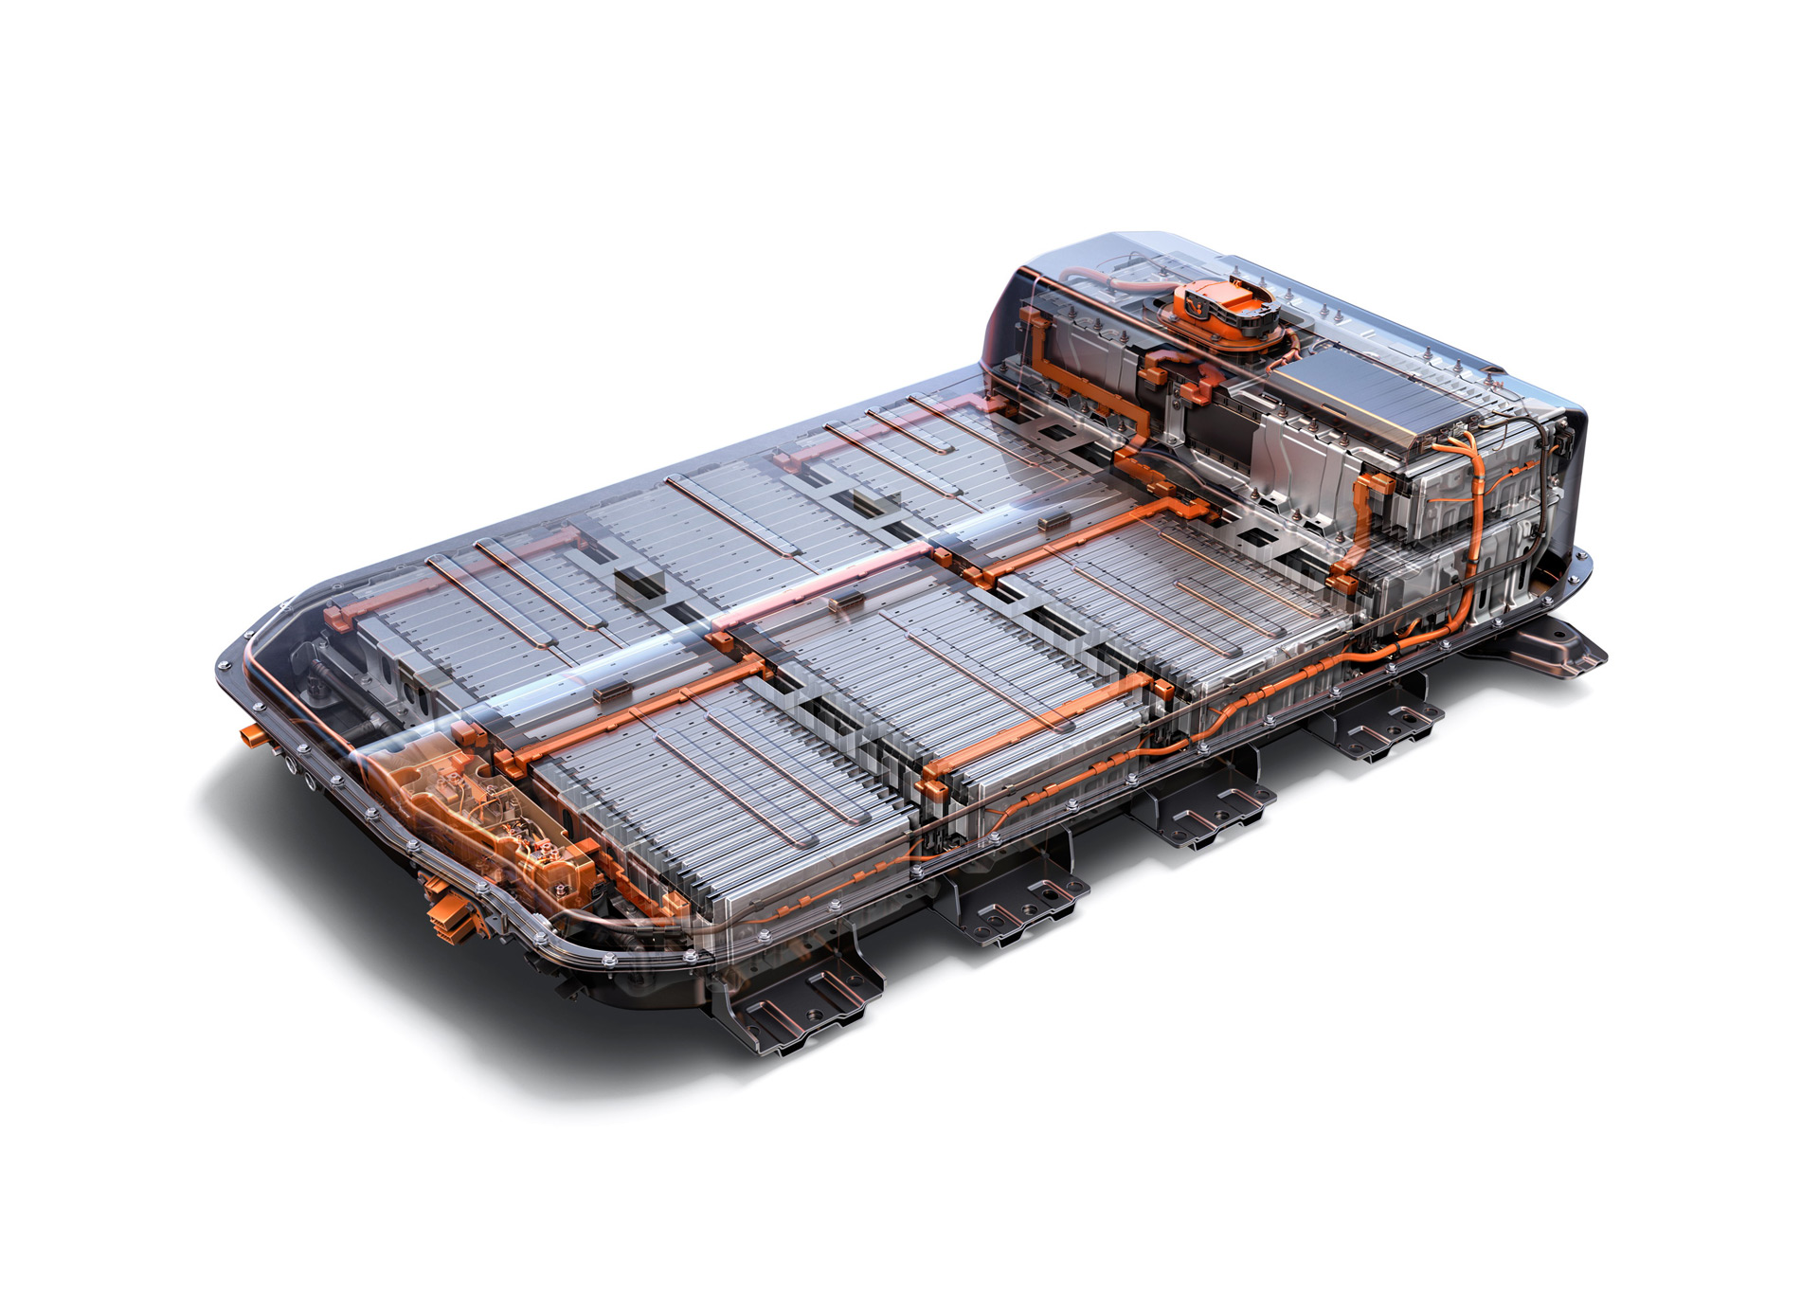
THE ESTABLISHMENT
ELECTRICTY AS THE ALTERNATIVE
Reference [8]
Reference [9]
Reference [10]
AN “ECO-FRIENDLY” SOLUTION?
Reference [11]
Reference [12]

Slide 7
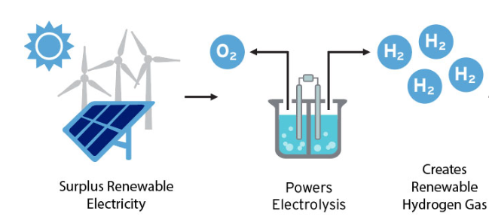
Use of excess energy
Reference [13]

Slide 8
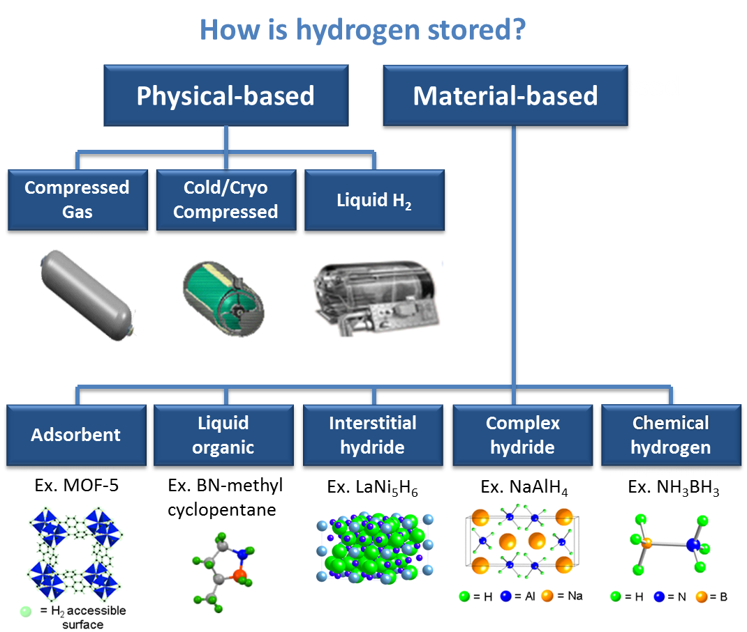
Reference [14]

Slide 9
Mobility outlook
Reference [15]

Slide 10
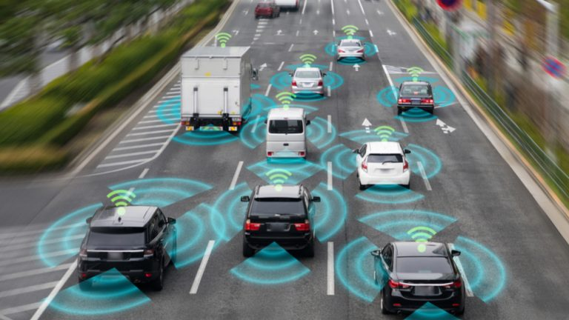
Autonomy and Connectivity
Reference [16]

Slide 11
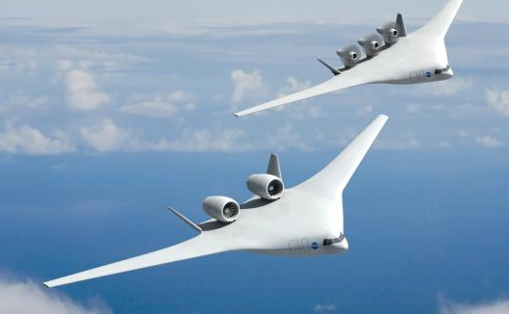
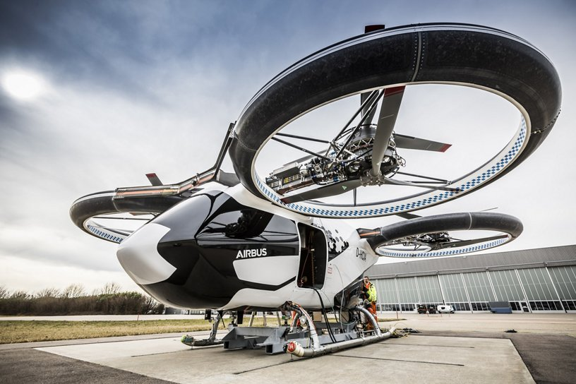
Future in Aviation
Reference [17]
Reference [18]

Slide 12
References
[1] https://www.grenadabroadcast.com/featured/climate-change-adaptation-and-mitigation-focus-of-two-day-workshop/
[2] https://br.123rf.com/photo_87845048_peda%C3%A7os-de-fundo-de-textura-de-carv%C3%A3o-preto-.html
[3] https://www.newscientist.com/article/2130231-uk-government-subsidises-coal-sector-with-356-million-a-year/
[4] https://www.wikiwand.com/en/Queensland_Pioneer_Steam_Railway
[5] https://en.wikipedia.org/wiki/History_of_the_automobile
[6] https://www.pinterest.com/pin/498421883741287209/
[7] https://asia.nikkei.com/Business/Aerospace-Defense/Mitsubishi-in-talks-to-sell-100-planes-to-US-company
[8] https://rail.bombardier.com/en/solutions-and-technologies/worldwide-projects.html?f-region=asia-pacific&show-by-page=50&page=1&f-country=cn&f-segment=all&f-type=Metro&f-name=all
[9] https://www.ft.com/content/9cba0522-f564-11e9-b018-3ef8794b17c6
[10] https://www.skatehut.co.uk/brands/the-urban/the-urban-hmbrg-electric-scooter-black.htm
[11] http://nfartigoroed.williamsportretreat.com/os-impactos-ambientais-das-sinas-hidrelytricas-53curybu8547.html
[12] https://poontru.com/electric-vehicle-batteries-ev-batteries-market-2019-analysis-growth-vendors-shares-drivers-challenges-with-forecast-to-2025/82897/
[13]https://static1.squarespace.com/static/53ab1feee4b0bef0179a1563/5bbbadf6652dead95067b5dc/5d10eab3c235c100016fc91b/1563800420248/hydrogen+energy+storage+infographic.png?format=1500w
[14] https://www.energy.gov/eere/fuelcells/hydrogen-storage
[15]Anders, N., Drewitz, M.: Entwicklungsperspektiven für den Personennahverkehr bis 2025. In: Der Nahverkehr, 9/2010, p. 53
[16]http://discharged.eu/2019/07/looking-beneath-the-hood-of-the-linked-automobile/
[17]https://www.dlr.de/next/desktopdefault.aspx/tabid-6624/10881_read-24688/
[18]https://www.airbus.com/innovation/urban-air-mobility/vehicle-demonstrators/cityairbus.html#smallmediagallery_20-par-smallmediagallery_20-1

