Slide 1
Elevator pitch
Benedikt Malý

Slide 2
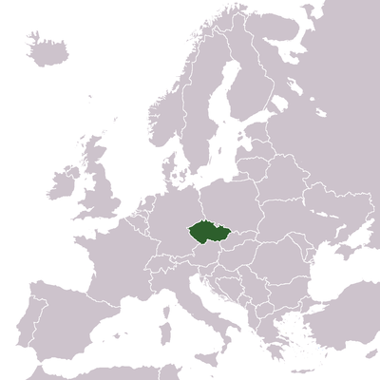


Czech Republic

Slide 3

Parts of presentation
1. Basic information
2. Typical features
3. Conclusion – Is it worth to visit Czech republic?

Slide 4

1. Basics about Czech republic

Slide 5
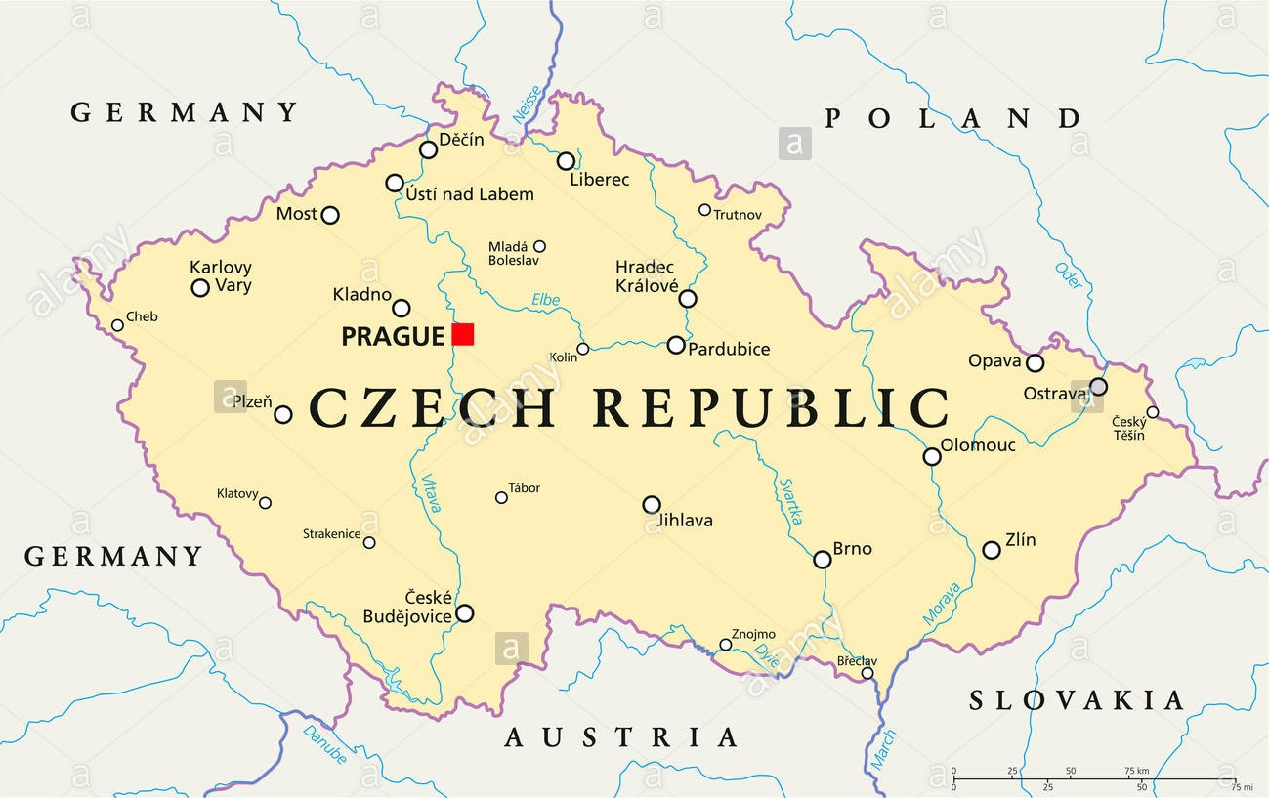
Ostrava
Prague
Brno

Slide 6
2. Typical features for Czech republic

Slide 7
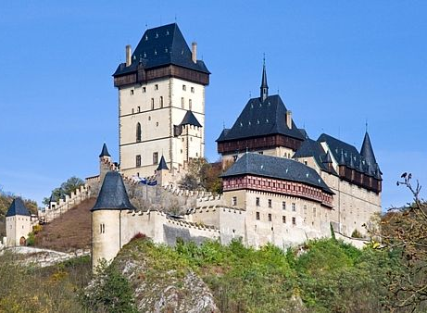

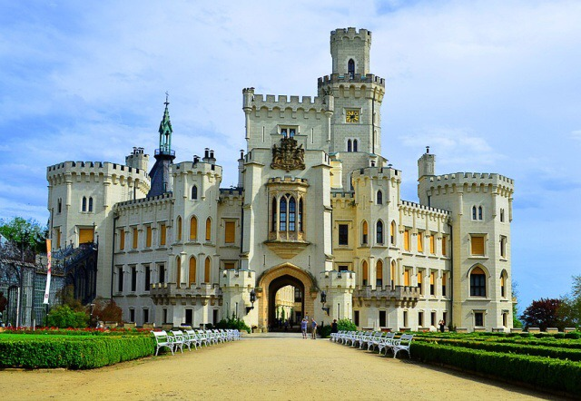
Country of castles

Slide 8
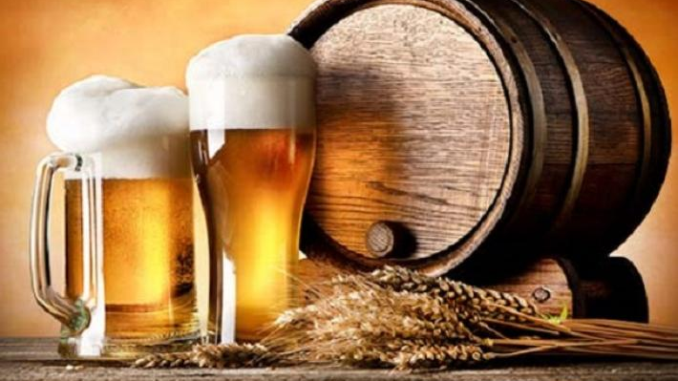
The biggest producers and consumers of beer
163 l/person/year

Slide 9

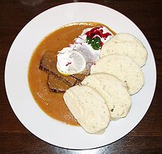
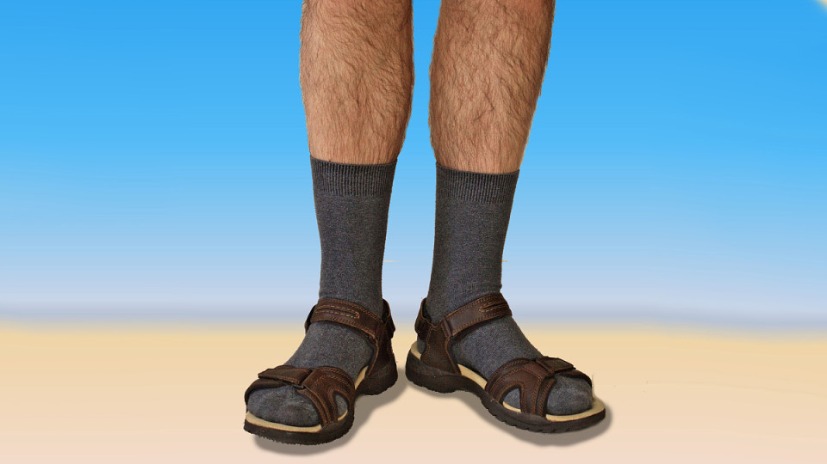
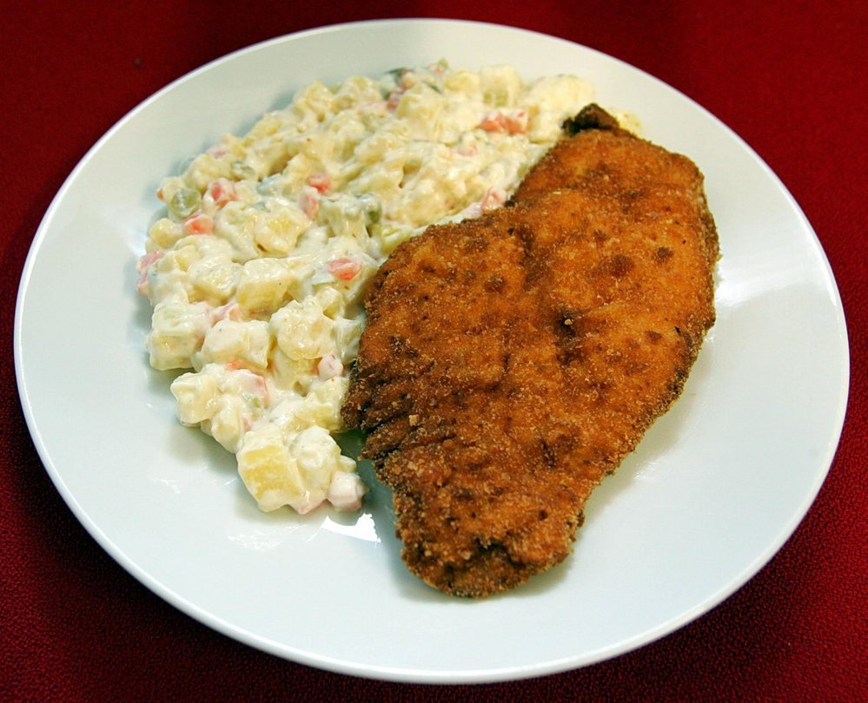
Another typical czech things

Slide 10
3. Conclusion
Is the Czech republic interesting to visit?

Slide 11
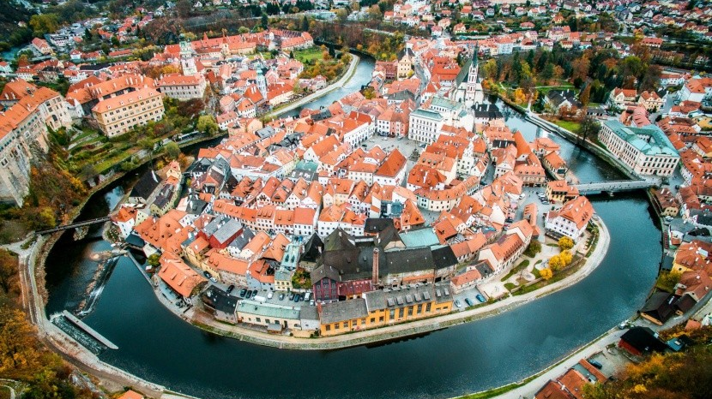
Historical cities

Slide 12
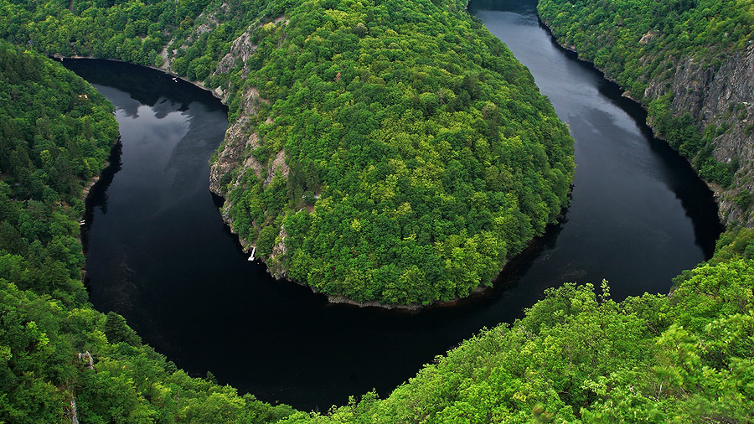
Nice nature

Slide 13
Thanks for your attention
Benedikt Malý

Slide 14
Sources
Praha [online]. 2015 [cit. 2018-11-05]. Dostupné z: http://www.golden-prague.cz
100+1 [online]. Prague, 2018 [cit. 2018-11-05]. Dostupné z: https://www.stoplusjednicka.cz/
Wikipedia [online]. Prague, 2018 [cit. 2018-11-05]. Dostupné z: https://cs.wikipedia.org/

