Slide 1
Best drama Series 2018
Carlos Eduardo Ribeiro Mendoza

Slide 2


Brazilian presidential election
Attempt of murder
Mass manipulation using
Facebook and Whatsapp
Candidate going to prison
Betrayal among parties

Slide 3
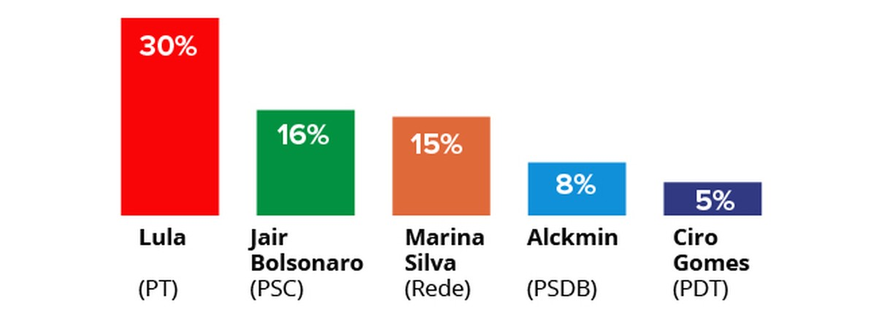
Lula da Silva
1st on the polls
ARRESTED!
But why?
Received Millions on bribes for controlling the most important port in the country?
Constructed an airport on his private property with millionaire government funding
Admitted receiving enormous undeclared funding and tax-evasion?

Slide 4
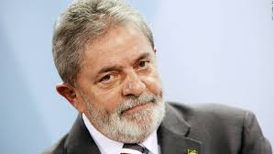
Lula da Silva
Received an 100.000€ apartment from a constructor, but never used it
JAIL!

Slide 5
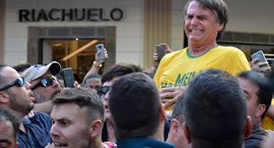
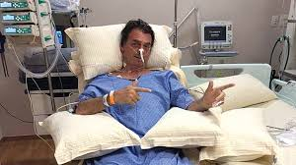
Jair Bolsonaro
Stabbed on the stomach, but growing on polls

Slide 6
Jair Bolsonaro
„The dictatorship should‘ve killed more, not only tortured“
„I‘m unable of loving a homossexual, I‘d rather my son to die“
How’s THIS guy winning?
„Women should receive less pay because they get pregnet“
„This wouldn‘t happen, I educated them properly“ when asked what would happen if his son dated a black woman
„I don‘t rape you because you don‘t deserve it“

Slide 7


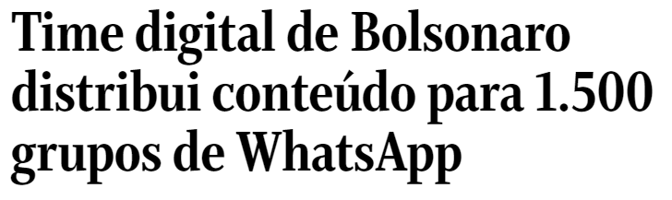
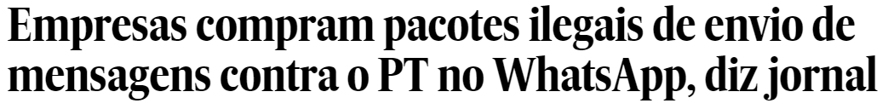


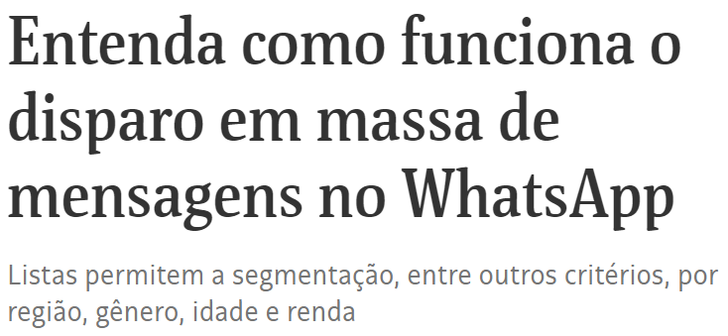
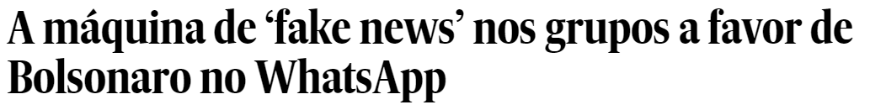

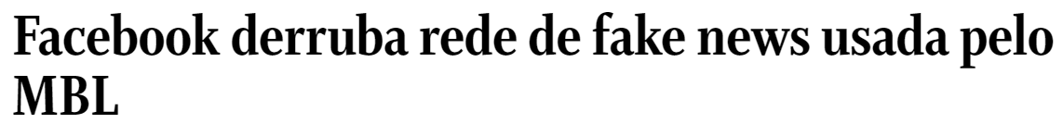
Conspiracy theory - sort of

Slide 8
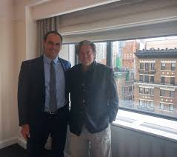

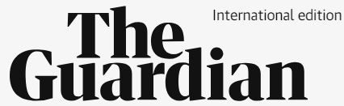

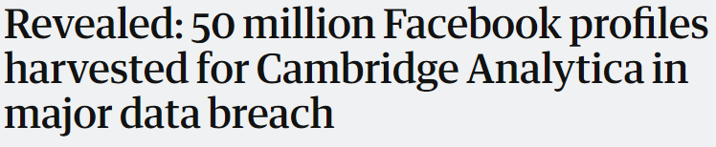
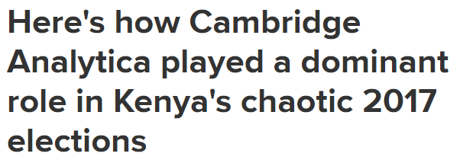


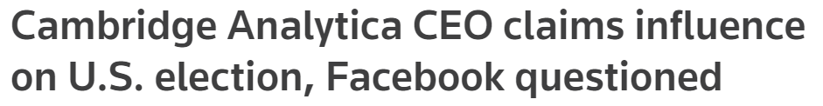
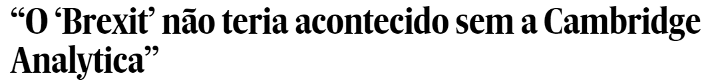

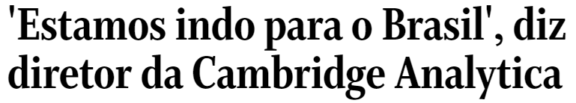
Conspiracy theory - sort of
Steve Bannon
Son of Bolsonaro

