Slide 1
The adaptation of the BRT system in Argentina

Slide 2
BRT SYSTEM
Is a bus-based public transport system designed to improve capacity and reliability relative to a conventional bus system
Roadways that are dedicated to buses.
Gives priority to buses at intersections.
Off-board fare collection.
Platform-level boarding.

Slide 3
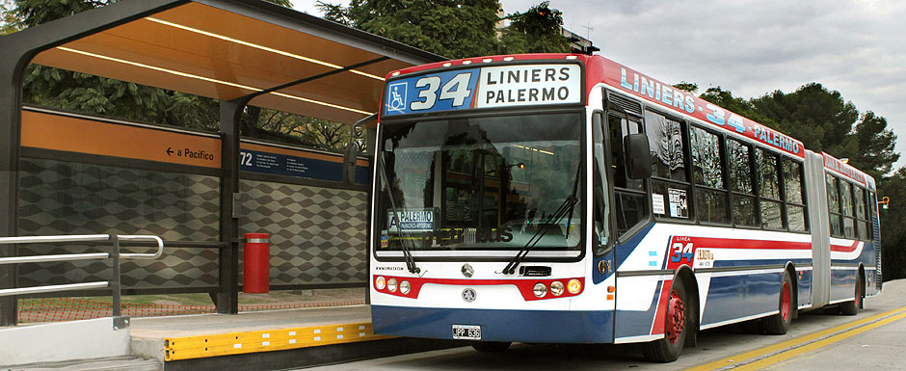
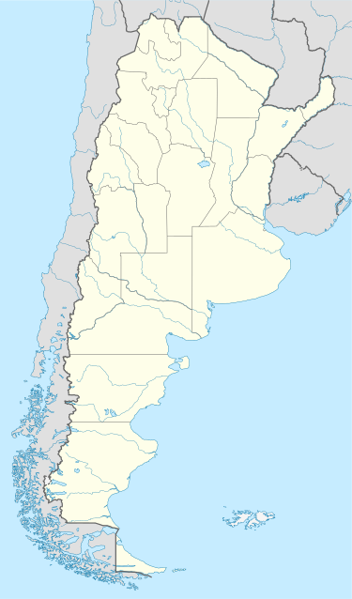
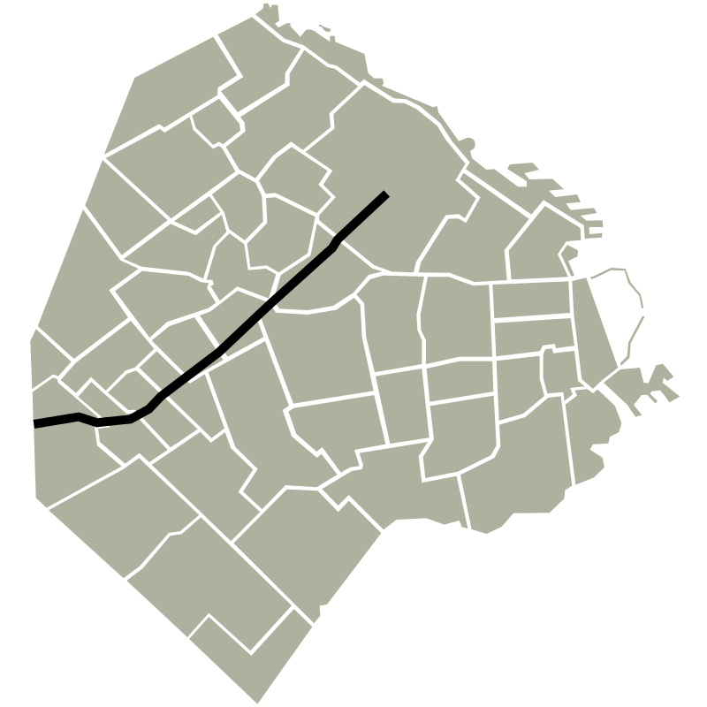
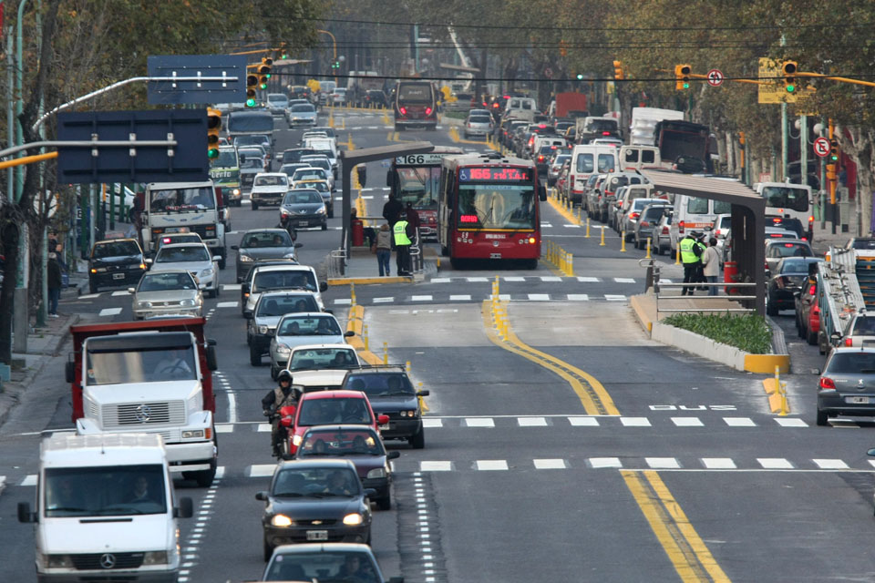
ARGENTINA’S FIRST BRT SYSTEM
It started operating on May 31, 2011
12km (7.5 miles) corridor
21 stations
Elevated station platforms

Slide 4
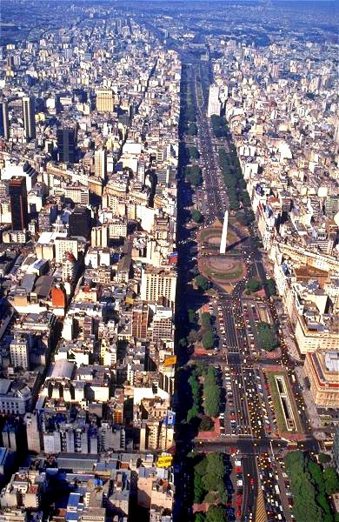
9 DE JULIO AVENUE

Slide 5
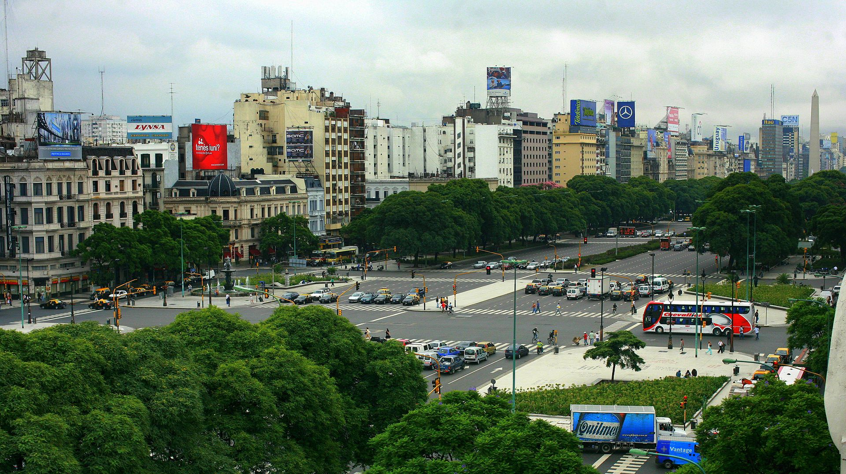
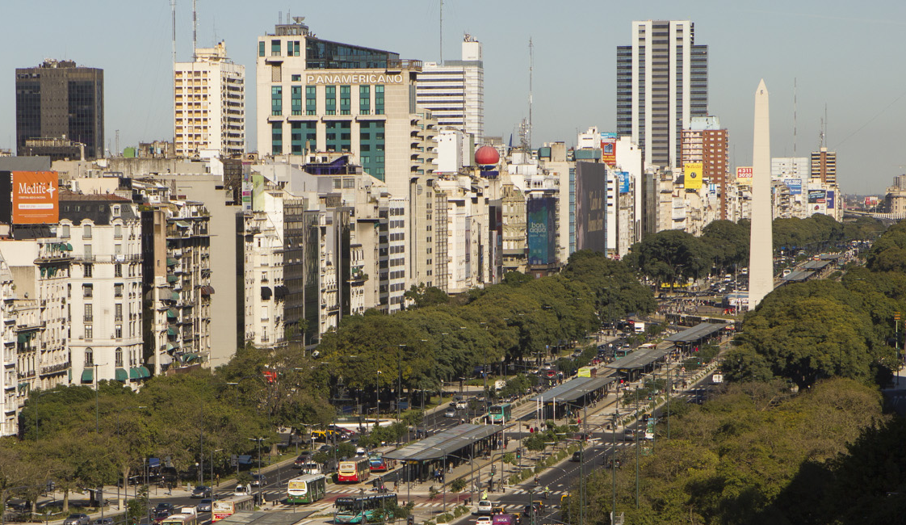
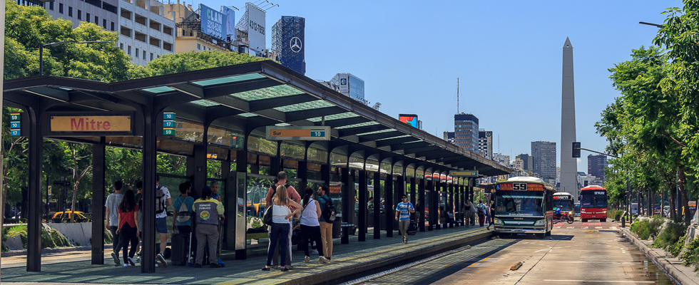
It started operating on July 24, 2013
3km corridor
17 stations
Elevated station platforms

Slide 6
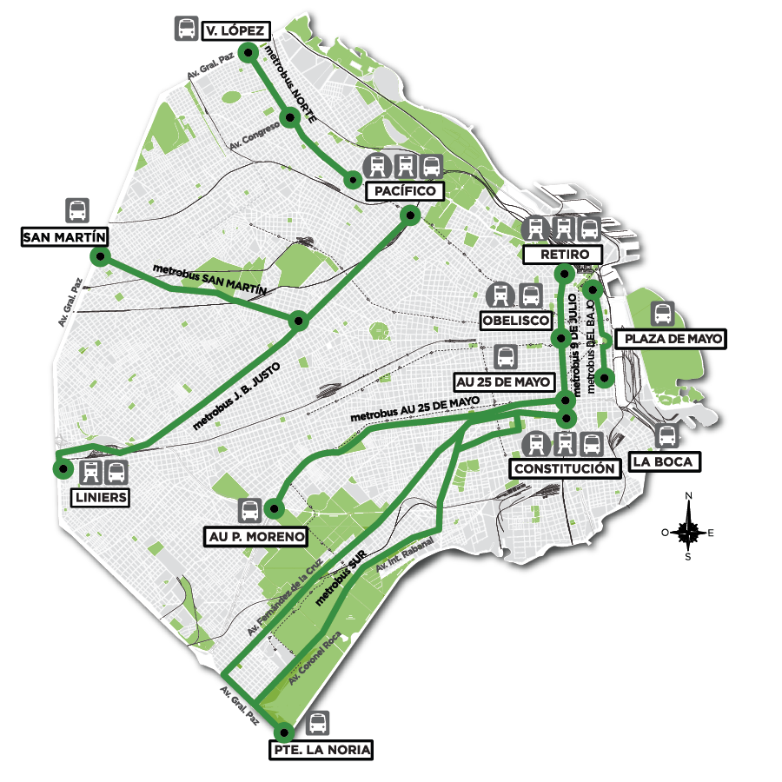
ARGENTINA’S METROBUS SYSTEM
Start dates of operation:
Juan B. Justo : May 31, 2011
9 de Julio : July 24, 2013
Sur : August 14, 2013
Norte : June 17, 2015
25 de Mayo : October 5, 2015
San Martin : April 27, 2016
Ramal Norte : November 24, 2016
La Matanza : May 5, 2017
Ramal del Bajo : June 6, 2017
Tres de Febrero : October 6, 2017
Total Length: 59.7 km
Number of people who use it daily : 842.000
Reduction of travel time: 40%

Slide 7
THE END

