Slide 1
Earthquake risk and prevention in Chile
Gabriel Valdés Alonzo

Slide 2
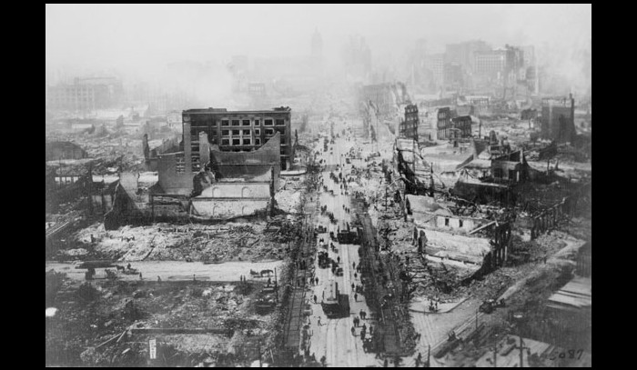
Valdivia Earthquake, 1960
Source: segunda compañía de bomberos de Santiago.
Notes:
9.5 Mw
2000 deaths
2 million homeless
US$ 500 million

Slide 3
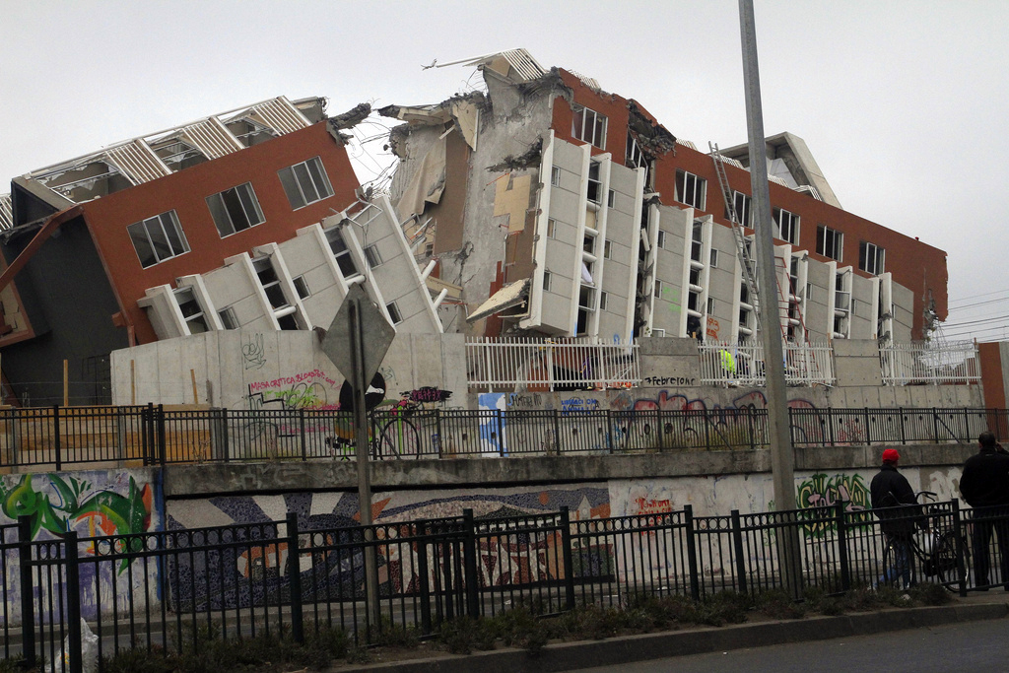
27F, 2010
Source: Claudio Núñez, CC.
Notes:
8.8 Mw
525 deaths, 25 not found
US$ 30 billion

Slide 4
Prevention
High enforcement of construction laws.
Constant training.
Cultural and educational approach.

Slide 5
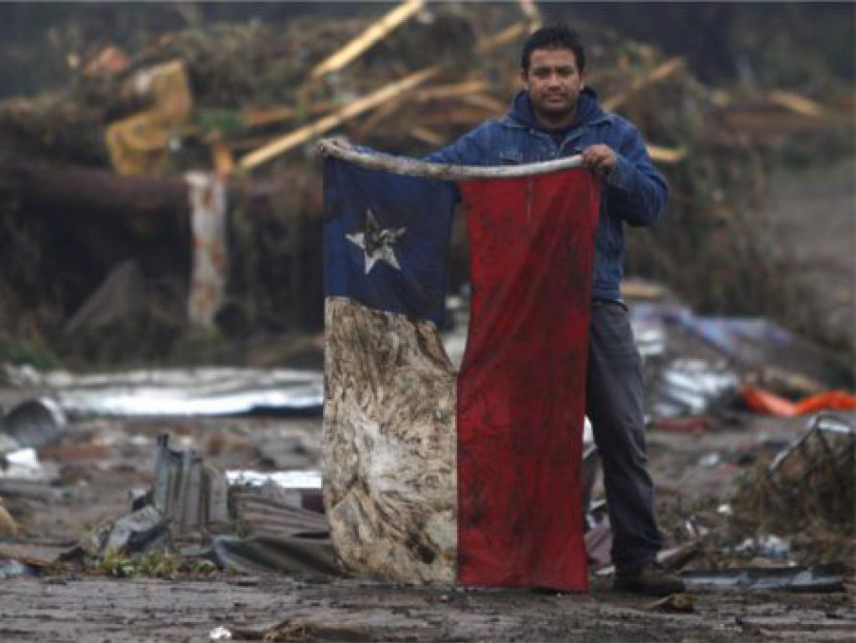
Source: Roberto Candia.

