Slide 1
Sustainable Tourism
Joël Fux

Slide 2

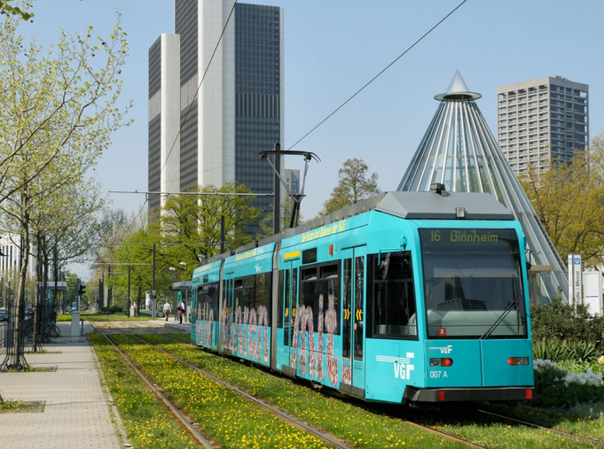

International tourist arrivals: 25 million. (1950) → 1.3 billion (2018)
(http://www.hotelroomsearch.net)
(https://www.frankfurt-tourismus.de)
(https://www.padworth.com)

Slide 3
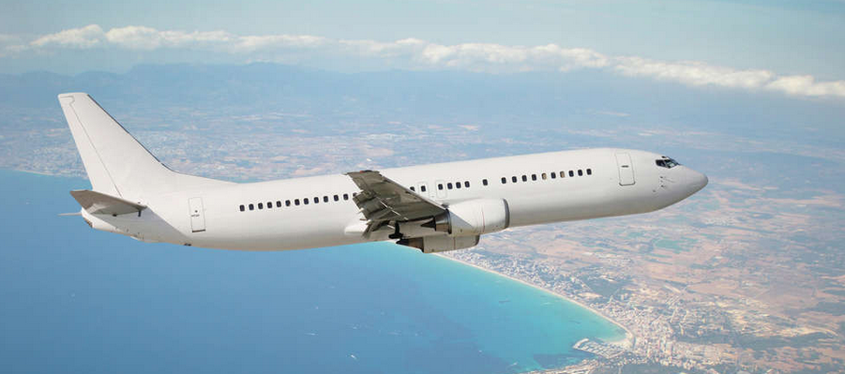
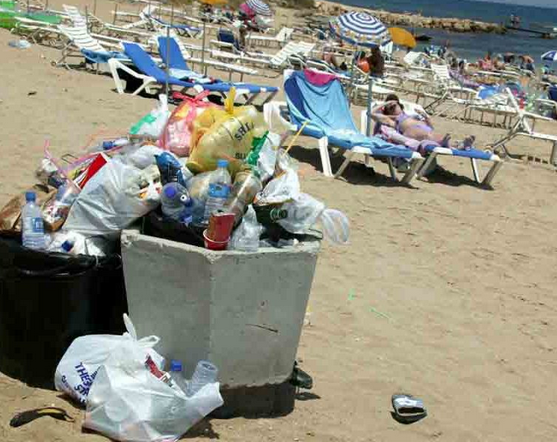

(https://www.merkur.de)
(http://cyprus-mail.com)
(http://ec.europa.eu)

Slide 4
Sustainable Tourism
Main aims:
Conservation of the environment
Support of local economy and culture

