Slide 1
Sustainable Tourism
Joël Fux, Carlos Mendoza, Oriol Falip
18.12.2018
1

Slide 2
1. Introduction
International tourist arrivals
1950 → 25 million
2013 → 1.1 billion
2018 → 1.3 billion
? 2030 → 1.8 billion ?
2

Slide 3
1. Introduction
Economic performance
2012 → 6630 billion USD
9.3% of global economic performance
Examples:
Malaysia and Thailand → 15-20%
Direct expenses
Input
Money spent
3
3

Slide 4

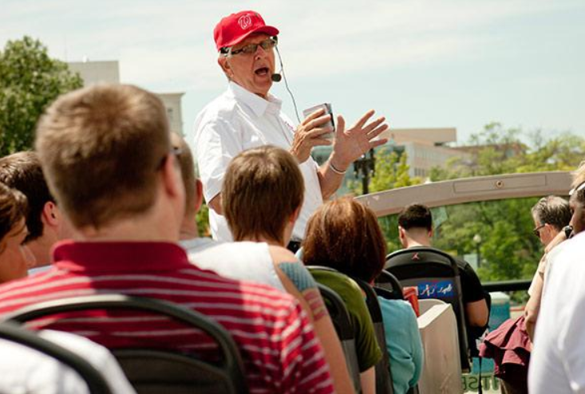

2. Pros of tourism: Creation of new jobs
(http://www.hotelroomsearch.net)
(http://www.monster.com)
(http://www.auslandsjob.de)
4

Slide 5

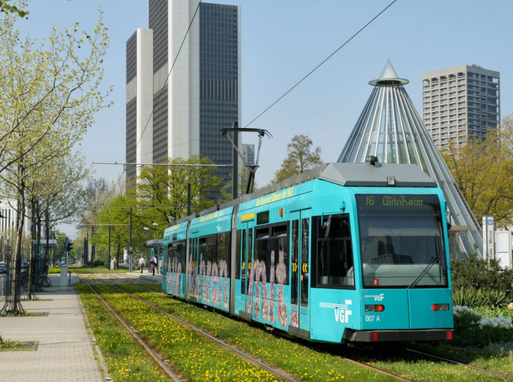
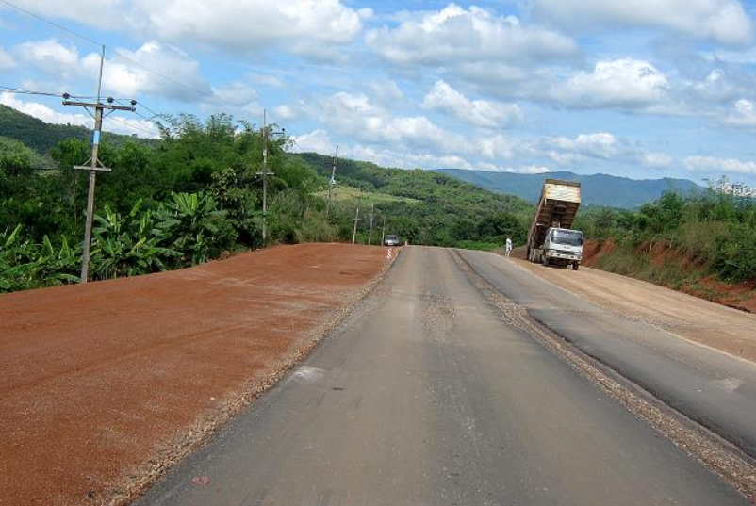
2. Pros of tourism: Infrastructure
(https://www.t-online.de)
(https://www.frankfurt-tourismus.de)
(https://www.pattayafans.de)
5

Slide 6
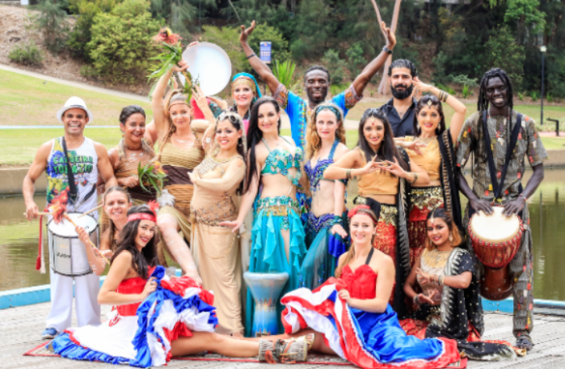
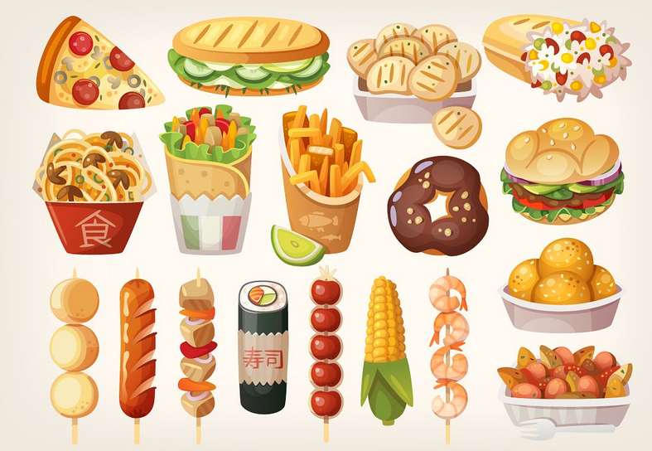

2. Pros of tourism: Cultural exchange
(https://www.publictelegraph.com)
(https://www.creativemarket.com)
(https://www.padworth.com)
6

Slide 7
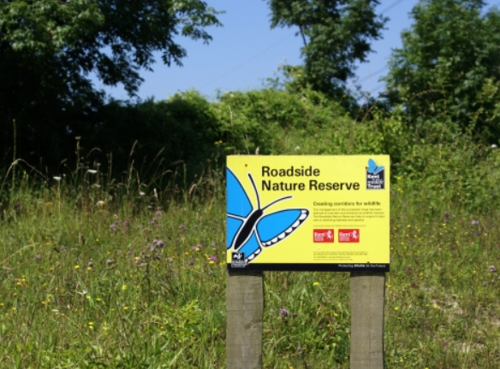
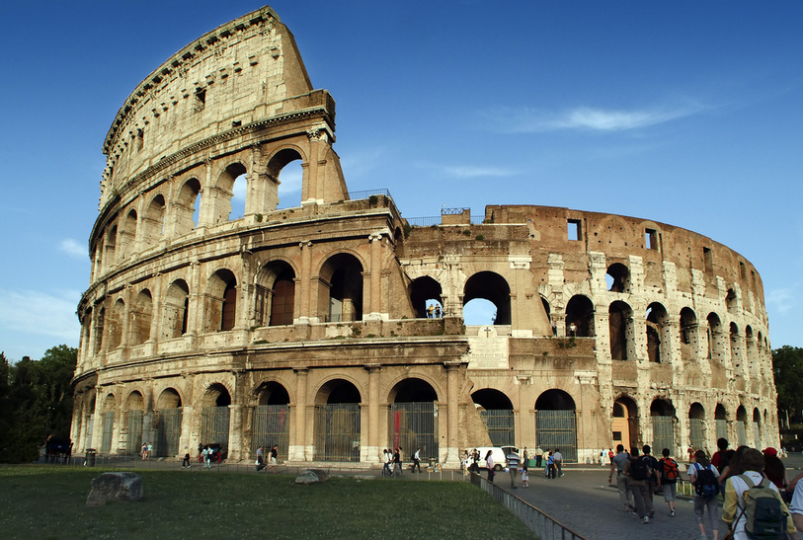
2. Pros of tourism: Preservation of natural areas
and historical buildings/places
(https://www.kentwildlifetrust.org.uk)
(https://www.countrydetail.com)
7

Slide 8

3. Cons of tourism: socio-economic view
Increment in rental of housing

Slide 9
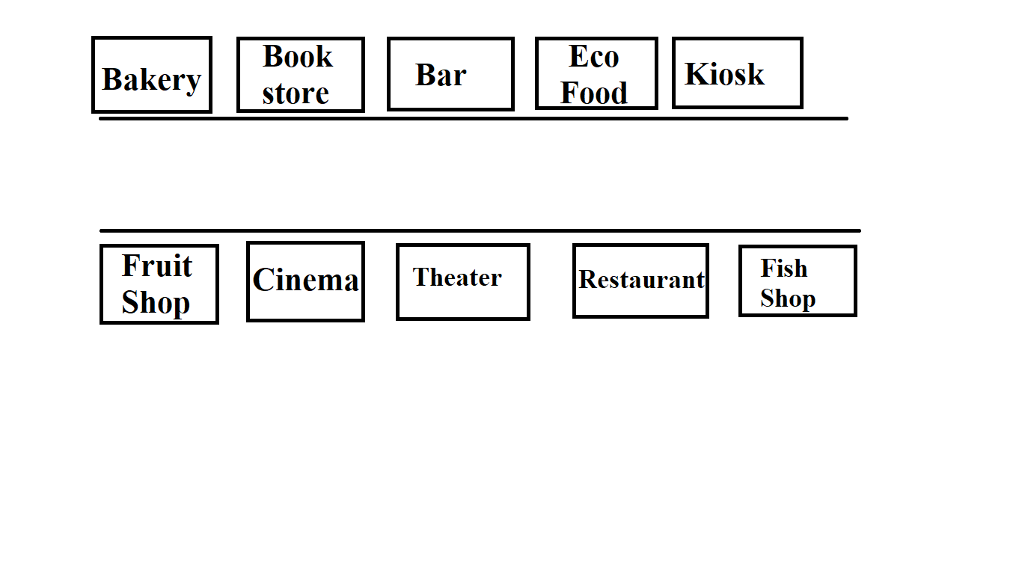
3. Cons of tourism: socio-economic view
Destruction of the local trade diversity

Slide 10
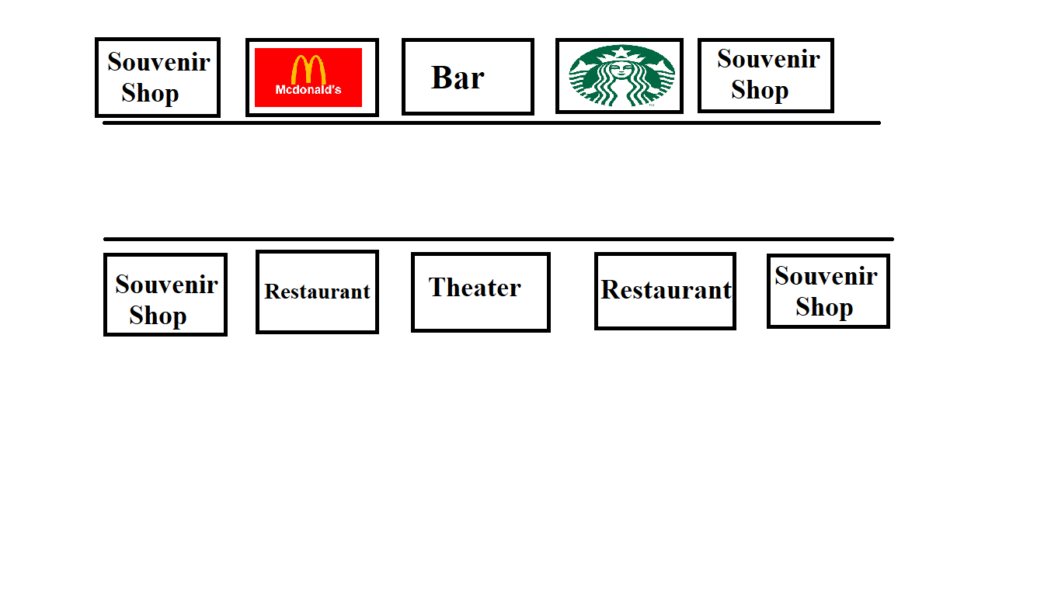
3. Cons of tourism: socio-economic view
Destruction of the local trade diversity

Slide 11
3. Cons of tourism: socio-economic view
Creation of precarious jobs
Temporal jobs
Low salaries
Family conciliation difficulties
Specific profile
Not paid overtime hours

Slide 12
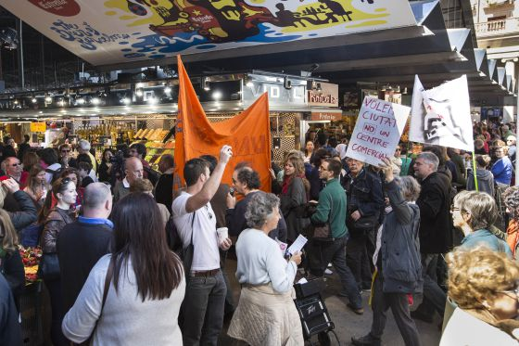
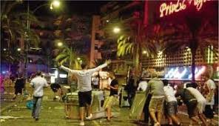
3. Cons of tourism: socio-economic view
Saturation of public transport
Overcrowded public areas
Neighbor-tourist conflicts

Slide 13
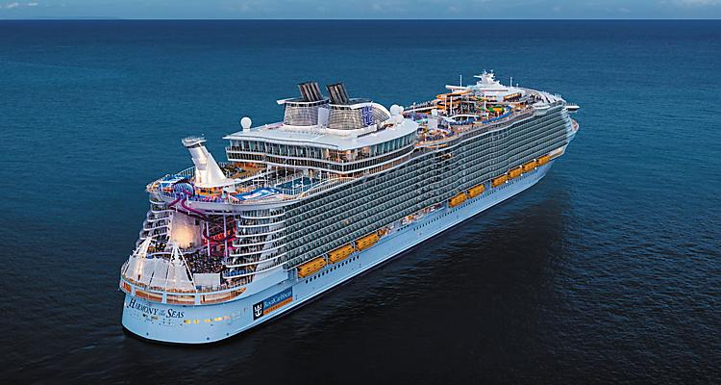
3. Cons of tourism: ecological view
Over exploitation of the natural resources
Degradation of the environment
Pollution
Consumes 2.500.000 l/day
50 millions of cars

Slide 14
4. Sustainable Tourism
Tourism
?
Crucial for economy
Cultural enrichment
Mass tourism
Environmental danger
14

Slide 15





4. Sustainable Tourism: Transportation
15

Slide 16



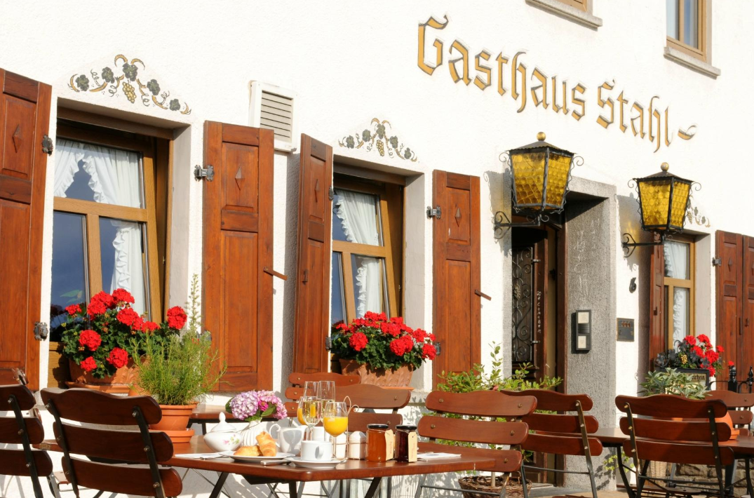
4. Sustainable Tourism: Accommodation
Abroad
http://www.worthnotworth.com/hotel-chains-and-brands/
Incentivates local economy
16
http://www.gasthaus-stahl.de/?lang=en

Slide 17
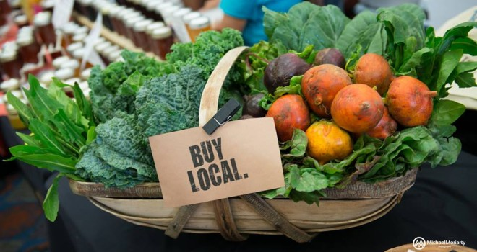
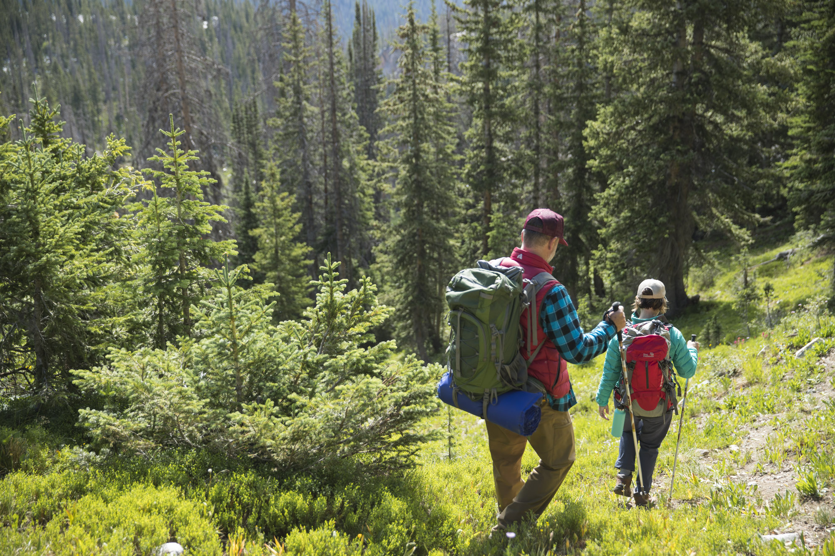
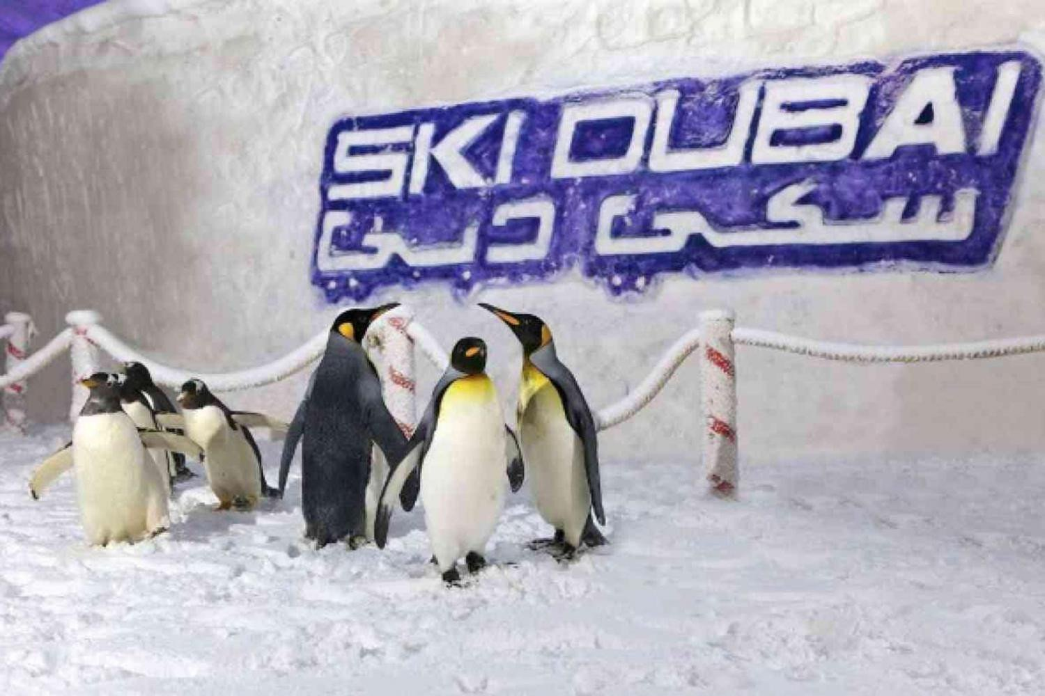
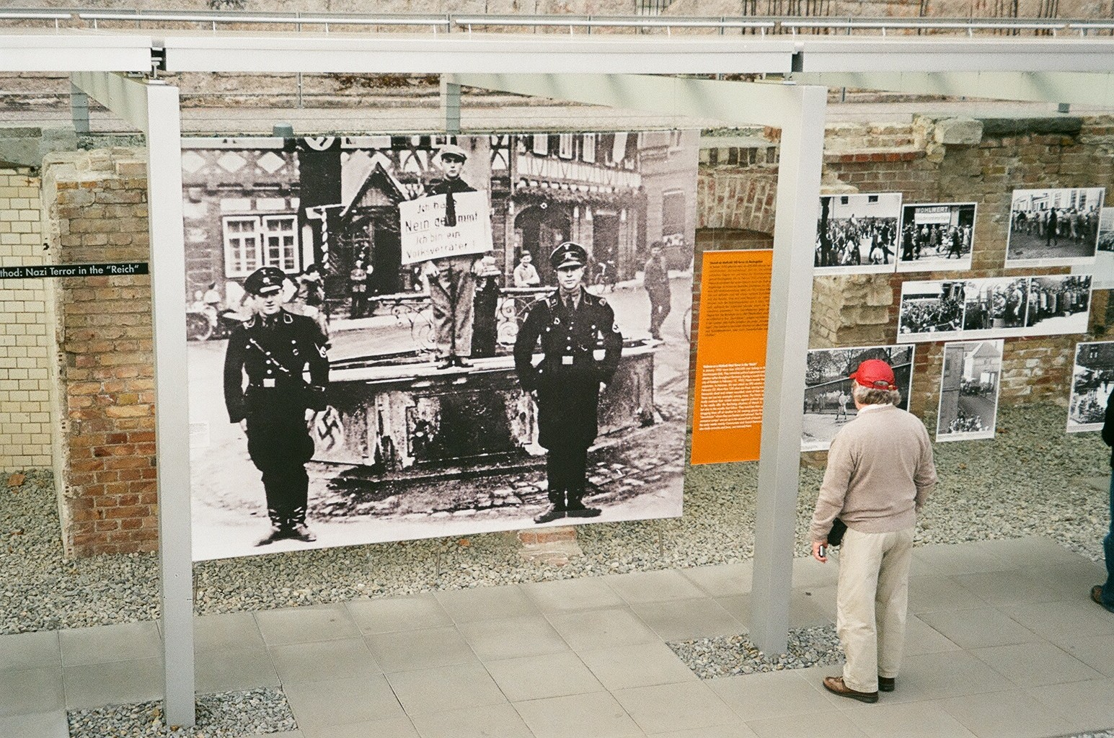
4. Sustainable Tourism: Activities
http://goodfoodfinderaz.com/why-local-foods/
https://www.travelwyoming.com/things-to-do/hiking
https://www.lamadubai.com/products/skidubai
http://germany.pointparkjournalism.com/2013/06/21/
17

Slide 18




4. Sustainable Tourism: Government Measures
H
Limit number of Beds
Max. 800!
!
Protected
Limit/Avoid entering some areas
Closed
on Sundays
Allow citizens to participate on measures regarding tourism
18

Slide 19
THANK YOU!

