Slide 1
Dynamic Analysis of Train Wheel
Raúl Bravo
Shushu Qin

Slide 2

Squeal Noise

Slide 3
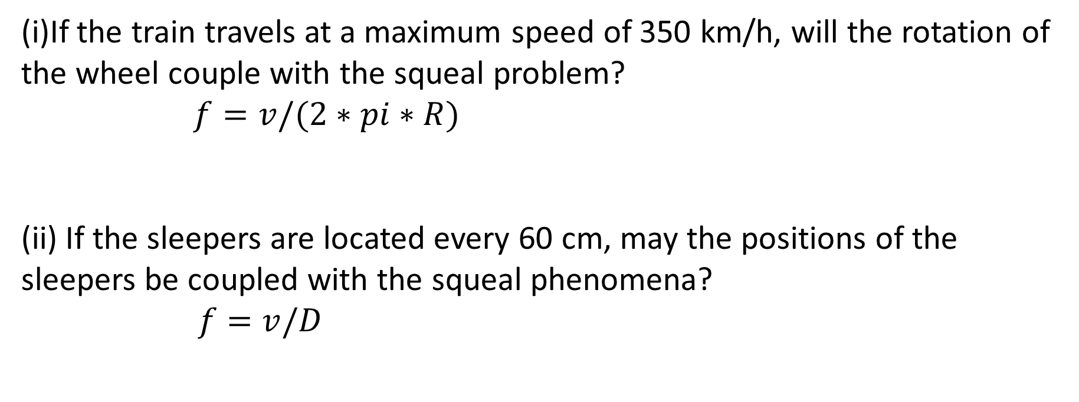
Squeal Noise
(i)If the train travels at a maximum speed of 350 km/h, will the rotation of the wheel couple with the squeal problem?
$f=v/(2∗pi∗R)$
(ii) If the sleepers are located every 60 cm, may the positions of the sleepers be coupled with the squeal phenomena?
$f=v/D$

Slide 4
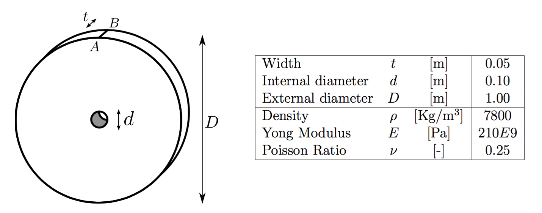
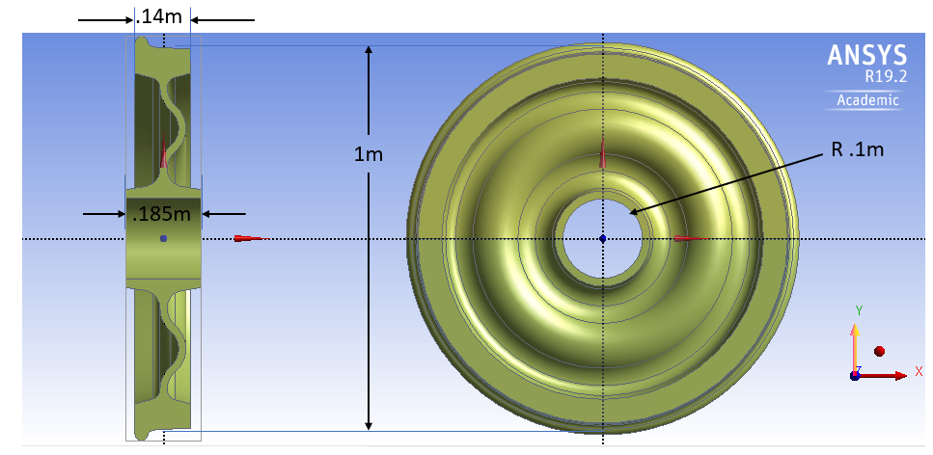
Problem Statement
Velocity = 350 km/h
Distance of sleepers = 60 cm
Figure. Simple geometry
Figure. Real geometry

Slide 5
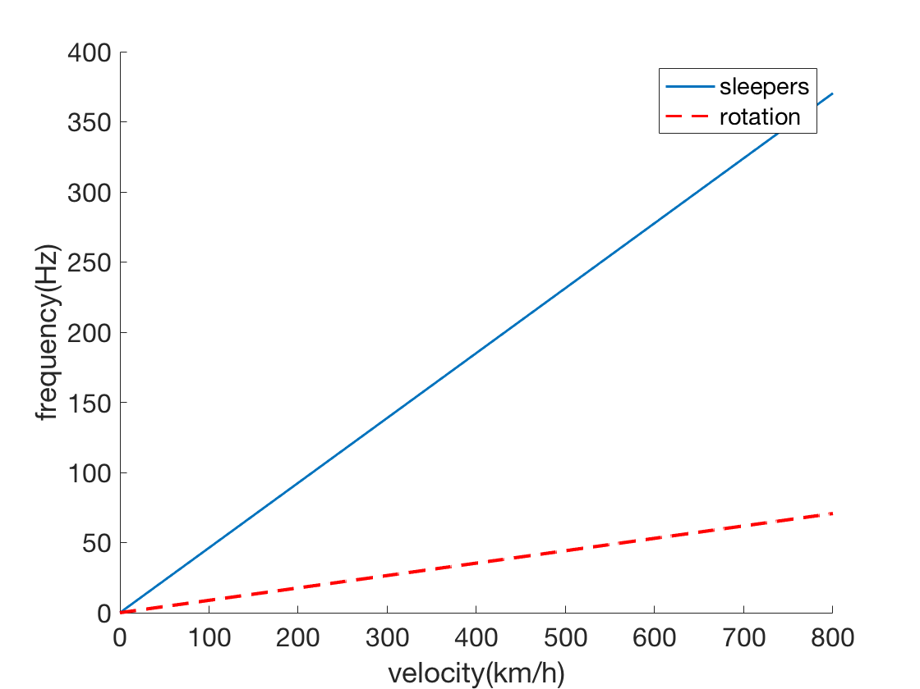





Methodology
*

Slide 6
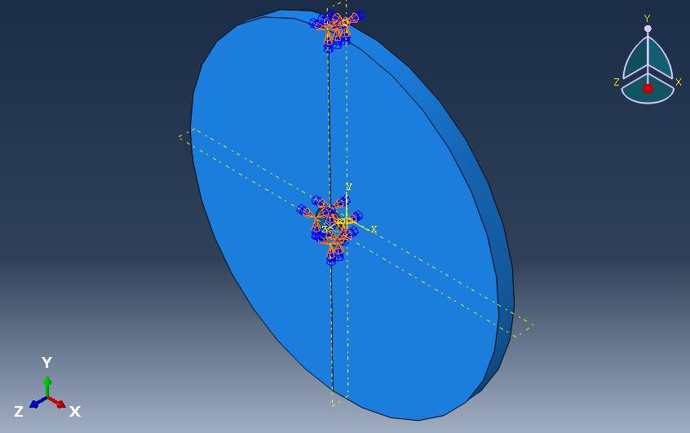
Methodology
Mesh sensitivity
Simulation on simple geometry
Optimization with regarded to radius
of the wheel
Simulation on real geometry

Slide 7
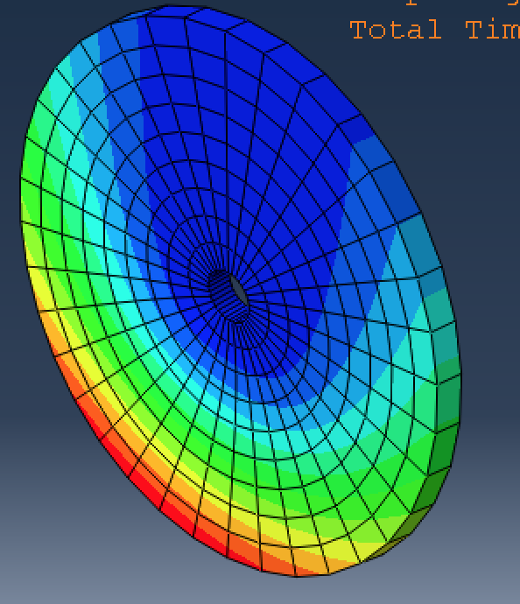
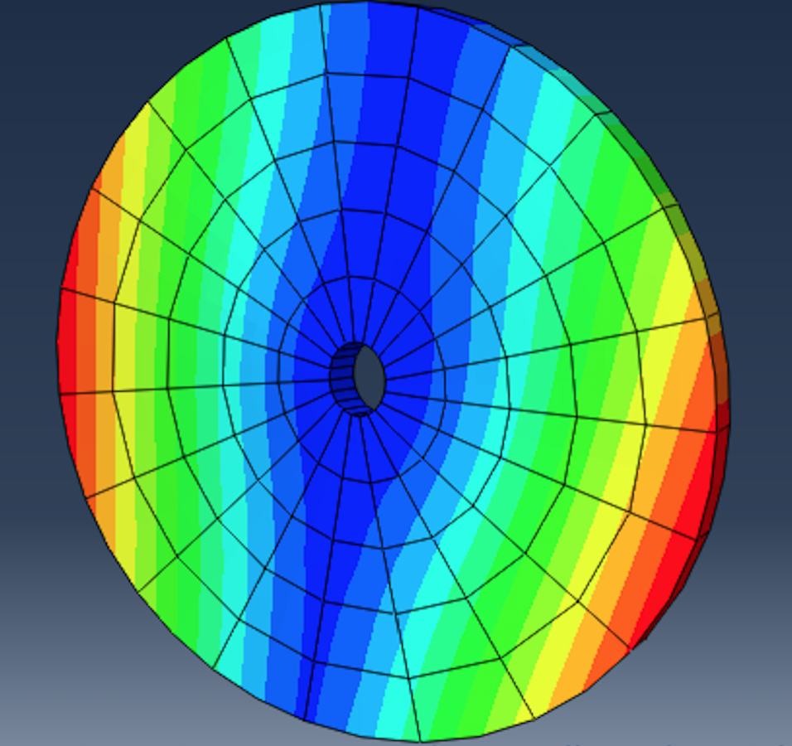
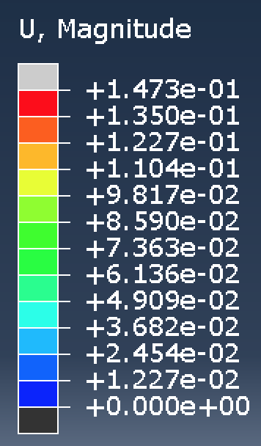
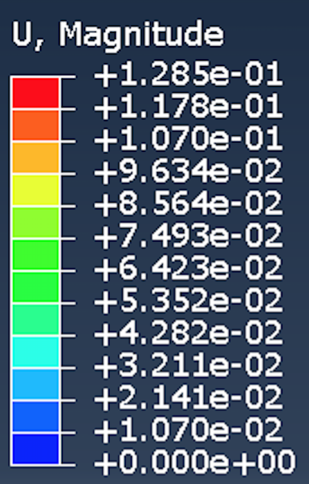
Test simulation
Linear Element
Mode1 f=25Hz
Quadartic Element
Mode1 f=172Hz

Slide 8
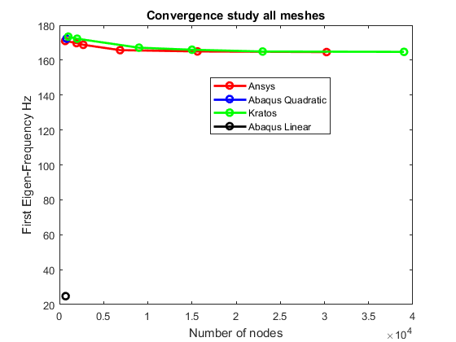
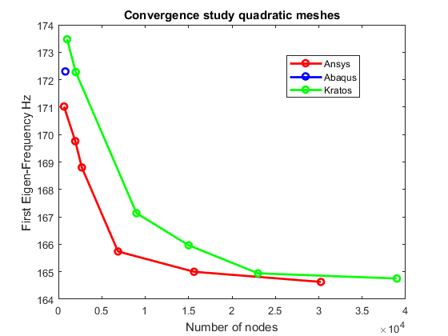
Mesh Sensitivity

Slide 9
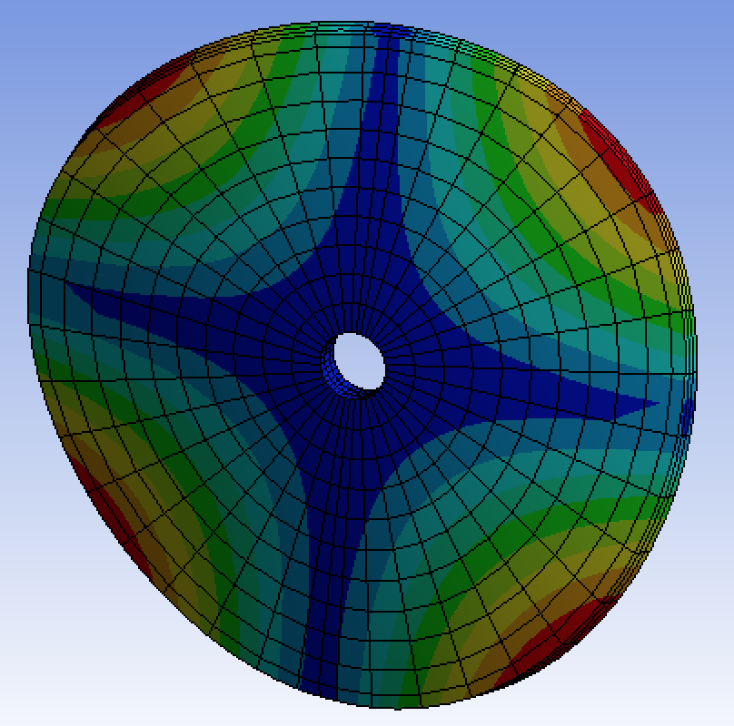
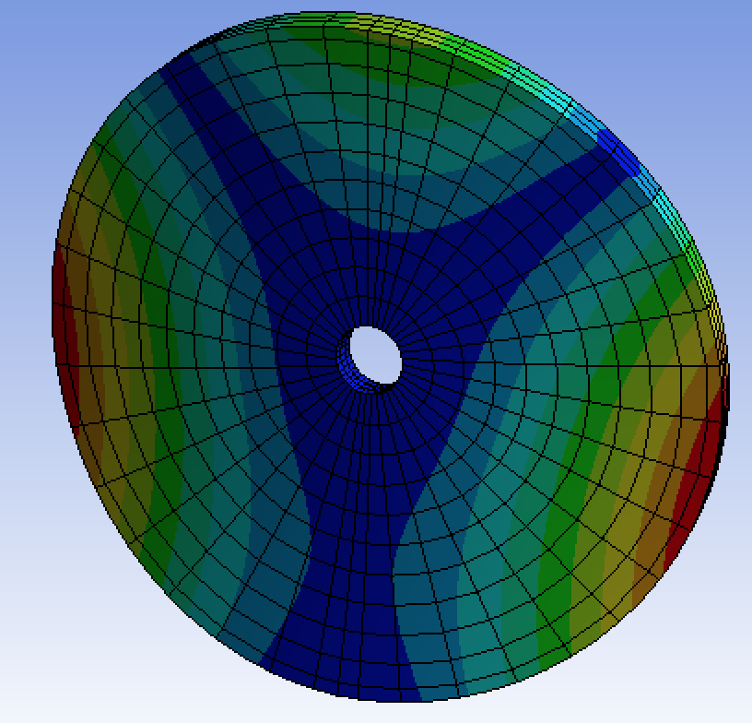
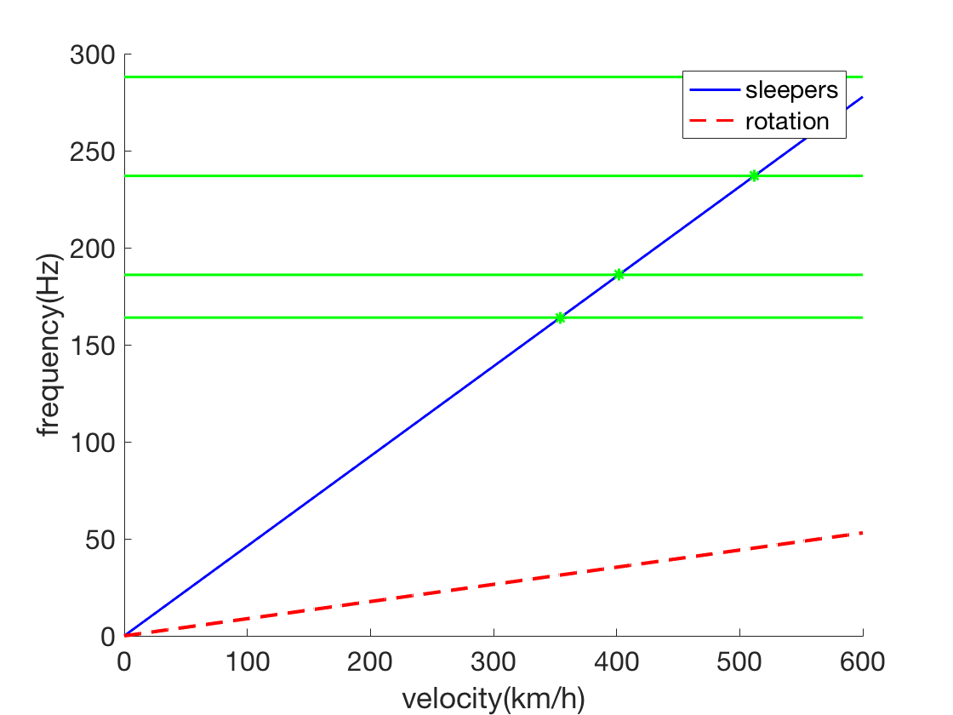
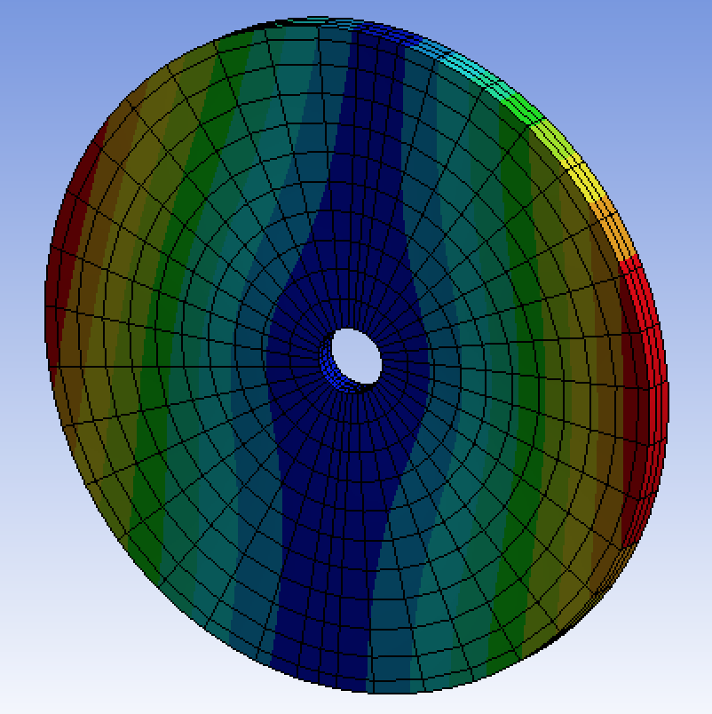
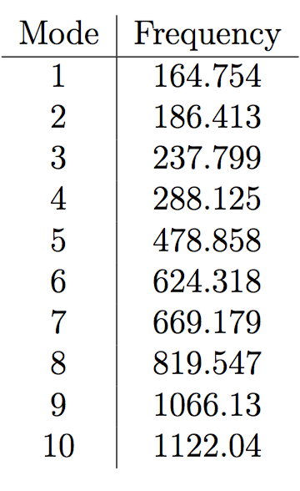
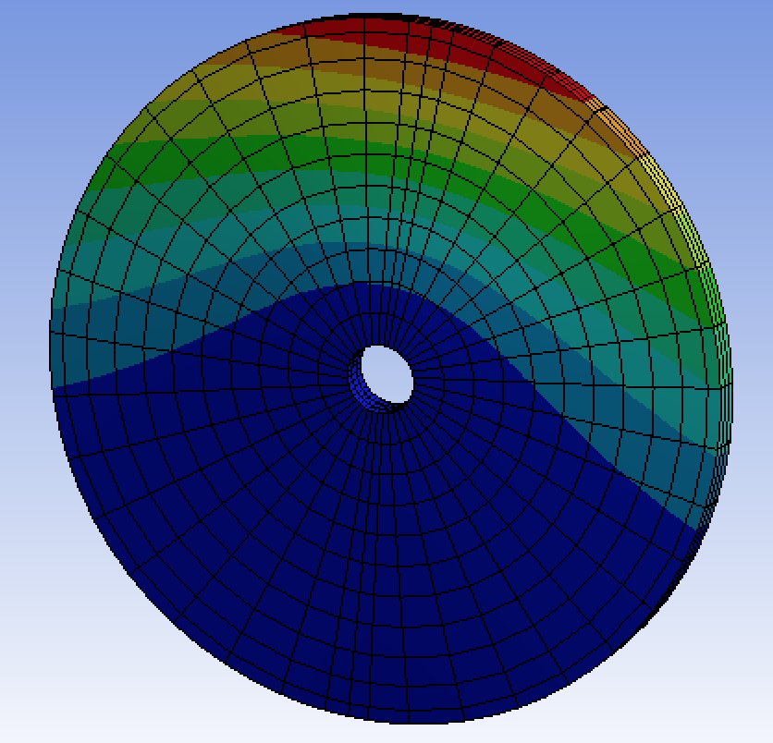
Simulation of simple model

Slide 10
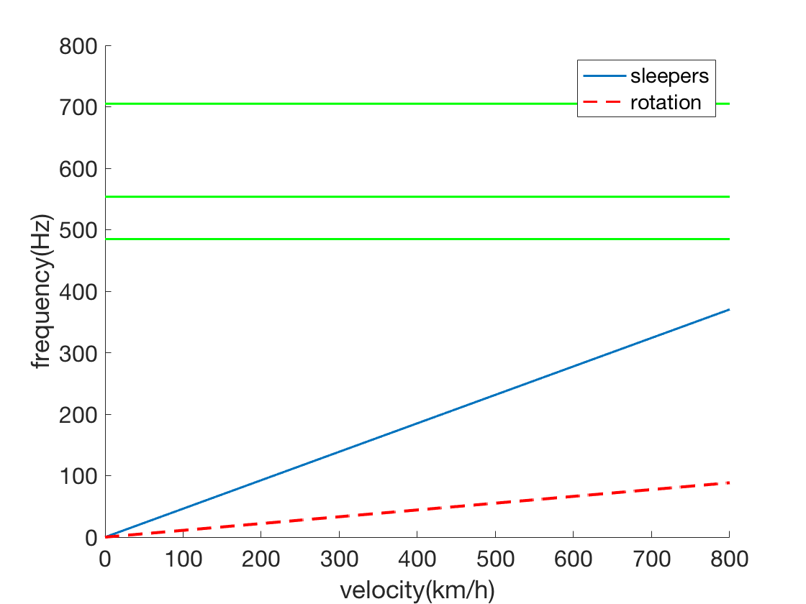
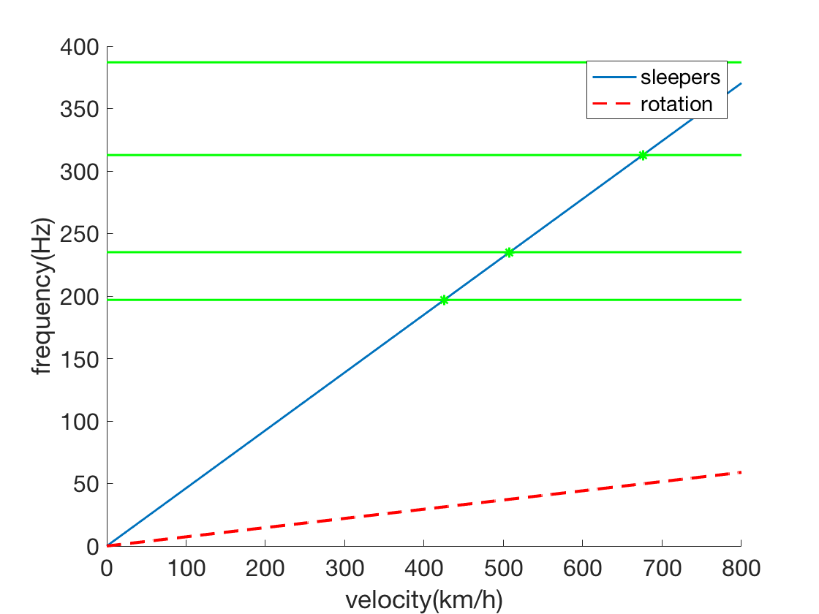
Optimization of the wheel
R=0.4m
R=0.6m

Slide 11
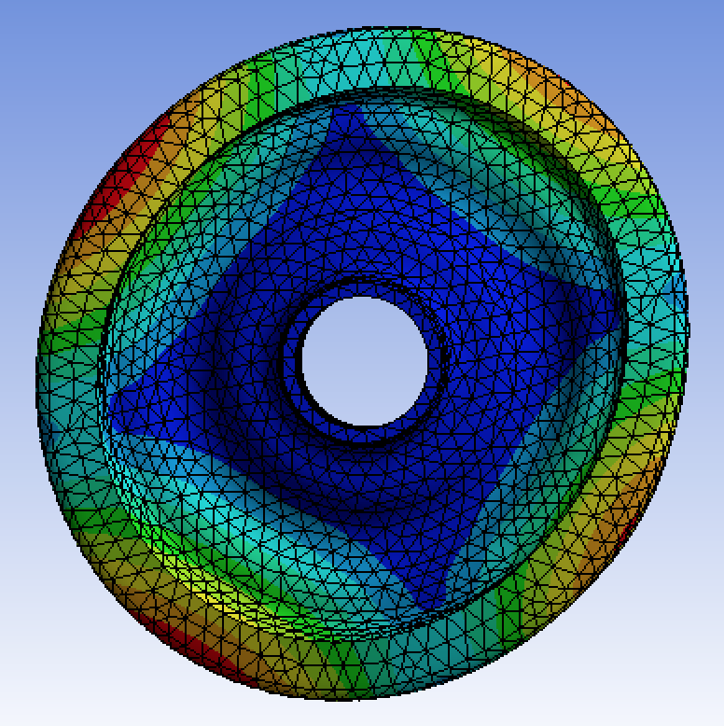
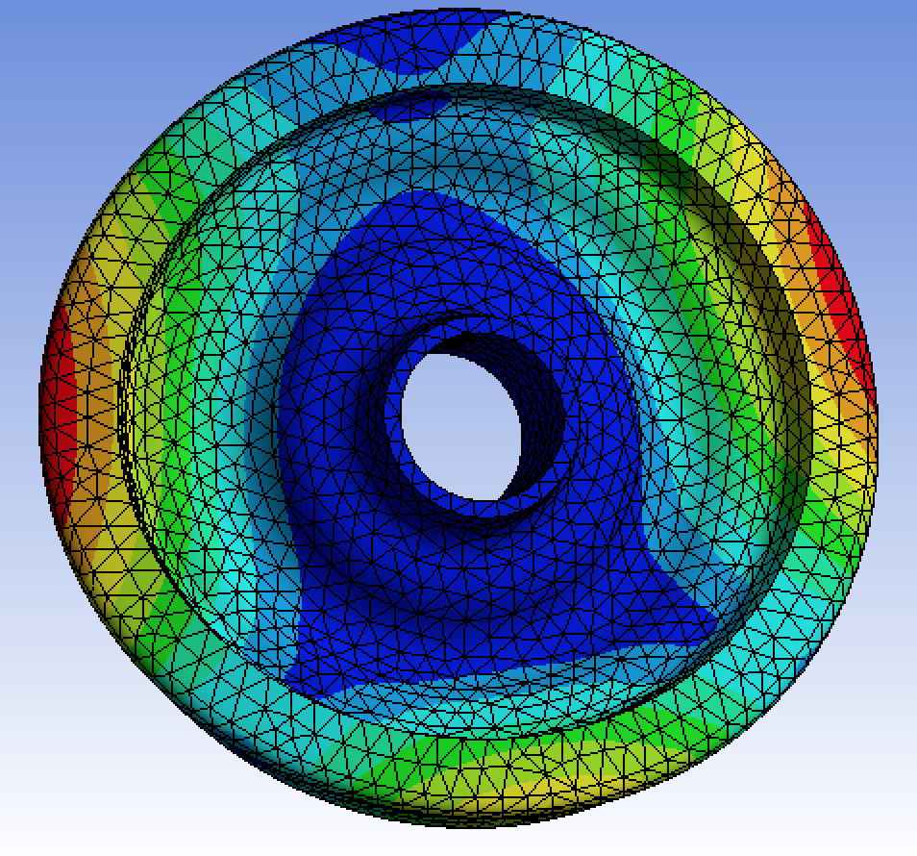
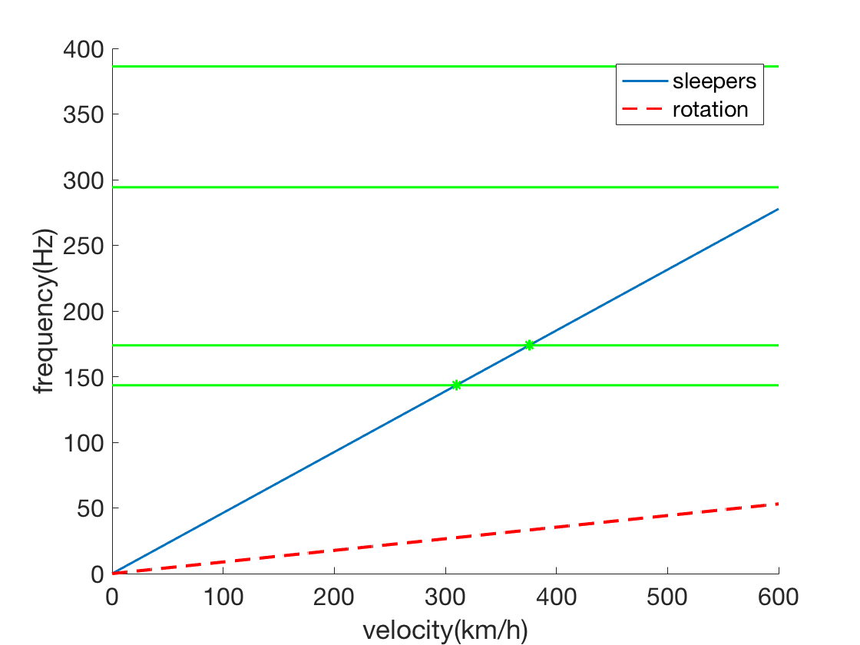
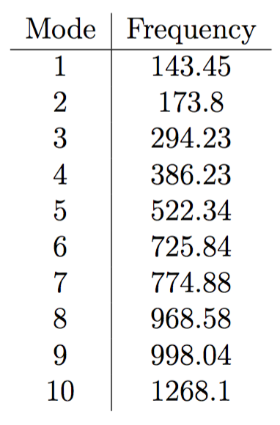
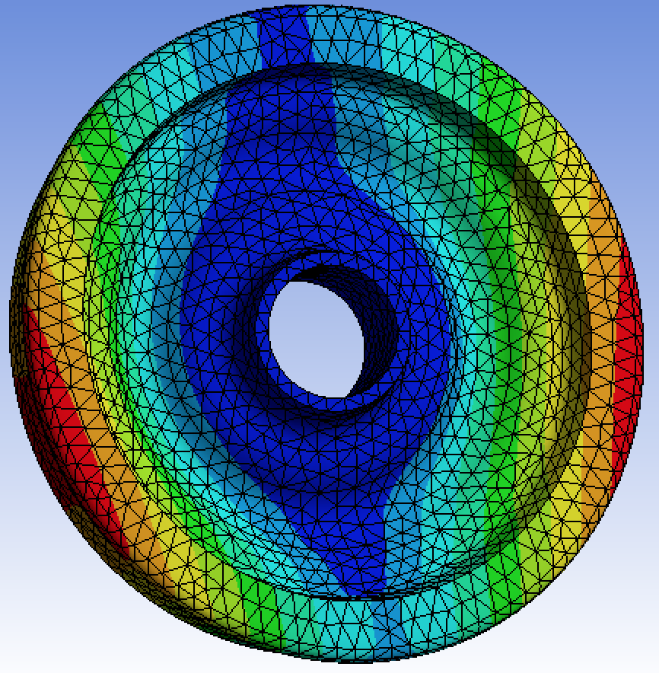
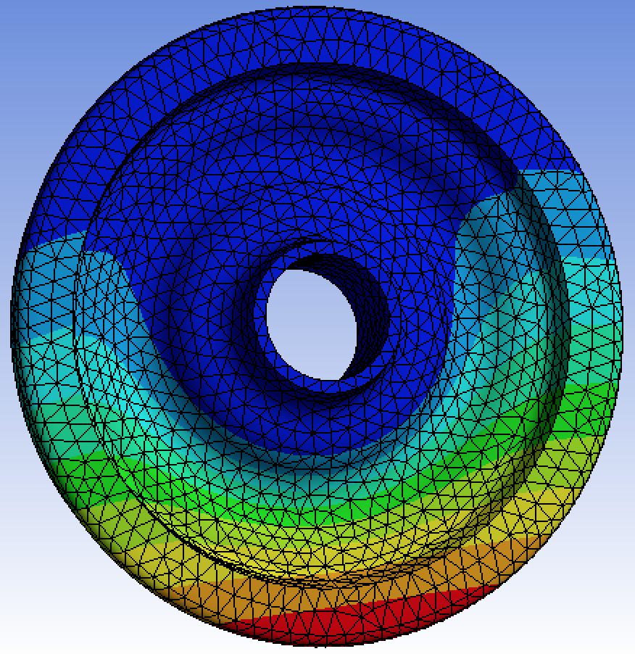
Simulation with real model

Slide 12
Conclusion and future work
Both the simple and real models of the wheel would generate squeal
Slight variations on the outer radius can be beneficial to avoid squeal. However, more work is to be done.
Other sources of squeal can be studied and simulated, which would require much more computational power.
Another possible improvement is to change the distance between the sleepers.

