Slide 1

Communication skills in a foreign language
5 ECTS

Slide 2
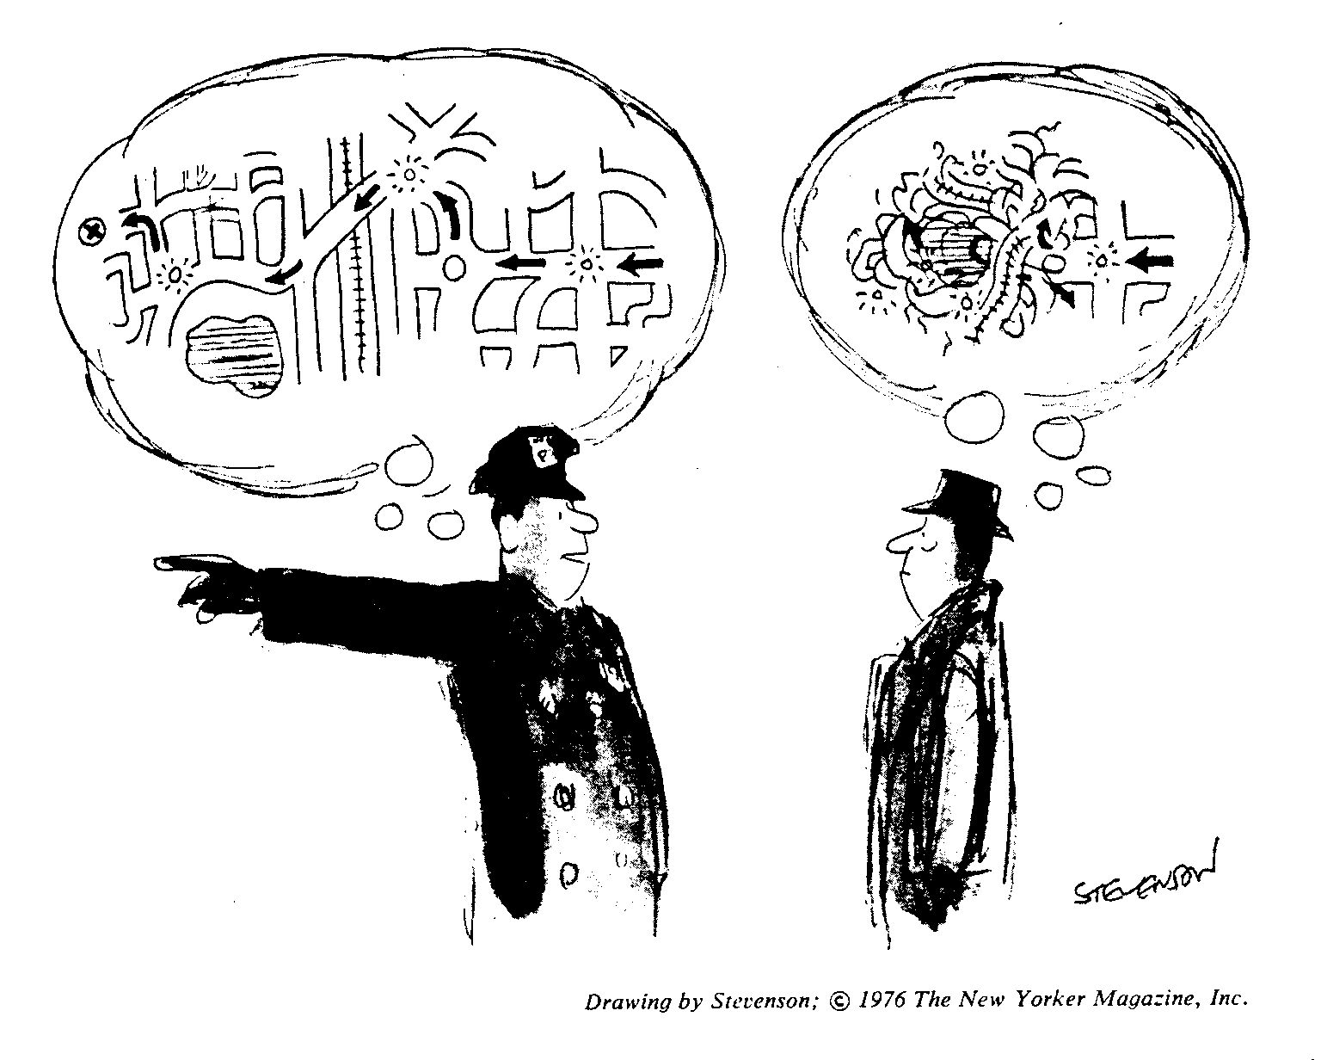
Communication skills in a foreign language

Slide 3
Communication skills in a foreign language
Francisco Zárate
zarate@cimne.upc.edu

Slide 4
Communication skills in a foreign language
Class organization
Informative session : October 3th 2013
Online sessions : October – December 2013
Evaluation : January 15th 2014

Slide 5
Communication skills in a foreign language
Online course
The student must follow the online sessions.
Time organization is up to the own criteria.
Consultancy at any time by mail or personal appointment.

Slide 6
Communication skills in a foreign language
Evaluation
Online exams and home works.
Online marks record.
Personal interview.

Slide 7


Communication skills in a foreign language
Catalan
Online version: www.parla.cat
German
Online version: idp.unedcoma.es

Slide 8
Communication skills in a foreign language
Catalan
Online version: www.parla.cat

Slide 9
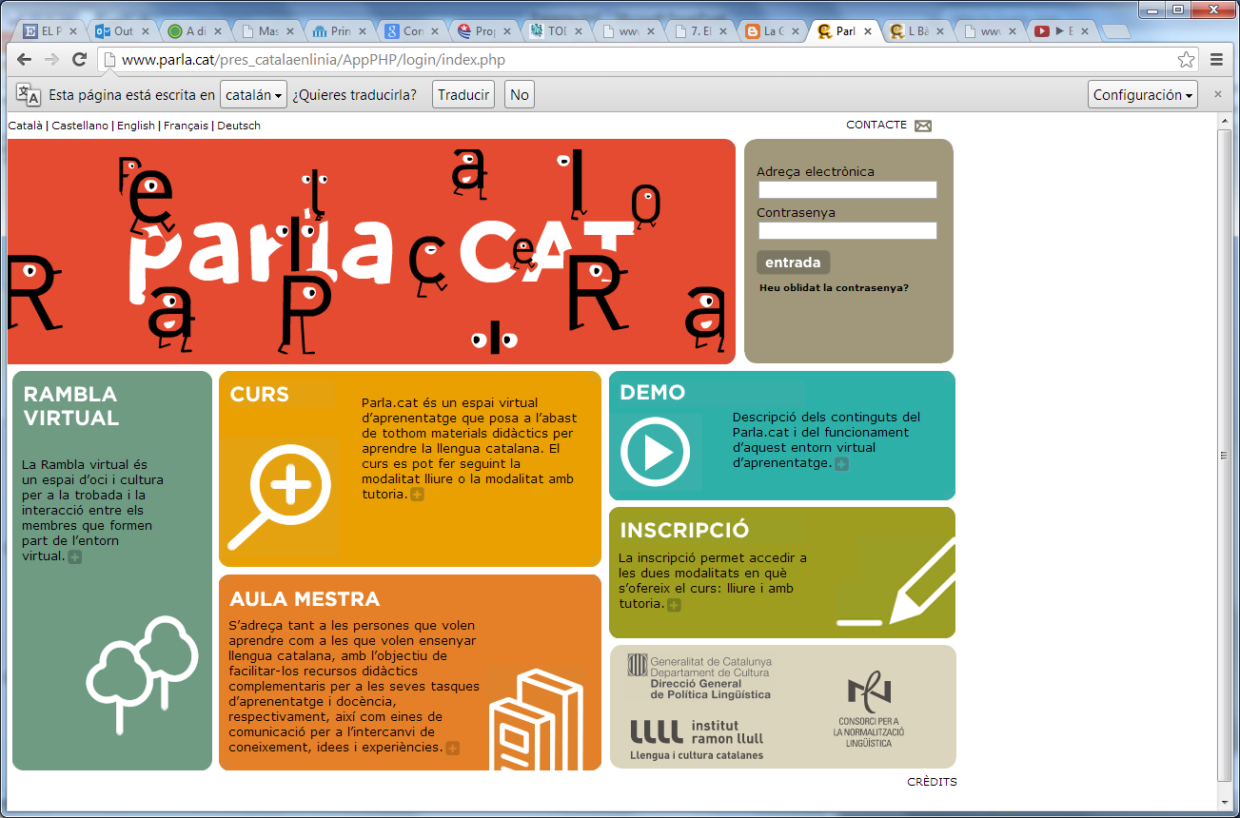
Catalan
www.parla.cat

Slide 10
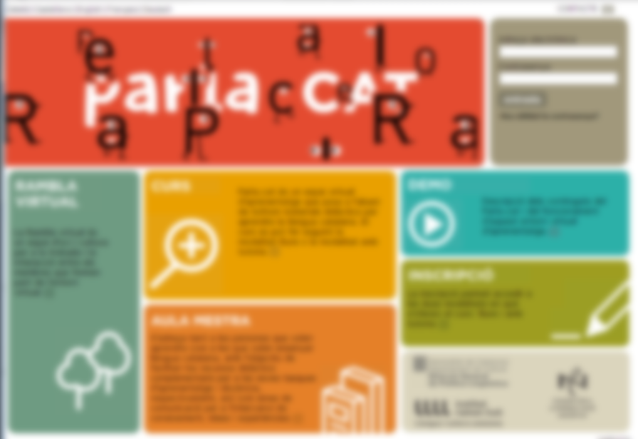
Catalan
www.parla.cat

Slide 11
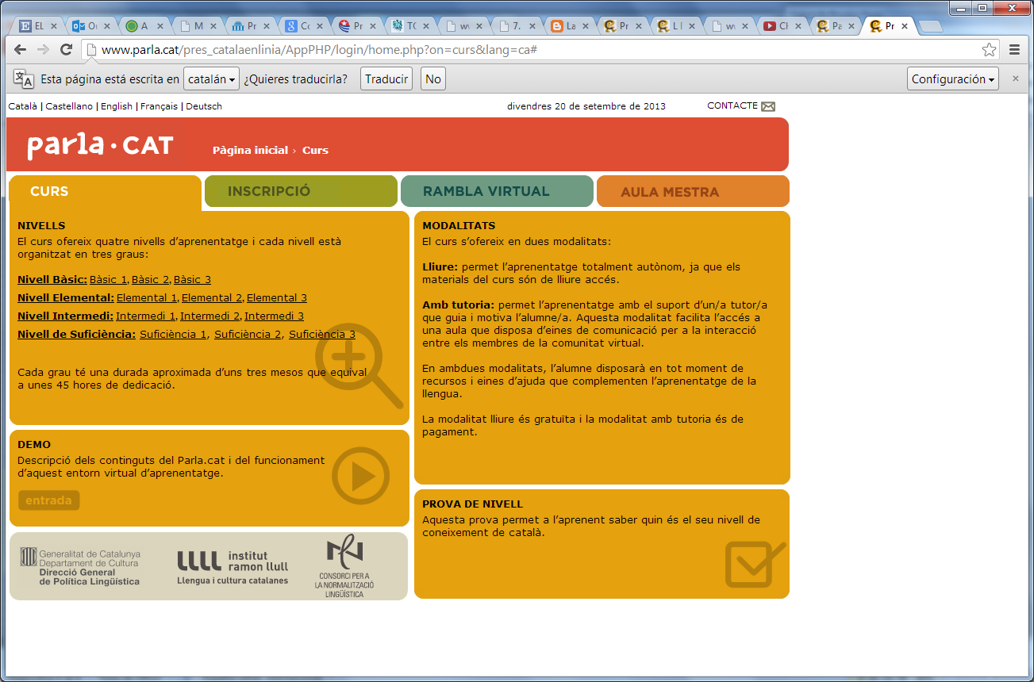
Catalan
www.parla.cat

Slide 12
Catalan
www.parla.cat

Slide 13
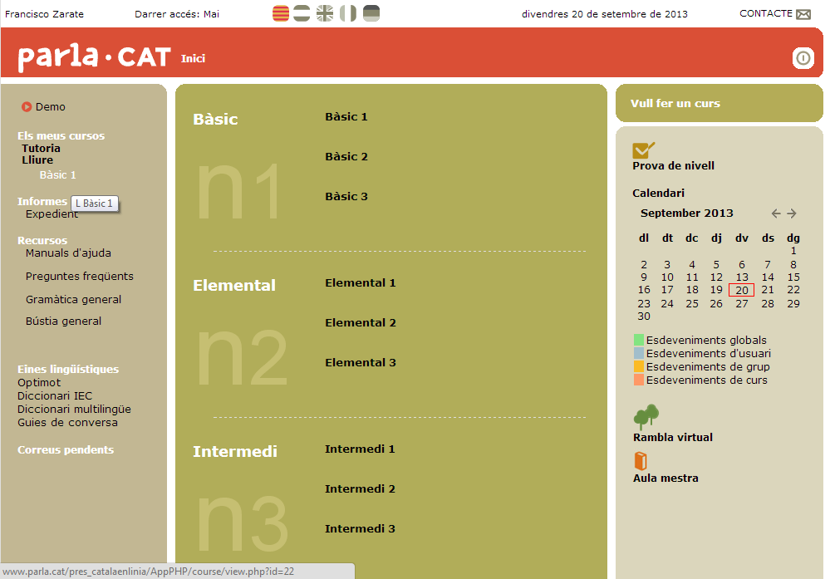
Catalan

Slide 14
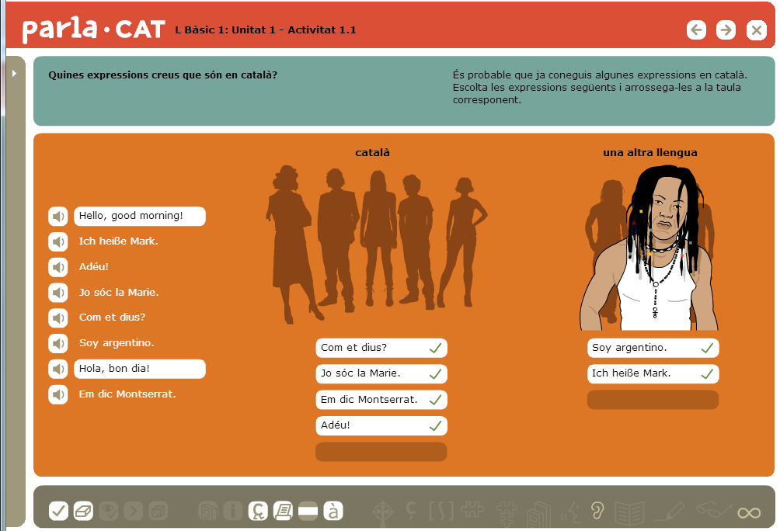
Catalan

Slide 15
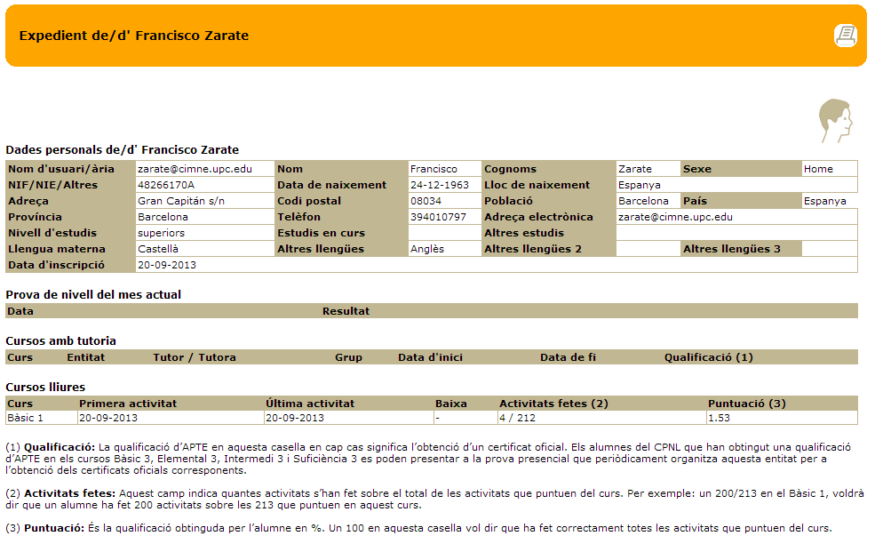
Catalan

Slide 16
Communication skills in a foreign language
German
Online version: idp.unedcoma.es

Slide 17
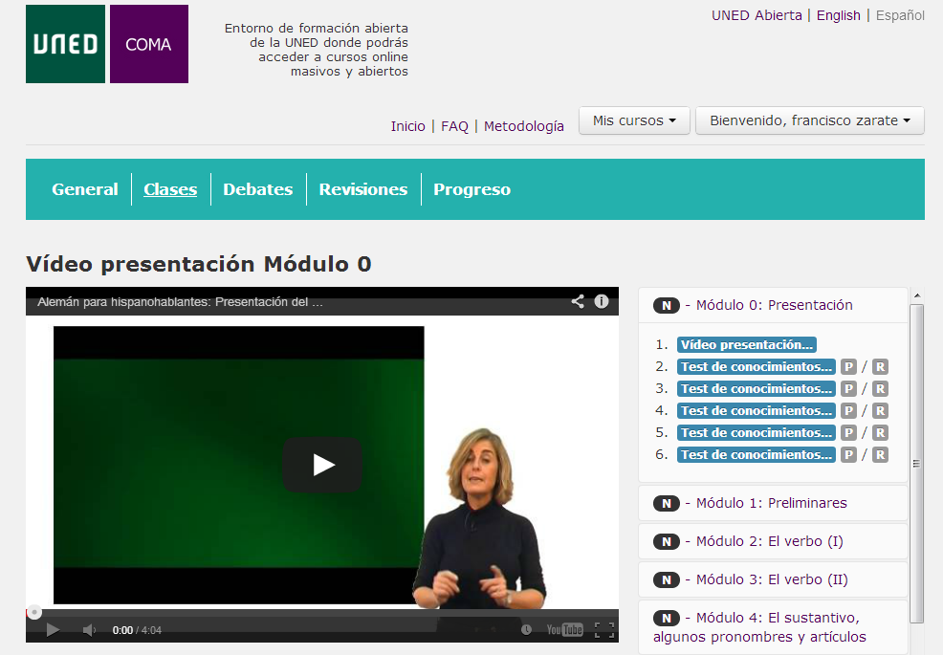
German

Slide 18
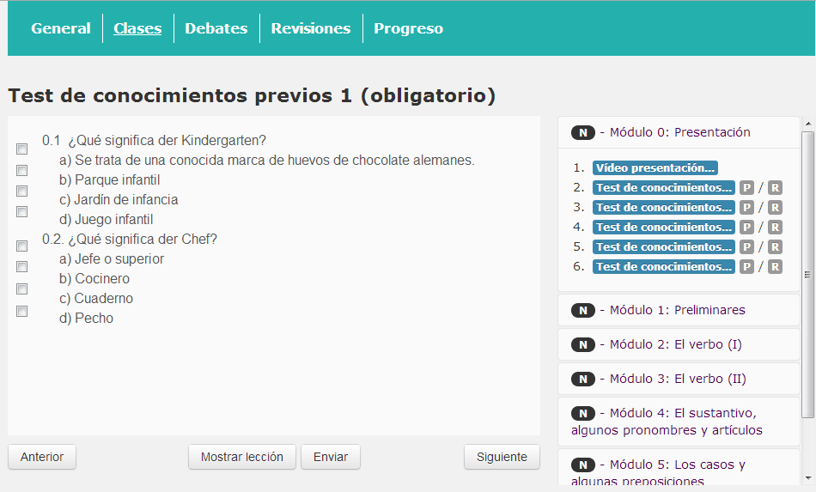
German

Slide 19
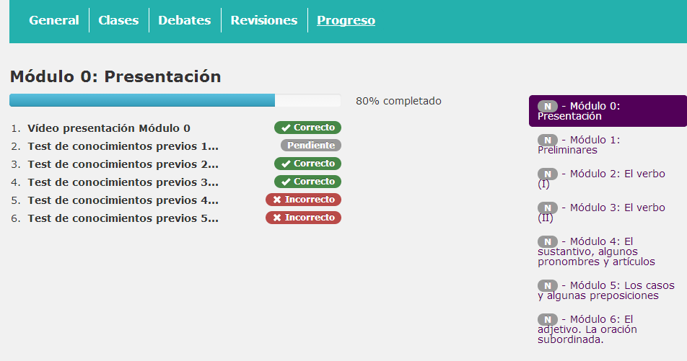
German

Slide 20


